Slide 1

Lesson 5) Building Connections Across The Gender Divide

Slide 2
Culture plays a large role in the development of qualities that might be defined as Masc or Fem
E.g.; Men from southern Europe tend to enjoy conversation more than women in northern Europe
E.g.; Some cultures prefer to keep emotions inside, whilst others tend to express them.
However, when we look across cultures we tend to find recurring gender differences even though the culture may have influenced the amount that men and women differ
For example – Finnish cultural norms tend to minimize the differences between men and women – but still women, in general, have a greater desire to talk out their problems with their friends than Finnish men do.

Slide 3

Relating across the gender divide is very much like relating to someone from another culture:
If you went to Japan you would learn to eat with chopsticks as way to relate better with people
If you want to be effective in relating with the opposite sex then, when necessary, it’s good you develop ways of relating that the opposite gender can understand and connect with – even though it’s not your natural way of doing things

Slide 4
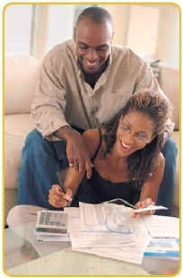
Discuss
Gender differences exist primarily because of nature’s life cycle – the need to have and raise a family
What are some of the main non-physical gender differences that you seem to notice between men and women?

Slide 5
Discuss:
  Who tends to be good at multitasking – doing 2 or 3 things at the same time – him or her?
  Who seems to be better at directions – getting from A to B – Him of Her

Slide 6
Discuss
  Who seems to be better at building a strong social network to support the family at difficult moments such as after the birth of a new child - him or her?
  Who seems to be more sensitive to possible upcoming difficulties in the family – is our child getting sick, is the house clean enough to keep germs away from our family, etc – him or her?

Slide 7
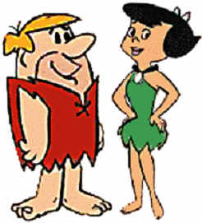
In Order to Fulfil Their Different Roles Well, Men and Women Developed differences In Their Brains:
Number of Connections between Left and Right Brain
Male Driven Testosterone versus Feminine Oxytocin

Slide 8
1) Differences in The Number of Connections Between L/R Brain

Slide 9
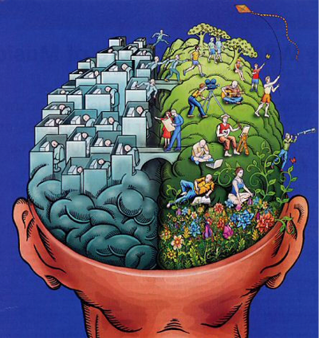
Simplified Picture of The Human Brain
This lecture is based on the work of:
Dr Ruben Gur – Studies gender brain differences
Dr Daniel Amen – Researched over 50,000 brain scans
Dr John Gray (Author – Men are from Mars, Women are from Venus)
Several other Specialists
Creativity
Actions
Achievement
Speaking
Thinking
Emotions

Slide 10
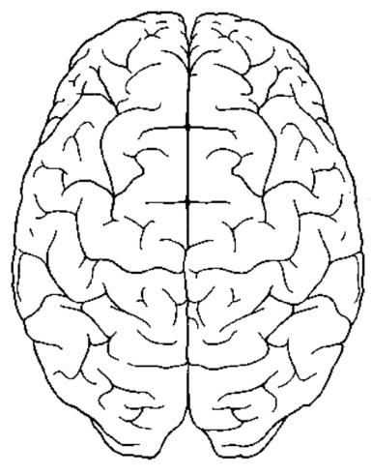

Connections between L/R brain
The two sides of the brain are two quite separate – and they are joined at the bottom by densely packed grey (Processing) matter
Women have much more of it – the two halves of their brain are better connected
This gives them certain advantages over men but it also creates challenges
Her Brain
His

Slide 11
1) She is usually better at multitasking
When he cooks, he just cooks. When she cooks she tends to do other things
So women naturally tend to do more around the home – and she might have to deal with an ongoing sense of inequality, especially if she works too.
Although most men can do more, most men can never keep up with a woman in the home. Women who can accept this as a fact of nature – are happier
Her Brain
His

Slide 12
2) She is usually better at connecting with and speaking about her feelings
Because her emotional and thinking centres are better connected – she can more easily think about what she feels about different events.
She also is usually better at talking about her feelings - and usually enjoys it.
Guys tend to find it harder – which some women find hard to accept. If she learns to accept what he can offer – she’s happier
Men, do they have feelings – yes – for example - when they are striving to achieve or are involved in actions (e.g. sport)
Actions
Achieve
speaking
Her Brain
Him
His
Thinking
Emotions

Slide 13
2) Can she help him connect to his feelings better?
He may never be able to connect with his emotions as you can… but you can help him understand his emotions better by catching his emotion and sharing it with him:
“It must be frustrating when you can’t get the kids to do what you want.” “Yes, it is. Thanks for understanding my struggles as a dad.”
“When you bought those flowers for me, you must have been feeling kind thoughts.” “Actually, I was just thinking what a great wife I have.”

Slide 14
3) She usually speaks with more emotional content
Women more often speak with emotion in their voices and words. She’s just sharing her world, this is what I’m experiencing
Men often find it hard to PROCESS this emotional content for men share emotional content ONLY at specific times – and these times they understand.
When she wants to share – he might to look away, freeze – struggle to deal with what her emotional content means
She can misread his body language - feel he’s not listening, doesn’t care. But she can develop strategies to overcome this problem
speaking
Her Brain
His
Thinking
Emotions

Slide 15
4) Because of better L/R brain – everything in her world is connected to everything
Women, when they talk with each other, tend to change to topic endlessly, but in her brain each topic has some related with the next - it just flows – and she feels close to other women she can connect with in this way.
When she talks with her partner she does the same thing – hoping to feel connected
Many men, however, struggle to stay focused - they don’t see the connections, just a random stream of thoughts that often go nowhere
Men, however, who can spend a bit of time each day listening to their beloved, being interested in their world, gain many rewards
Her Brain
His

Slide 16
5) Because of better L/R brain – she usually better at remembering the details of what happened
Research shows women are far better at remembering past events than men.
When women share with each other, sharing the details is often the fun bit.
If a woman is sharing all the little details of her day with her guy, then this shows she trusts you.
Guys tend to not to remember details of their daily life – “How was your day Dave” – “Fine.”
- Many guys find that sharing a couple of details about their day allows her to feel connected and also gives her the green light to share about hers.
- When she just says “I’m fine” and nothing else – guys, watch out! Make sure you take time to just listen to her worries – and say sorry.
Her Brain
She remembers more details than him
His

Slide 17
6) Her Details often make it hard for him to understand – he needs clear, direct directions
From a male perspective male/female communication is made harder because she sees all the connections.
When she wants something done, she often shares all the details. “I’m really worried about the door. It lets in so much cold air. Also, the kids leave it open a lot and the electricity bill is high enough already. I also feel embarrassed when friends come round. When you compare our door too our neighbours,….. Maybe it should be painted red…”
He gets really confused: Ladies, He just needs clear directions (E.g.; Honey, could you fix the door for me. It would make me so happy)
Her Brain
Details confuse him
His

Slide 18
7) Because of less L/R brain – men tend to focus on one thing at a time – cut off from everything else
When men focus on tasks – they tend to forget everything else in the world.
For example, if he’s watching TV, or he is fixing the sink, he often just focuses on that.
Multitasking women, however, don’t get this, and will often try and talk to their beloved about something important while he’s doing what he’s doing.
This often leads to arguments as miscommunication occurs because it is hard for him to do two things well at the same time, she feels that she wasn’t listened to, or because he doesn’t hear what she asked him to do, etc
Her Brain
He focuses on one task at a time
His

Slide 19
Basic rules of communicating across the gender divide
What he can learn
Either: He has to learn to stop whatever he’s doing – turn and face the girl – and give her his undivided attention.
Or: He can say: “Darling, I appreciate that you want to talk. I will be all yours in 20mins after the game finishes.”
Or She can learn:
Either to say something like “Darling, is it possible for us to have 10 mins of sharing after you’ve finished.”
Or if what he is watching is not that important to him: “Honey, would you mind if I turned off the TV? I’d really like to talk to you.”

Slide 20
8) MOST IMPORTANT POINT:
WHAT WISE WOMEN UNDERSTAND
Because it takes men large amounts of energy to move around their brain – men are by nature creatures of HABIT – OF A DAILY ROUTINE THAT, ONCE ESTABLISHED, TAKES VERY LITTLE ENERGY TO THINK ABOUT DOING.
The wise women understands that is her role to help her beloved develop a daily routine that fulfils her needs for some sort of equality.
E.g.; He wakes up, makes the bed, lays the table, empties the dishwasher, loads the dishwasher in the evening, cleans on Saturday morning etc.. ALL as a daily routine.

Slide 21
WHAT WISE WOMEN UNDERSTAND
– He is a creature of habit
The wise women understands that helping her beloved establish a routine takes time and her encouragement – but once it’s established, he’ll do it everyday for life without anything being said.
The simplest way to get his agreement to do certain things by habit is to sit, talk and plan who will do what BEFORE they start living in the same house together.
If she doesn’t do this, once they move in together and he gets into his routine – it is harder to change his habits – but it is not impossible. It’s just a step by step process of helping him add one more task at a time to his daily routine – and praising and encouraging him during each learning process.

Slide 22
Even when there are one off things that need doing … wise women find a ritual that works for him
Men have all their plans in their head in order of priority
If she needs him to do something that is not urgent - she needs to respect his need
To plan a time in his schedule when he thinks he can fit it in
To plan how it will be done. Often it’s the first time he’s done something like this, so his subconscious needs some time to work out how he’s going to do it.
If she comes with a non-urgent requests but expects it to be done immediately, this frustrates him enormously (there are other more important things on his list and maybe he’s not sure how to do it) and she can only expect that he will not do what she has asked. Add to this that men know they are not slaves or their wives PA – but if they are spoken to like this..they will become much more resistant.

Slide 23
Even when there are one off things that need doing … wise women find a ritual that works for him
Wise women therefore find a habit forming method of asking him to do things that works for him and her.
There will always be things she needs him to do – so it’s wise for young couples to sit down together and find a habitual strategy that works for both of them.
For example:
They agree that she can have a list of up to 5 things she needs him to do on the edge of his computer screen with a date that it ideally needs to be done by. This gives him freedom to plan
They might agree that Wednesday night is fix it and bake evening – he fixes things and she bakes his favourite cookies and then they romance.
They agree that she can ask nicely, and nicely again, and nicely again, and every time she asks, it moves higher up his priority list – and after three times + 3 days, she will just get someone else in to fix it.

Slide 24
9) Gender and worries: Discuss
Who tended to get more worried about things in your home – your mother or father?
If you are in a stable couple relationship – which of you tends to get more anxious about problems in general?

Slide 25
9) How men and women tend to deal with stress is different because of L/R brain connections
The worry box is on the left side of the brain.
Because she has usually more connections between her Emotional Centre and her Worry Box – she tends to get more emotionally worried than he does
Research shows that the loss of Eur 5 for a woman is emotionally equivalent to a man losing Eur 100
In some couples it works the other way round – especially from different cultures
Her Brain
Worry Box
His
Emotions

Slide 26
Because she feels her worries more intensely -
There are many other ways that her ability to feel worry more intensely is expressed in many families - E.g.;
She might worry about many more things than he does - they don’t register in worry box - Are the children dressed properly? Are you getting sick? Her looks? Her weight? Why is my husband late?
The parents’ in-law are coming over, does my kitchen and bedroom look clean?
Expressing fear over future possibilities – not actual events - even if those possibilities are quite small.
This is one of her natural gifts – to be valued - appreciated

Slide 27
Because she feels her worries more intensely -
Small worries can look like big issues to many women. The floor is dirty, the car has been stolen – both are felt and said with the same intensity.
Ideally such women need to learn to place a value from 1-10 on their worry thoughts before they start to speak about them – speaking more calmly for small issues, and expressing worry more intensely for larger issues.
If they don’t then their partner will respond by having a less helpful attitude – firstly because he become confused about what is really important to her and secondly because he is going save energy to deal with the next ‘crisis’.

Slide 28
Many Men Find It Hard To Understand A Women’s Level Of Emotional Worry
It’s hard for men to understand how much worry goes on in many women’s brains.
If we can compare:
  Imagine as a man that you’ve lost the keys to your car, you can’t find them anywhere, and you have an important meeting in 1/2 hr
  That level of frustration and anxiousness is similar to the worry level that many women experience many days of their life

Slide 29
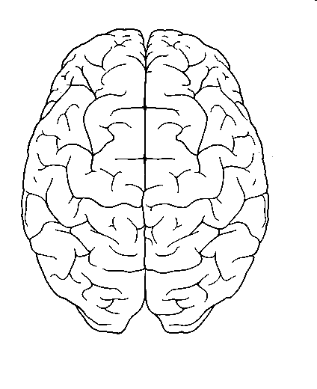

– Since her brain is fully connected most women have no place them to go to deal with their emotional worries
So women typically de-stress through talking about their problems
In the past, her network of friends and family would have acted as support system to listen to her worries
She can then see her life in a more balanced, less stressful way
With many women today having only a small support system many men find they need to make time to regularly listen to her worries.
Alternatively, she finds a network of friends to regularly go out with
Her Brain

Slide 30
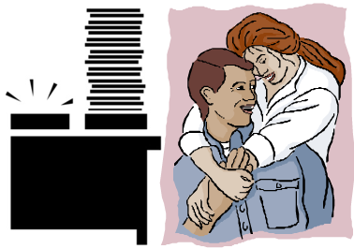
Sharing her worries is also useful because:
Her Brain
She can think more deeply about the issues
And then start to make rational plans about what she will do next
= less worries
- Then she can remember how wonderful he is really is.

Slide 31
Men and listening to her worries
Most men tend to try and fix things by themselves – or they put the problem to one side in their brain and let the subconscious search for answers.
When they are stuck – they then might go to another guy to seek solutions.
The listening man recognises that the talking guy needs advice – so amongst men – he is sharing his problem = he needs ADVICE
Or they might minimize the problem (It’s not so bad)
- Most men DO NOT naturally understand ”LISTEN FOR The SAKE OF Just SHARING WORRIES”

Slide 32
But when she’s sharing her worries...
Her Brain
She usually doesn’t want advice or her problems minimized. She wants the listener to:
Share her burdens
Let her sort out her many problem brain by letting her talk, organize and find her own personal solutions
No advice when I’m sorting out my brain please – it’s already crowded enough. And please don’t minimize my problems – to me even small problems look big to me

Slide 33
9) When she has many worries, and many are emotionally charged, she has no where to go and hide
When women have too many things they are worrying about they become STRESSED – and being stressed they often start using their unhealthy ego-states when communicating with their partner.
Men tend to misread this emotional anxiety – seeing it as complaint, disrespect, she’s never happy, etc
Men’s thinking ”If she wants more support, wants me to listen to her worries, she just has to ask – but she hasn’t asked so she is just being nasty and overly critical.”
Sick parents
Her Brain
Worry Box
Kids
Emotions
Work

Slide 34
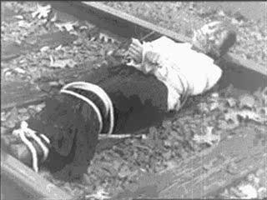
Men Don’t See She’s Struggling
- Many women don’t know how to ask ”Darling, I’m tied up in knots right now by all my worries – I need more support from you – can you just listen to my worries and free me.”
Many men need to learn this one point – when she’s emotionally stressed - she needs her knight in shining armour to come and rescue her – to hold her, to listen to her worries – to SHOW HER COMPASSION

Slide 35
It’s a very hard thing for many men to do – but that is your role – to be there to protect her
When she is blaming or criticising it’s hard for men not to respond - but if he has been doing the Work – he can seek out external, nurturing reasons for what she is doing:
“What is causing my beloved to act like this. IS she overly stressed about something. Or am I the cause of this?”
Then you go up to her, hold her in your arms, and ask her to explain what is wrong. Just LISTEN. And when she finishes speaking you ask ‘What else.’ and just listen. Don’t offer advice. Just listen till she has nothing left to say.

Slide 36
Question time for him
When you get home late from work (and you didn’t phone her to warn her) she is really upset with you. Do you:
1) Tell her to learn to understand that customers call just as you are leaving?
Or
2) Seek to understand that her worry box works 20 times harder than yours – that not worrying is not an option – that after you are late by 15 minutes she already is terrified that you are dead and she has to raise the children alone - and so you strive your best to let her know when you will be late – even if it’s just a text.

Slide 37

Question time for him
Guys – she’s invited her relatives over for Friday night. Tonight is Wednesday night
1) What might you expect to start happening soon?
2) What could you do to help be a part of the solution?

Slide 38
Question time for her
You had a hard day at work with your boss/ employees/customers/etc. Do you:
1) Come home and have a depressed evening – maybe blaming and criticising him
Or
2) Activate his natural desire to protect you by saying something like ”My dearest white knight. I had a terrible day. Can I just spend 15 minutes telling you how awful it was and then I can put it behind me and we can have a nice evening.”

Slide 39
Question time for her
You find that your worry box constantly is getting overloaded. Do you:
1) Expect your partner to become your counsellor, able to listen again and again to your worries?
Or
2) Do you develop other ways to de-stress yourself – learn to take some ’me’ time – develop supportive friendships, massages, community connections, etc. Maybe even re-evaluate your life and ask ‘Am I doing to much. Can I cut back Before my stress tears our relationship apart.’

Slide 40
Stress and the New Baby
Sadly, a large number a divorces and separations happen in the first year after the birth of the first child.
One reason for this is that there is much more pressure in the home – and many men find it difficult to understand the stress levels that their partner is feeling or they find it difficult to understand how they can help their partner during this challenging time.

Slide 41
New baby on the way
Studies show that if a man understands what to expect, and he understands the role he needs to play for the first year, then he is much more able to fulfil his partner’s expectations. So, if a new baby is on the way
  Read some ‘baby-is-on-the-way’ books together
  Plan which extra household chores he will do
  Realise that sex will be complicate for a while
  Plan when you will have time for each other
  He really needs to think about doing more around the home during the first year after the birth

Slide 42
How men often relax and de-stress
His Brain
- Men, after a long day at work, their thinking and speaking part of the brain is often stressed.
– Because of less l/r connections they often let the brain relax by closing down the left brain and moving over to the right brain = disconnect from their worries
Stressed
Creativity
Actions
Speaking
Worry box
Thinking
Emotions
Left Brain
Right Brain

Slide 43
Most Men Go To Their Black Hole To Let the L Brain Recharge
His Brain
They often do activities that require little speaking or thinking but usually some achievement or action - their Black Hole
Fishing, cards, hobby
Watch or play sports
Playing computer games
Changing TV channels
‘How was your day dear’ ‘Fine’ (wants to leave the day behind)
Creativity
Actions
Achievement
Speaking
Closed down for an hour to re-charge
De-stress in a non-thinking
Black Hole
Thinking
Emotions
Left Brain
Right Brain

Slide 44
In the Black Hole - Little thinking or speaking
His Brain
- Wives often don’t understand the Black Hole – their partner’s re-charging place.
- One of the most painful experiences for wives is to see their partner doing Nothing when she feels there’s so much to be done.
- This can lead to arguments.
Creativity
Actions
Speaking
Closed down for an hour to ease stress
De-stress in a non-thinking
Black Hole
Thinking
Emotions
Left Brain
Right Brain

Slide 45

Is there anything she can do to stop him going to his Black Hole?
If she doesn’t like it, experts believe that there are things that she can do together with him that will relieve his stress – and she just has to ask him – let’s go bowling, let’s watch a movie together - any black hole (non-speaking, non-thinking) activity will do fine for most men

Slide 46
For Him – Learn to Treasure the Differences
Men need to learn to value and treasure the different strengths that women have as mothers/homemakers. Value:
Her ability to multitask – she will always do more than you – appreciate her giving
Her ability to notice the small details – Are the kids wearing a coat; is there a problem at the kid’s school, etc
Her ability to value time together talking
Her ability to sense when something might be going wrong within the family system – to be open to learn from her intuition

Slide 47
For Her – Learn to Treasure the Differences
Women need to learn to value and treasure the different strengths that men have. Value:
His ability to finish a long task without being easily distracted
His ability to respond to her desire for him to listen to her worries when she asks directly
His ability to recharge his batteries through spending time in his black hole
His ability to be more easily coached to be a better partner through positive re-enforcement

Slide 48
Summary – Reducing negatives is a good goal
The amount of connectivity between the L and R brain of men and women has much to do with the historic roles they have had to play in raising a family. They have very little to do with connecting romantically.
Thus, even when couples get the communication across gender cultures right it doesn’t add much to the feeling of togetherness – but it does reduce the number of negative moments of interaction in the relationship.
Since negatives destroy the feeling of love – reducing them is a good goal.

