Slide 1
Creating Healthy, Thriving Marriages, Families and Societies!

Slide 2
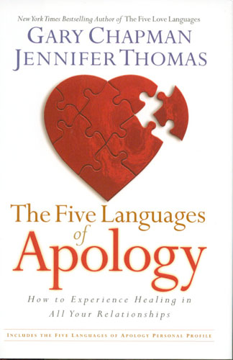
The Five Languages of Apology

Slide 3
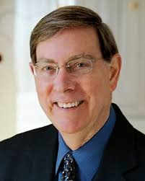
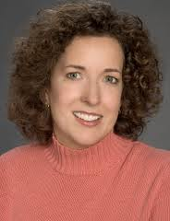
How To Experience Healing In All Your Relationships
Authors
Dr. Gary Chapman
World famous author and Christian counselor.
Founder of The Five Love Languages and many others.
Also available in Japanese
Dr. Jennifer Thomas
Clinical Psychologist and author.
They spent over 2 years doing the research and interviewing 1000’s of people on what they thought was a genuine apology.

Slide 4
Why Apologize?
“I said I was sorry.” … “I apologized.”
“No you didn’t. You never said/did…”
It didn’t work or didn’t seem sincere.
Desire/Goal not achieved:
No Forgiveness and reconciliation…
No Restoration of the relationship.
Epidemic of Broken Relationships:
High divorce rate. Parenting breakdown. Alienation, resentment, anger, frustration, hopelessness...

Slide 5
Each person has a “Primary Apology Language”
Often you will also have a “Secondary Apology Language”

Slide 6
I’m Sorry
Expressing Regret.
I want to know if you understand how deeply your behavior has hurt me.
You need to say you are sorry and what specifically you are sorry for.
You need to show remorse, not just sorry you got caught.

Slide 7
I Was Wrong
Accepting Responsibility.
I want you to accept responsibility for what you did or said and acknowledge that it was wrong.
Name your mistake and accept fault.

Slide 8
Please Forgive Me
Requesting forgiveness.
Those are the words I want to hear.
Requesting forgiveness is the way to touch my heart.
It's what feels sincere to me. Be patient with me, I may need some time or greater clarification.

Slide 9
I’ll Try Not To Do
It Again
Genuinely Repenting
I want to hear your desire and plan to change your behavior, otherwise you have not truly apologized. Nothing else seems sincere.
Repentance literally means turning around 180 degrees. Don’t make excuses.

Slide 10
What Can I Do To Make It Right?
Making Restitution.
I want to know “do you still love me?”
Your behavior was so unloving that I wonder how you could love me and do that. What debt do you owe? What amends must be made? Are you going to help me get over this?

Slide 11
Justice vs. Restoration
Example 1: An Employee steals from a company. He gets caught, tried, found guilty, fined and imprisoned.
Justice has been served, but…
no restoration of his job.
Example 2: An Employee steals but realizes his mistake, takes responsibility, reports it, apologizes, expresses regret, repays full value, and pleads for mercy.
Restoration of job and relationship is
possible.

Slide 12
Restoration of true love is the deepest desire in all our hearts and the heart of God
Therefore, learning the skill of sincere apologizing is vital for the restoration of the world.

Slide 13
Apologizing To Yourself.
We make mistakes and moral failures causing inner turmoil.
Need to apologize to ourselves.
Then we need to forgive ourselves, so we can feel love and peace.
If necessary, use a mirror and written out apology.

Slide 14
Apologizing To GOD.
(Not in the book.)
What is God’s Apology Language?
How do you personally have to repent and apologize to God in order to feel sincere and that God forgives you?
Until you feel God’s forgiveness you won’t be able to feel God’s Love.

Slide 15
Summary:
I’m sorry.
I was wrong.
Please forgive me.
I’ll try not to do it again.
What can I do to make it right?

Slide 16
I believe that we are in the age for healing minds, hearts, and bodies.
GOD is sending us the tools we need to accomplish it and bring about peace on earth together with Him.
Thank You

