Slide 1
The Matching and Blessing Process …for 1st generation single applicants

Slide 11
Going through the Matching, Holy Wine Ceremony, Blessing Ceremony and 3 Days Ceremony is being Reborn!

Slide 12
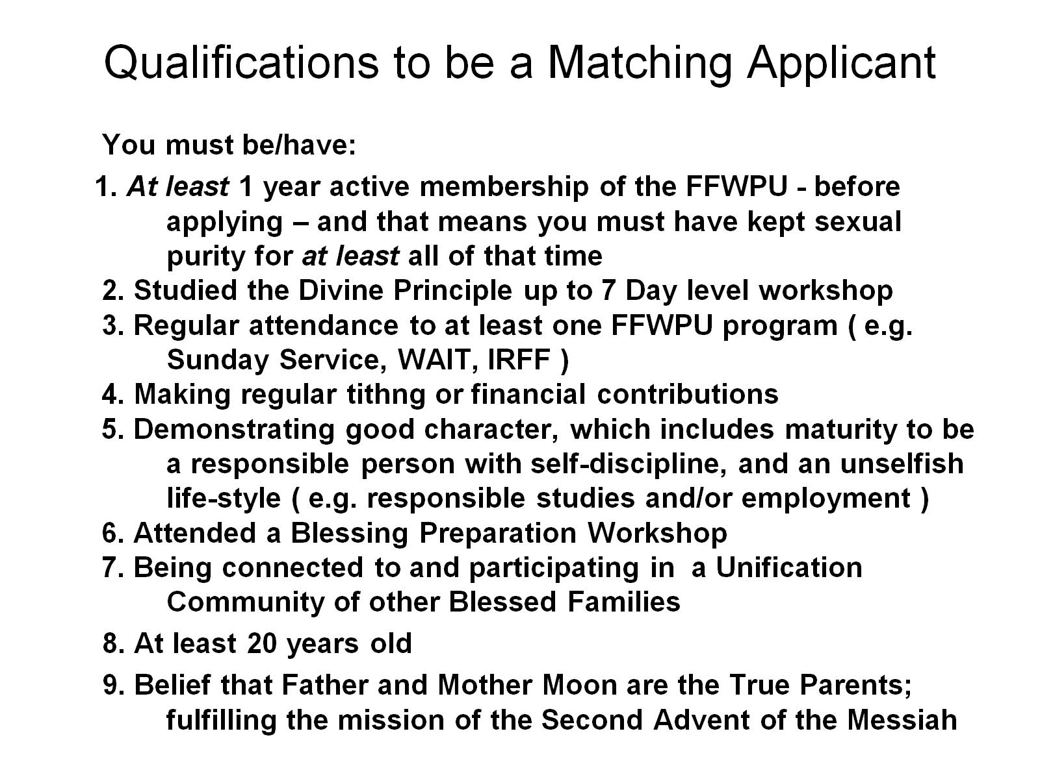
Qualifications to be a Matching Applicant

Slide 13
So, first you have to qualify yourself.

Slide 14
A Change in Paradigm

Slide 15
To Whom does this system apply?

Slide 16
We have a system to support you

Slide 17
Step 5 - If everything is in order, you become a candidate Step 6 - Blessing Preparation Workshop Offer a 7 Day Fast Save money for your Blessing Donation (1500 Euros)

Slide 18
“How the partners are selected?”

Slide 19
Step 9. – Receive email from the BFD to mark the end of the 21 days.

Slide 20
Step 10 - End of 21 Days. Time to decide; ‘yes’ or ‘no’ to start the ‘Heavenly Courtship’

Slide 21
Step 12 – end of the 25 weeks the couple receive this:

Slide 22
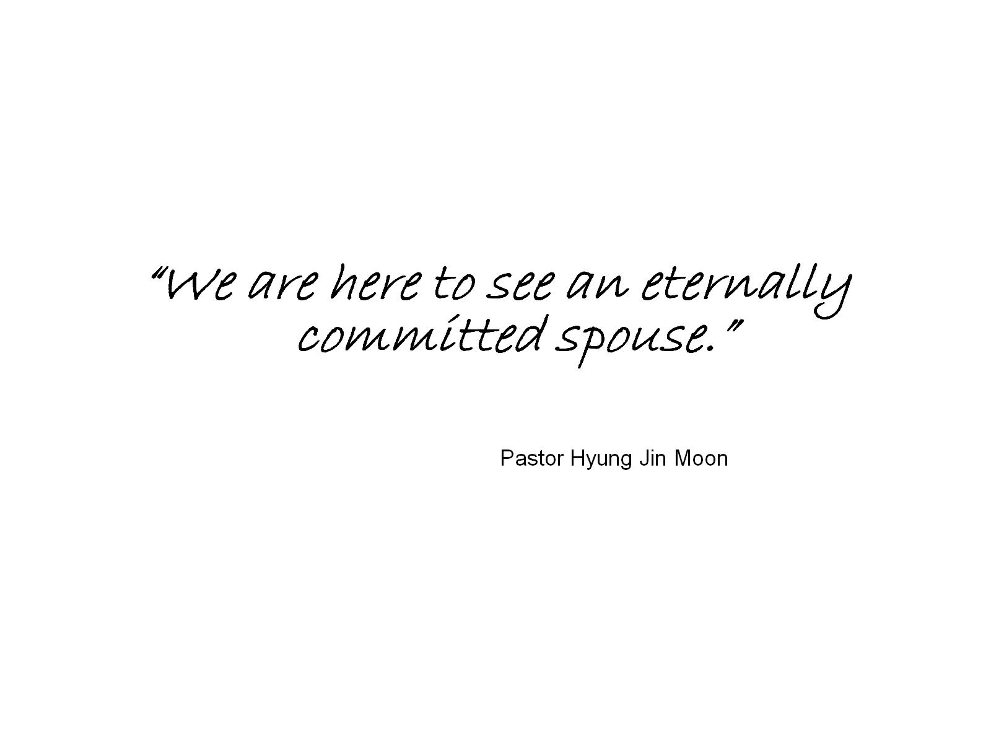

Slide 23
Step 13 – Make a considered and serious decision, after meeting your partner AT LEAST once. If you have made an absolute commitment, please send a ‘Commitment Photograph’ to BFD. At this stage your couple would be considered ‘matched’ and ‘engaged’.

Slide 24
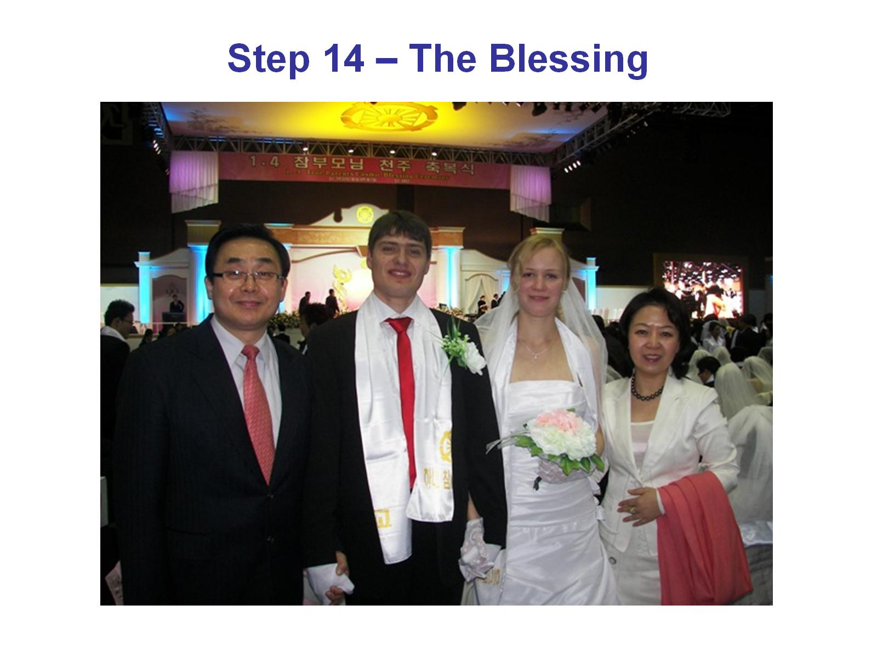
Step 14 – The Blessing

Slide 25
So ‘the Blessing’ includes a process:

Slide 26
Important things to consider:

Slide 27
The Blessing Vows:

Slide 29
They help us aspire to more than an ordinary marriage!

Slide 30
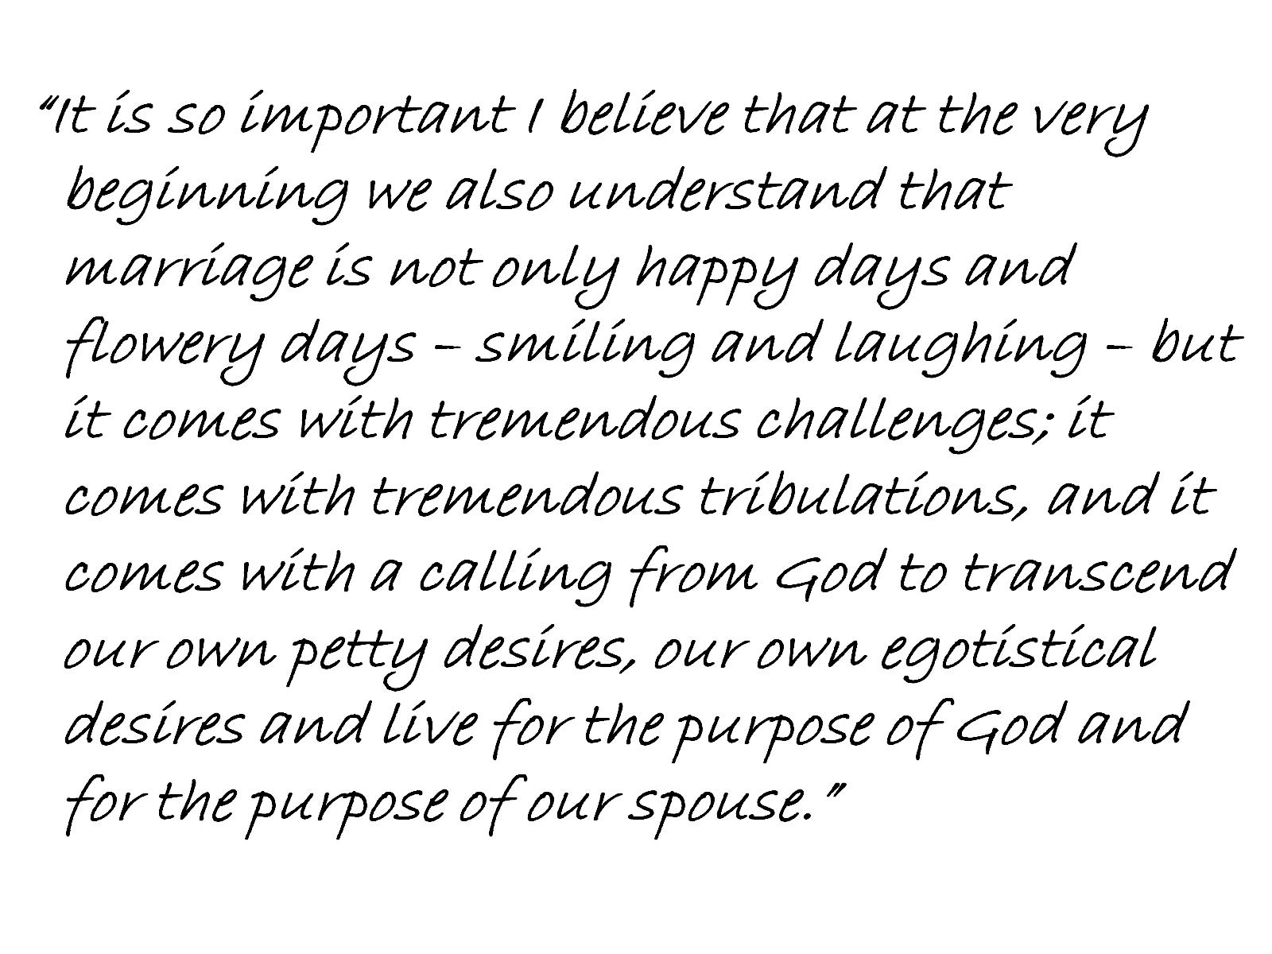

Slide 31
What does it mean to take responsibility for mistakes?

Slide 33
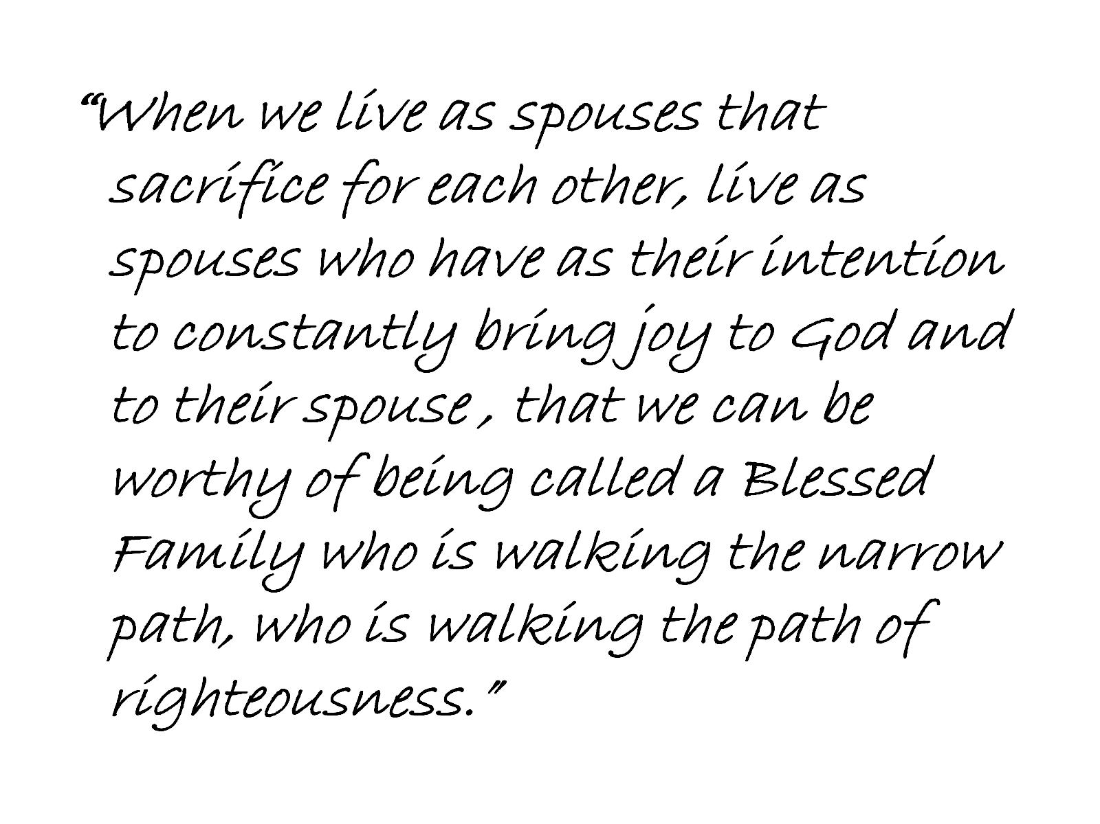

Slide 36
A life of Common Purpose

Slide 37
What gives us value or worth?

Slide 38
Stories from people who went through this process:

Slide 39
Petr and Linda Navrátil

