Slide 1
The Family is the
School of Love and the
Cornerstone for World Peace
American Clergy Leadership Conference
Little Rock Zion International Deliverance Ministries
Brooklyn, NY - Saturday, January 11, 2014
Notes:
During the next few minutes, I would like to talk about the importance of marriage and family. And explore

Slide 2
“As far back as our knowledge takes us, human beings have lived in families… Human
societies have reaffirmed their dependence on the family as the basic unit of human living - the family of father, mother and children.”
Margaret Mead, 1965
Notes:
The primary ministry of Reverend Sun Myung Moon and Dr. Hak Ja Han Moon is the blessing of marriage. We believe that God’s work in the world, through all religions, is culminating today in the perfection of marriage.
In addition, secular scholars are realizing that marriage and family life are indeed essential to human happiness, peace and prosperity.
Let us explore some of Reverend Moon’s teachings and activities in this vital area.

Slide 3
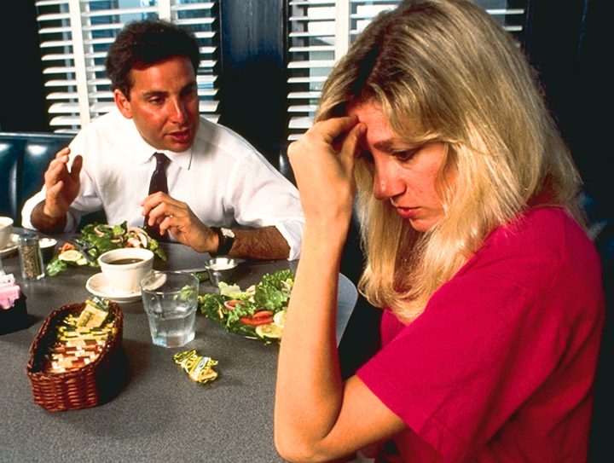
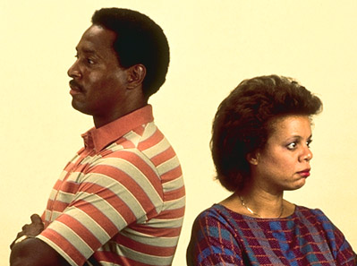
Our Families are in Trouble
Notes:
The family is in serious trouble these days. There are all kinds of explanations available:
Social – environmental – economic – biological – spiritual. The marriage is being redefined.

Slide 4
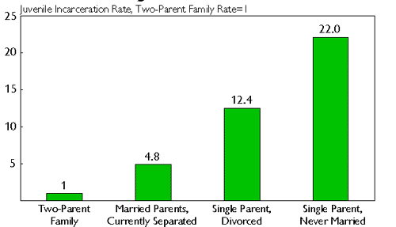
Sexual Disorder and Family Breakdown
Notes:
Sexual disorder in the family, the marriage factor, is the biggest predictor of problems in society, such as juvenile incarceration / delinquency and poverty.
-
But, we don’t teach our children that. We teach them how to put a condom on a banana

Slide 5
Declining Families, Declining World
The ruin of a nation begins in the homes of its people.
Proverb from West Africa, Ghana
Notes:
We can turn that around to mean, the restoration of a nation begins in the homes of its people.
There can never be a world of peaceful nations, until there are nations of peaceful families.
2014/1/10
5

Slide 6
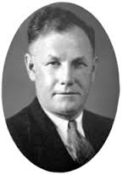
Studied 80 primitive tribes and 6 known civilizations through 5,000 years of history.
He concluded: “The whole of human history does not contain a single instance of a group becoming civilized unless it has been absolutely monogamous,
Joseph Daniel Unwin
Notes:
Dr. Joseph Daniel Unwin was a British ethnologist and social anthropologist at Oxford and Cambridge Universities. He sought to prove that the traditional family was oppressive, and should be done away with. He discovered instead….

Slide 7
Studied 80 primitive tribes and 6 known civilizations through 5,000 years of history.
He concluded: “…nor is there any example of a group retaining its culture after it has adopted less rigorous customs.”
Joseph Daniel Unwin

Slide 8
Studied 80 primitive tribes and 6 known civilizations through 5,000 years of history.
"Once a society departs from a social form of absolute marital monogamy, social chaos ensures within three generations."
Joseph Daniel Unwin
Notes:
This is a serious warning to us. And people from all backgrounds recognize the social cost of the breakdown of the family. Liberals and conservatives, Republican and Democrats agree we have a serious problem. But we cannot agree on how to solve the problem.
Instead of looking to economists, social scientists, and politicians to solve the problem, perhaps we should go to our Creator for an answer.

Slide 9
Does Almighty God have a Plan?
According to Jesus, Almighty God had a plan from “the beginning.”
When the Pharisees asked Jesus about divorce, he replied…“Haven’t you read that at the beginning the Creator ‘made them male and female,’ and said, ‘For this reason a man will leave his father and mother and be united to his wife, and the two will become one flesh’? So they are no longer two, but one flesh. Therefore what God has joined together, let no one separate.”

Slide 10
Does Almighty God have a Plan?
“Why then,” they asked, “did Moses command that a man give his wife a certificate of divorce and send her away?”
Jesus replied, “Moses permitted you to divorce your wives because your hearts were hard. But it was not this way from the beginning.”

Slide 11
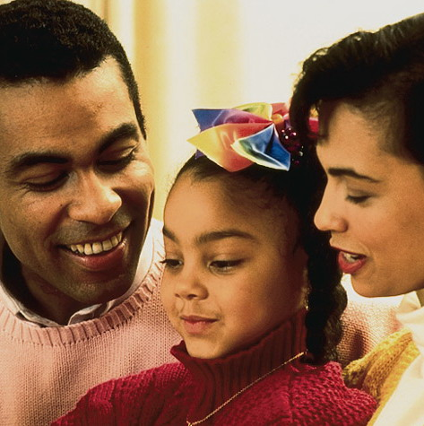
Family is God’s School of Love
The family is the most
important of all human
institutions.
Without the family
we simply would not exist.
Notes:
The primary ministry of Reverend Sun Myung Moon and Dr. Hak Ja Han Moon is the blessing of marriage.
We believe that God’s work in the world, through all religions, is culminating today in the perfection of marriage.
In addition, secular scholars are realizing that marriage and family life are indeed essential to human happiness,
peace and prosperity. And through the family language, culture, ethics, and core values are transmitted.
And it is in the family that we learn to relate well with brothers and sisters. These same skills extend to
relating well with those outside the family.
Most importantly, it is within the family that children experience unconditional love from their parents.
And parents experience the heart of God, our Heavenly Parent.
2014/1/10
11

Slide 12
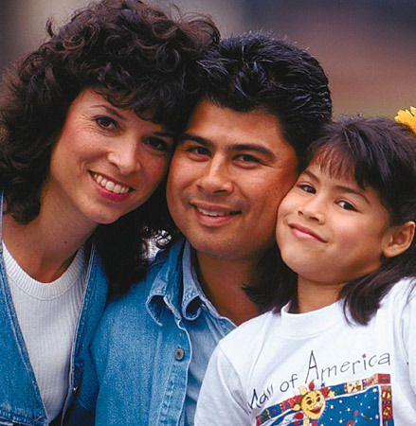
The Family is Sacred
The family---marriage and parenthood---
is regarded as sacred by the world’s religions.
Notes:
2014/1/10
12

Slide 13
God dwells in the Family
When a man honors his father and mother, God says, “I regard it as though I had dwelt among them and they had honored me.”
Judaism, Talmud
Notes:
2014/1/10
13

Slide 14
When the family declines, ancient traditions are destroyed. With them are lost the spiritual foundation for life, and the family loses its sense of unity.
Hinduism, Bhagavad-Gita 1.40
Notes:
In the Bhagavad-Gita, during a battlefield discourse between Krishna and Arjuna, we learn….
2014/1/10
14

Slide 15
The Family honors God
“Honor thy Father and Mother”
“Do not commit adultery”
Ten Commandments
Notes:
2014/1/10
15

Slide 16
Family is God’s School of Love
He has created spouses for you and planted affection and mercy between you.
Qur’an 30.21
Notes:
For God to be a God of Love, he needs an object of his love. He gave us families so that we can learn to love and experience his love for us.
2014/1/10
16

Slide 17
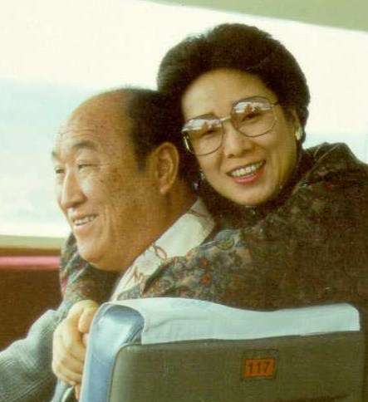
God dwells in the Family
We marry in order to resemble God. God exists as a being of dual characteristics. Thus, husband and wife… together more fully reflect God’s original nature…
Mrs. Hak Ja Han Moon, April 1996

Slide 18
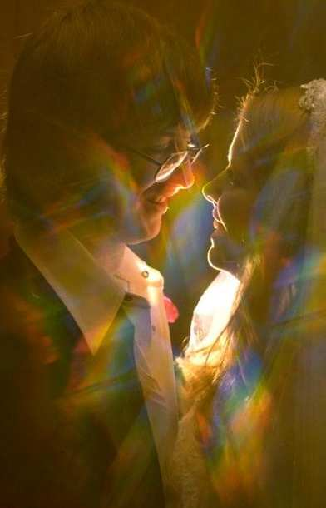
Sexual Abstinence before
Marriage is a Must
Premarital sex weakens our character and our capacity to enjoy a good marriage and family.

Slide 19
Sexual Abstinence before
Marriage is a Must
Premarital sex weakens our character and our capacity to enjoy a good marriage and family.
We must first focus on our character, talents, capacities, and virtues, to become a good man, husband and father; or a good woman, wife and mother.

Slide 20
Marital Love Must be Exclusive
No Adultery
Adultery/infidelity undermines trust and violates the heart of one’s spouse.
Pre-marital sex and multiple sexual partners, including pornographic sex, create self-centered habits and weaken the bonds of love in marriage.
Our sexual organ is not to be used freely, but only in exclusive partnership with our spouse.
No spare key
Notes:
Most essential, then love, what kind, if mature unselfish, centered on God, representing yingyang of the universe, embodies God’s highest expression. Bonding of hormones, glue, single parents great, but societies that best raise their children, 2 parents, will thrive, produce children of secure, loved and loving, responsible, conscientious

Slide 21
“No Spare Keys”
The husband should fulfill his marital duty to his wife, and likewise the wife to her husband. The wife does not have authority over her own body but yields it to her husband. In the same way, the husband does not have authority over his own body but yields it to his wife. Do not deprive each other except perhaps by mutual consent and for a time, so that you may devote yourselves to prayer.
1 Corinthians 7:4

Slide 22
Our Spouse and Sexual Love
If all men and women admit that their sexual organ belongs to their spouse, we all will bow our heads and become humble when we receive our spouse's love. Love comes to you only from your partner.
“In Search of the Origin of the Universe”
The Reverend Sun Myung Moon

Slide 23
Sexual Disorder and Family Breakdown
Sexual promiscuity, infidelity, pornography lead to sexually transmitted disease, divorce, and family breakdown

Slide 24
Sexual Disorder and Family Breakdown
Sexual promiscuity, infidelity, pornography lead to sexually transmitted disease, divorce, and family breakdown
Family breakdown undermines social stability, good citizenship, educational development, and contributes to crime, youth alienation and suicide.

Slide 25
Sexual Disorder and Family Breakdown
Sexual promiscuity, infidelity, pornography lead to sexually transmitted disease, divorce, and family breakdown
Family breakdown undermines social stability, good citizenship, educational development, and contributes to crime, youth alienation and suicide.
To build a world of peace, we need to restore true love, true parenthood and true family

Slide 26
The Problem in the First Family
You are of your father the devil
Jesus in John 8:44
The Fall of Man
Notes:
By the fall, man was brought under the false fatherhood of Satan. Man changed fathers. We left our true father, God, and united with the false father, Satan. The first man and woman became children of Satan. Under the false fatherhood of Satan, Adam and Eve united unlawfully as a couple without God’s Blessing or permission. And when they multiplied children, they all came under the same false father. They were all born as the children of sin, not children of god. Therefore, the multiplication of sinful children from one generation to another has brought about this fallen, sinful world.
2014/1/10
26

Slide 27
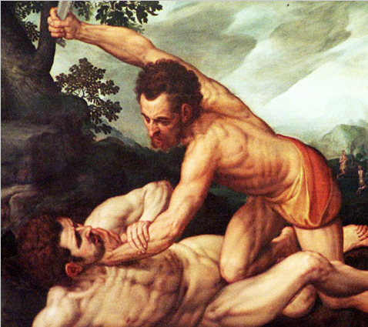
The Problem in the First Family
…. mistrust, hatred, racism, crime and war
…where nations and societies can destroy each other and feel no pain.
Kingdom of hell on earth
Notes:
Because God is not at the center, this is a world of sin, a world of mistrust, a world of crime, a world of war. And we, the nations and societies of this world, can destroy each other and feel no pain. This is the kingdom of hell on earth.

Slide 28
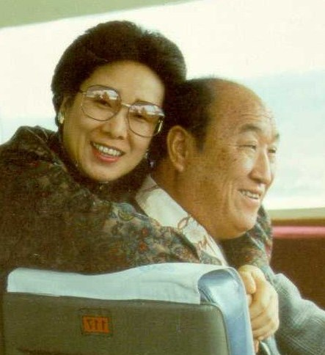
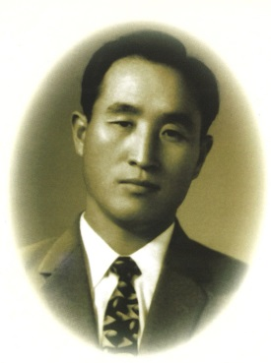
Love, Life and Lineage
You should educate everyone to understand that all human beings without exception are descended from the Fall and must change their blood lineage through receiving the Holy Marriage Blessing from the True Parents….
The Reverend Sun Myung Moon
Notes:
This was the guidance that Father Moon gave a group of pastors just like you many years ago…to understand the fundamental importance of the lineage, the new seed.
The clues are all there in the Bible…

Slide 29
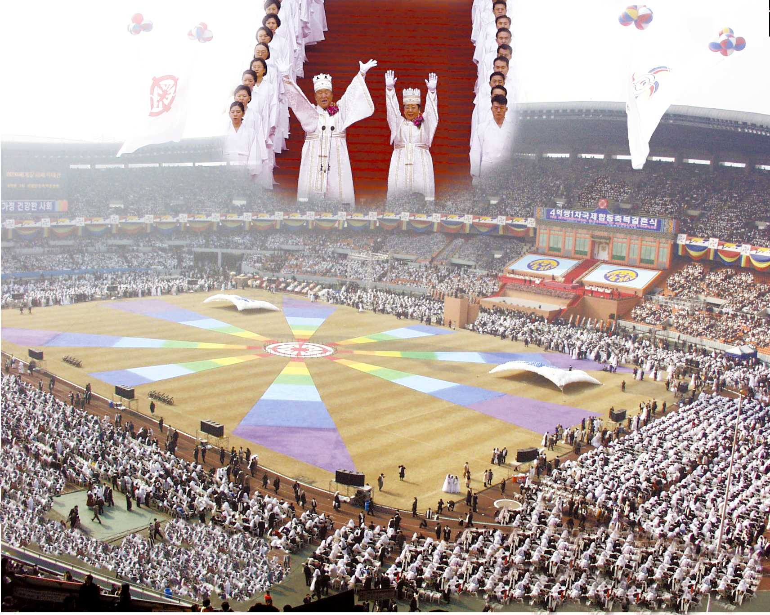
The Blessing Ministry
Notes:
If you ask people what they know about Father and Mother Moon – if anything at all – they might answer “Mass Weddings” like this one in 1992

Slide 30
36 Couples - 1960
Notes:
The Blessing Movement started over 50 years ago

Slide 31
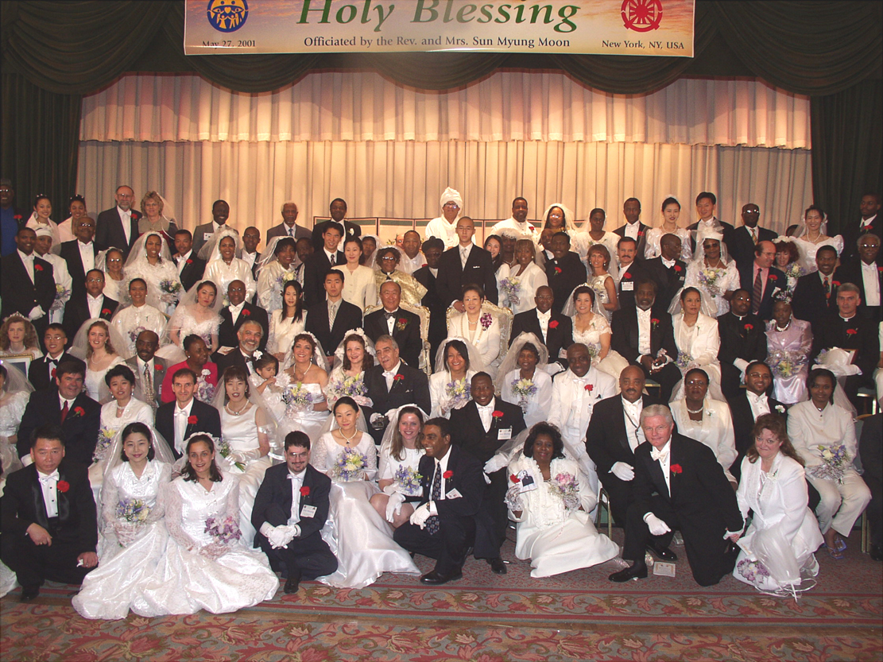
Marriage Blessing of Religious Leaders
Notes:
Has expanded to include religious leaders from all faith communities. If you look carefully you can see Archbishop Stallings and his briide on Rev. and Mrs. Moon’s right side. To their left is Archbishop Milingo, and Pastor T. L. Barrett and their brides. Kneeling in the front are Bishop Jesse Edwards and his wife, Rev. Tanya Edwards.

Slide 32
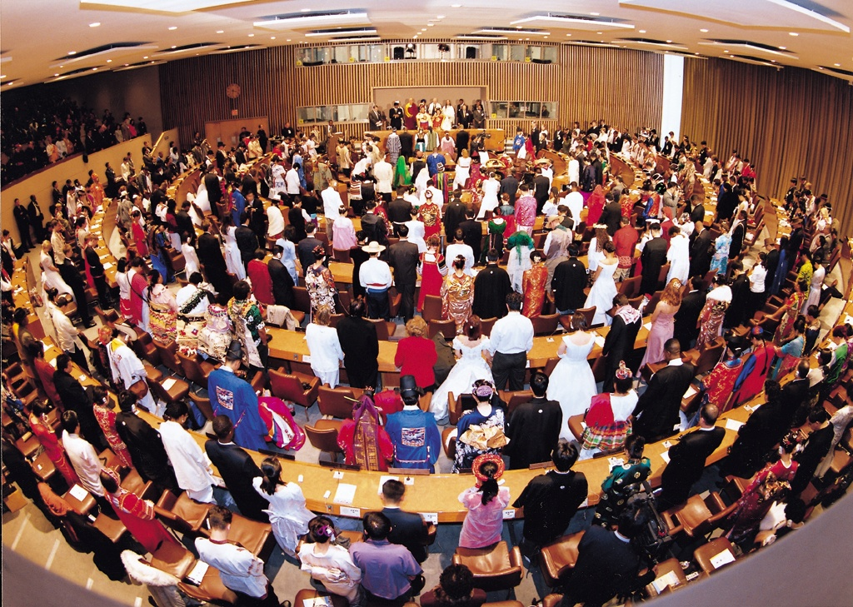
World Peace Blessing Ceremony held at the United Nations
Notes:
And a Marriage Blessing has even taken place at the chambers of the United Nations.

Slide 33
The blessing pledge
To be faithful in marriage: no adultery
To raise children and grandchildren to be pure in preparation for marriage
To live for the sake of others as a married couple and as a family
To encourage people of all races, religions, nationalities and cultures to live as one family under God.
Notes:
Father and Mother Moon have conducted a number of such marriage blessings have been conducted in recent years, including couples from all races, religions and nations, both previously married couples and newly matched couples.
These couples are affirming this teaching and joining together to begin creating heavenly families. They are affirming a common value that unites races, religions and nations, to build not only true families but also world peace.

Slide 34
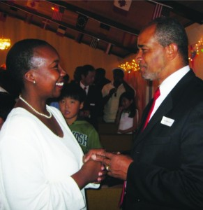
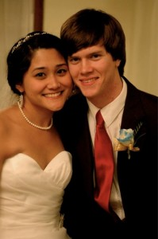
Sunday, January 26 – Marriage Rededication
Friday, February 11 – Marriage Blessing
Let’s work together to
rebuild the family…
Notes:
In January and February of 2014, 430 churches across America will share the Marriage Re-dedication and Family Blessing with their congregations. This is wonderful way to affirm the importance of the family. You are invited to hold a ceremony with your congregation.

Slide 35
The End!

