Slide 1
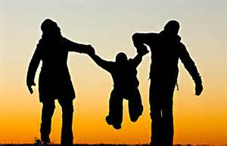
Gender Mainstreaming versus Family Values
Notes:
jokjjhjgjh

Slide 2
Gender Mainstreaming
Male or female behaviors are solely instilled
Elimination of polarity between men and women
Sex can change arbitrarily
„Traditional Family“ should be abolished

Slide 3
Gender Mainstreaming
All Kinds of sexual relationships are promoted
Equalisation of any kind of sexual relationships
Prompting „sex games“ – alone or with others

Slide 4
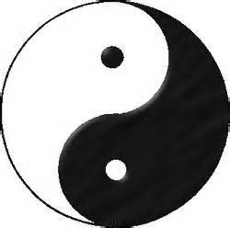
Comparison (1)
GT: Male or female behavior are instilled ONLY
FV: Male or female behavior is not instilled ONLY
but an expression of the inner nature
(character), TOO
GT: Elimination of the sexual polarity
FV: Polarity underlays the structure and function
of the hole universe

Slide 5
Comparison (2)
GT: The male or female sex can be
changed arbitrarily
FV: There are only two sexes:
either male or female.
Those are determined by birth.
We do not have the right to change our sex.

Slide 6
Comparison (3)
GT: The „traditional family“ should be abolished
FV: The natural family is timeless
GT: All sorts of sexual relationships are promoted
FV: One man – one woman is the highest expression of God‘s image

Slide 7
Comparison (4)
GT: Equalisation of all kinds of sexual relationships
FV: Only by the interaction of opposite sexes offsprings can emerge
– Sustainability of the human society

Slide 8
Comparison(5)
GT: Prompting „sex games“ – alone or with others
FV: Our love organ belongs to God and our spouse.
It is the center of love, life and lineage.

Slide 9
The Intention behind Gender-Mainstreaming
Gabriele Kuby:
„Since the turn of the millenium gender-mainstreaming‘ is pushed by the UN, the EU and the governments of the Western World by all kinds of political, legal and financial means. Ostensibly it‘s all about the equality of women with men. In reality it‘s about the destruction of the sexual polarity of man and woman and the abolishment of any moral norms of sexuality…“

Slide 10
German Institute for Youth and Society http://www.dijg.de
The GIYS researches and informs about topics as:
Identity
Marriage and Family
Bonding and Identity Development
Identity and Sexualiy
Male and fimale Identity and Culture
Violation of Identity

Slide 11
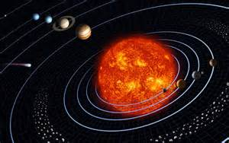
The Universe

Slide 12
Natural Order of the Universe
Vertical Order
Center of the Galaxy
Individual Order
Sun
Mercur
Venus
Earth
Mars
Jupiter
Horizontal Order
Notes:
3 Hauptordnungen

Slide 13
The Natural Order within the Family
Vertical Order
Grandparents
Individual Order
Parents
Brother
Sister
Brother
Sister
Children
Horizontal Order
Notes:
Traditional Role of Education
1. Passing on knowledge and cultural values
2. Teaching moral standards and social responsibilities
3. Preparing good citizens

Slide 14
Positions in the Family
Grandparents & Parents
Younger
Siblings
True
Love
Husband
Wife
Elder
Siblings
Children & Grandchildren
Notes:
Explosion of Destructive
Youth Behavior Since 1940s
1940s School Problems
1. Talking out of turn
2. Chewing gum
3. Making noise
4. Running indoors
5. Getting out of line
6. Improper clothing
7. Littering
1990s School Problems
1. Drug abuse
2. Alcohol abuse
3. Pregnancy
4. Suicide
5. Rape
6. Robbery
7. Assault
Source: William J. Bennett et al., Index of Leading Cultural indicators, Empower America, Mar. 1993

Slide 15
The Four Great Realms of Heart
Parent‘s Love
Children’s Love
Sibling’s Love
Conjugal Love
Parent’s Love
Kind
Conjugal Love
Sibling‘s Love
Children‘s Love

Slide 16
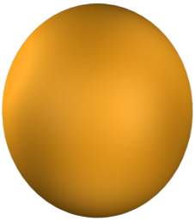
The Realm of Children’s Love
God‘s
Love
Notes:
Early Appeal of
Non-Directive Education
1. Used interactive methodology
2. Supported by the science of its time
3. Coincided with the loss of confidence in traditional values
4. Seemed to promote tolerance

Slide 17
The Primary Quality of Children’s Love
Filial Piety
Notes:
U.S. Policy Recognizes Limitations of Non-Directive Methods
Rejects Òopen-ended decision-making, values clarification and therapeuticÉ strategiesÓ in drug abuse education
Source: U.S. Dept. of Education guidelines for drug prevention education, 1988
Mandates federal funding for directive abstinence-oriented sex education
Source: Act of Congress, 1996

Slide 18
The Realm of Sibling’s Love
Peers
Friends
Cousins
Give and Take
Notes:
Why Moral & Ethical
Education Was Neglected
1. Rise of moral relativism
¥ All values subjective
2. Increasing pluralism
¥ Unclear whose values should be taught
3. Confusion that teaching values was promoting religion

Slide 19
Parents Can Solve Conflicts between Siblings
God‘ s
Love
Notes:
Part 2.
Why Give Priority
to Moral & Ethical Education?

Slide 20
Primary Virtues of Sibling’s Love
Harmony & Purity
Notes:
Ò The greater our material power, the greater our need for the spiritual insight and virtue to use our power for good and not evilÉWe have never been adequate spiritually for handling our material power; and today the morality gap isÉgreater than it has ever been in any previous age.Ó
Source: Arnold Toynbee British Historian, ÔCivilization on Trial

Slide 21
The Realm of Conjugal Love
God‘s
Love
Notes:
Two Dimensions of Values

Slide 22
Spouse’s Realm Draws on other Realms
Husband
Friend
Father
Son
elder Brother
younger
Brother
Wife
Friend
Mother
Daughter
elder Sister
younger Sister
Notes:
ÒCharacter is destiny.Ó
Heraclitus, Greek philosopher

Slide 23
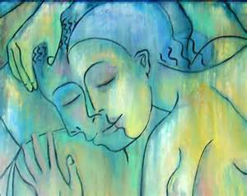
Primary Virtues of Spouse’s Love
Treue & Verbindlichkeit
Notes:
Part 3.
What Is a
Balanced Education?

Slide 24
The Realm of Parent’s Love
God‘s Love
Notes:
Philosophy & Science
of Education
Philosophy of Education
Purpose
Ideals
Goals
Science of Education
Curriculum
Methods
Administration

Slide 25
Primary Virtues of Parent’s Love
Investment & Compassion
Notes:
Good Character
Inner disposition conducive to right conduct
¥ Attitudes and habits
¥ For the purpose of loving

Slide 26
Society — Extension of the Family
Leaders, Superiors
younger
Peers
Parents
younger
Siblings
Husband
True
Love
Wife
Elder
Siblings
Elder
Peers
Children
Subordinates

Slide 27
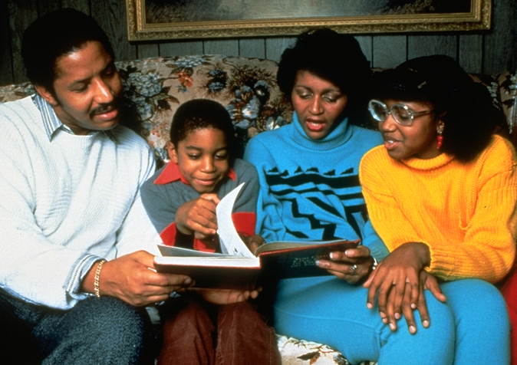
Cornerstone of World Peace
Families bridge Cultures
Peaceful Families support peaceful nations
Basis for empathy with all people
Notes:
Throughout history...education has had two great goals: To help young people to become smart and...become good.Ó
Source: Dr. Thomas Lickona, ÔEducating for Character

Slide 28
“An ideal family is the place, where parents, children, husband and wife and brothers and sisters want to be connected in true Love. Under these circumstances they have equal rights for all times. There heaven on earth starts and heaven in the spirit world will automatically be realized.”
SMM (CSG “Love and Family”)
Notes:
Morals Goal — Loving Relationships & Family
Strong marriages
Effective parenting
Ethical practice
living for higher purpose

Slide 29
