Slide 1
Does God exist?

Slide 2
What’s new?
If you go to your school every day and every day it looks the same do you think much about it?
If one day you go there after the holidays and in the main entrance there is a large sculpture what would you do? Look at it. What would you think?
Where did it come from? Who made it? Why is it here?
How much do we notice the world in which we live?
Do we take the world for granted?

Slide 3
Existence
If something has always existed we don’t need to explain it – where it came from or who made it.
If the universe has always existed we don’t need God to explain its existence.
“If we say that God has always been, why not save a step and conclude that the universe has always been?” Carl Sagan, Cosmos, 1980
Has the universe always existed?
Notes:
In reply to a question in 1996 about his religious beliefs, Sagan answered, "I'm agnostic.” Sagan's views on religion have been interpreted as a form of pantheism comparable to Einstein's belief in Spinoza's God. Sagan maintained that the idea of a creator of the universe was difficult to prove or disprove and that the only conceivable scientific discovery that could challenge it would be an infinitely old universe

Slide 4
Discovering the beginning
Edwin Hubble discovered galaxies are moving away from each other (1920s)
The universe is expanding
Like a balloon inflating, all the parts are moving away from each other
Notes:
Up until 1950s scientists believed the universe had always existed. Fred Hoyle ‘Steady State Theory of the Universe’
Arno Penzias and Robert Wilson observed in 1965 a radio background source that was spread all over the universe---the cosmic microwave background radiation. The radiation has the same intensity and spectral character as a thermal continuous source at 3 K

Slide 5
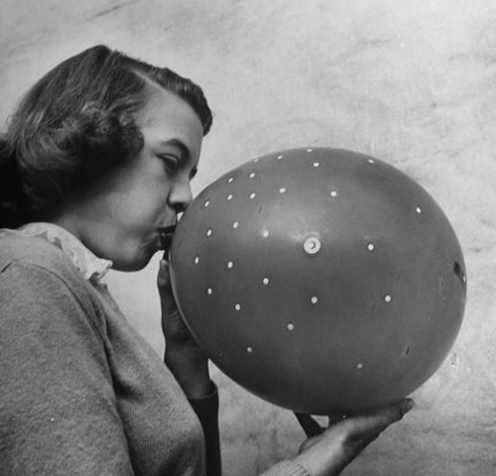

Slide 6
Discovering the beginning
Edwin Hubble discovered galaxies are moving away from each other (1920s)
The universe is expanding
Like a balloon inflating, all the parts are moving away from each other
Therefore they must originally have started from the same place
Notes:
Up until 1950s scientists believed the universe had always existed. Fred Hoyle ‘Steady State Theory of the Universe’
Arno Penzias and Robert Wilson observed in 1965 a radio background source that was spread all over the universe---the cosmic microwave background radiation. The radiation has the same intensity and spectral character as a thermal continuous source at 3 K

Slide 7
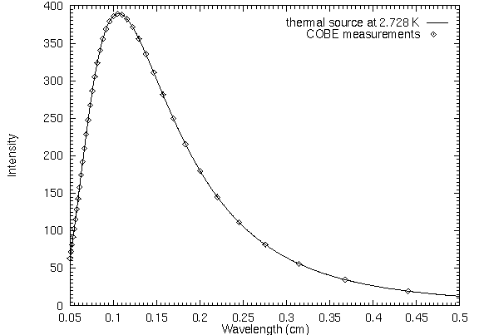
Cosmic background radiation
In 1963 a constant radio background source that was spread all over the universe was discovered
It was a relic or echo from the Big Bang
Notes:
The only way to explain constant 2.7K radiation in every direction in universe was it came from a single source - big bang. Discovered by Robert Wilson and Arno Penzias at Bell Laboratories

Slide 8
The Big Bang
Singularity
Infinitely small
Infinitely dense
Infinitely hot
13-15 billion years ago
Notes:
Where did it come from? We don't know. Why did it appear? We don't know.
There are many misconceptions surrounding the Big Bang theory. For example, we tend to imagine a giant explosion. Experts however say that there was no explosion; there was (and continues to be) an expansion. Rather than imagining a balloon popping and releasing its contents, imagine a balloon expanding: an infinitesimally small balloon expanding to the size of our current universe.
Prior to the singularity, nothing existed, not space, time, matter, or energy - nothing. So where and in what did the singularity appear if not in space? We don't know. We don't know where it came from, why it's here, or even where it is. All we really know is that we are inside of it and at one time it didn't exist and neither did we.

Slide 9
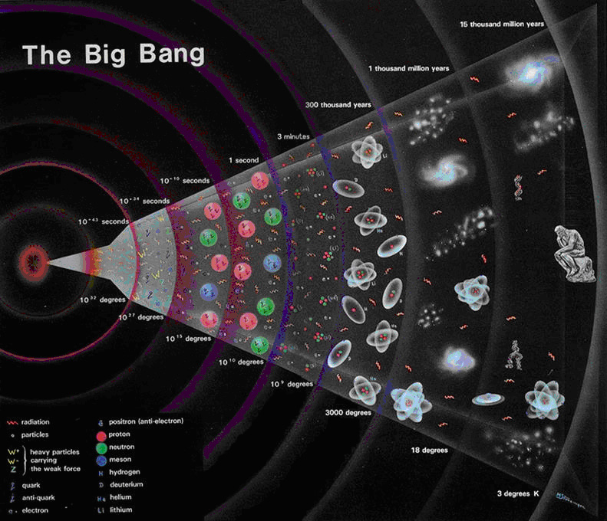
The expanding universe

Slide 10
What happened at the Big Bang?
Time and space
started with the
Big Bang
Universe appeared with time, not in time
So there was no
‘before’ the Big Bang
Big Bang
Space
Time
Notes:
Steven Hawking, George Ellis, and Roger Penrose turned their attention to the Theory of Relativity and its implications regarding our notions of time. In 1968 and 1970, they published papers in which they extended Einstein's Theory of General Relativity to include measurements of time and space.^{1, 2} According to their calculations, time and space had a finite beginning that corresponded to the origin of matter and energy."³

Slide 11
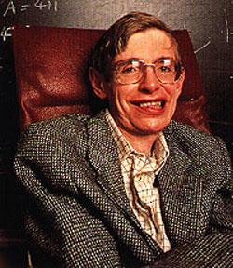
Big Bang implies God
“Science could predict that the universe must have had a beginning, but it could not predict how the universe should begin: for that one would have to appeal to God.”
Stephen Hawking 1988
Notes:
Hawking an atheist and hostile to religion

Slide 12
What would you expect from a Big Bang?
Chaos
Disorder
Randomness
Ugliness
What is the universe like?
Cosmos
Orderly
Complexity
Beauty

Slide 13
How does one explain this?
What were the initial conditions at the Big Bang?

Slide 14
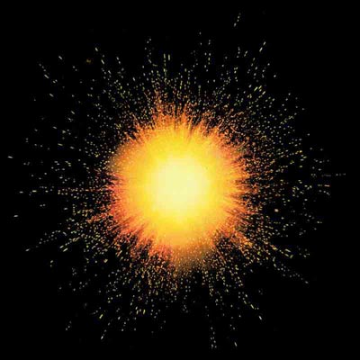
It had to be a smooth beginning
It was smooth - If the Big Bang was too ragged the result would have been turbulence and a cosmos of black holes. The chance of a smooth beginning is 1 in 10¹⁰ ¹²³
Ragged beginning
Notes:
If the conditions of the Big Band had not been exactly as they were there would be no universe and no human life or consciousness. Therefore some scientists say that it looks like the BB was designed. This is called Anthropic Principle

Slide 15
It had to be a smooth beginning
It was smooth - If the Big Bang was too ragged the result would have been turbulence and a cosmos of black holes. The chance of a smooth beginning is 1 in 10¹⁰ ¹²³
Smooth beginning
Notes:
If the conditions of the Big Band had not been exactly as they were there would be no universe and no human life or consciousness. Therefore some scientists say that it looks like the BB was designed. This is called Anthropic Principle

Slide 16
Expansion at a precise speed
If the universe had expanded 1 part in a million more slowly the universe would have collapsed within a fraction of a second.
If the universe had expanded 1 part in a million faster galaxies would never have formed.

Slide 17
Nuclear forces . . .
If the weak nuclear force was a bit stronger all matter would have become helium and heavier elements. There would be no water and the sun would explode instead of burning. If it was a bit weaker there would be only helium since the weak nuclear force makes neutrons decay into protons.
If the strong nuclear force was 2% stronger quarks would not turn into protons and there would be no hydrogen. A 5% weakening would unbind the deuteron (Proton+Neutron) and there would be no elements heavier than hydrogen.

Slide 18
And electromagnetism . . .
A change of just one part in 10⁴⁰ would affect star formation. Slightly stronger and they would be red stars and too cold. Slightly weaker and they would be blue, very hot, radioactive and short lived. A doubled strength would mean 10⁶² years would be needed for life to evolve by which time all protons would have decayed.

Slide 19
The strength of gravity
Gravity is 10³⁹ times weaker than electro-magnetism. A slight change in this proportion would prevent the formation of stars. At its precise strength it was possible for clouds to form stable stars which do not fragment.

Slide 20
How do we explain the “fine-tuning” of the starting conditions of the universe?
How do we explain why there is a universe at all?

Slide 21
A scientific explanation . . .
“Because there is a law such as gravity, the Universe can and will create itself from nothing. Spontaneous creation is the reason there is something rather than nothing, why the Universe exists, why we exist.”
Stephen Hawking, The Grand Design, 2011
Why is there gravity?
Is gravity eternal?
Is gravity God?
This doesn’t explain the “fine tuning”
Maybe gravity is an expression of the Universal Prime Force of God?
Notes:
But where does gravity come from? Is gravity eternal? Is gravity God?
Idea universe is absurd is unsatisfying.
Muliverse idea - Occum’s Razor. There is no evidence or ever can be any evidence for other universes so why postulate their existence. Simplest explanation is best - one Creator. Even if were many universes still the question remains of explaining their origin. Why is there a universe or why are there multiple universes.

Slide 22
Hawking again . . .
“The question is: is the way the universe began chosen by God for reasons we can't understand, or was it determined by a law of science? I believe the second. If you like, you can call the laws of science “God”, but it wouldn't be a personal God that you could meet, and ask questions.”
Stephen Hawking, Channel Four, 2011
Assumptions, assumptions, assumptions . . .
Maybe we can know why God created the universe
Why can’t God be personal?
Notes:
Maybe we can understand the reasons God chose to create the universe.
Why couldn’t God be personal?
Assumptions

Slide 23
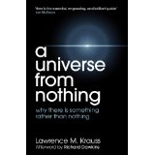
Quantum fields created universe
Total energy of the universe is zero
Quantum fields but no matter – quantum vacuum
Quantum fields unstable
The universe appeared as a quantum fluctuation
Notes:
Krauss explains, only in a flat geometry universe (like ours appears to be) does the total “Newtonian gravitational energy” of each cosmic object equal zero. This happens because the negative energy of gravitational attraction cancels out the positive energy of motion. Therefore, the net energy of the universe is zero and if that’s the case, then the universe is essentially nothing. Krauss implies that if the universe really adds up to nothing, why then must we feel compelled to invoke “Someone” (like the biblical God) to explain its cause?
According to relativistic quantum field theories, particles are to be understood, rather, as specific arrangements of the fields. Certain ­arrangements of the fields, for instance, correspond to there being 14 particles in the universe, and certain other arrangements correspond to there being 276 particles, and certain other arrangements correspond to there being an infinite number of particles, and certain other arrangements correspond to there being no particles at all. And those last arrangements are referred to, in the jargon of quantum field theories, for obvious reasons, as “vacuum” states. Krauss seems to be thinking that these vacuum states amount to the relativistic-­quantum-field-theoretical version of there not being any physical stuff at all. And he has an argument — or thinks he does — that the laws of relativistic quantum field theories entail that vacuum states are unstable. And that, in a nutshell, is the account he proposes of why there should be something rather than nothing.

Slide 24
But . . .
A quantum vacuum is not “nothing” as it assumes the existence of quantum fields which create matter
True “nothing” is no fields
Otherwise where did the fields come from? Are they eternal? Are they God?
Fields are an expression of the Universal Prime Energy
Notes:
The true relativistic-quantum-field-­theoretical equivalent to there not being any physical stuff at all isn’t this or that particular arrangement of the fields — what it is (obviously, and ineluctably, and on the contrary) is the simple absence of the fields! The fact that some arrangements of fields happen to correspond to the existence of particles and some don’t is not a whit more mysterious than the fact that some of the possible arrangements of my fingers happen to correspond to the existence of a fist and some don’t. And the fact that particles can pop in and out of existence, over time, as those fields rearrange themselves, is not a whit more mysterious than the fact that fists can pop in and out of existence, over time, as my fingers rearrange themselves. And none of these poppings — if you look at them aright — amount to anything even remotely in the neighborhood of a creation from nothing.

Slide 25
How can we explain this?
Multiple universes exist and ours just happens to support life
But there is no evidence for the existence of other universes. If there were they would be in our universe
Occam’s razor - among competing hypotheses, the one that makes the fewest assumptions should be selected
Even if there are multiple universes still doesn’t explain why they exist
Notes:
Idea universe is absurd is unsatisfying.
Muliverse idea - Occum’s Razor. There is no evidence or ever can be any evidence for other universes so why postulate their existence. Simplest explanation is best - one Creator. Even if were many universes still the question remains of explaining their origin. Why is there a universe or why are there multiple universes.
Occam's razor (also written as Ockham's razor from William of Ockham, and in Latin lex parsimoniae) is a principle of parsimony, economy, or succinctness used in logic and problem-solving. It states that among competing hypotheses, the one that makes the fewest assumptions should be selected.

Slide 26
Or . . . .
An intelligent Creator designed the initial conditions to support the development of complexity, life and consciousness
Notes:
Occam's razor is attributed to the 14th-century English logician, theologian Father William of Ockham (d'Okham), although the principle was known earlier.The words attributed to Occam, entia non sunt multiplicanda praeter necessitatem (entities must not be multiplied beyond necessity), are absent in his extant works.^{[5]} This principle is sometimes phrased as pluralitas non est ponenda sine necessitate ("plurality should not be posited without necessity").^{[6]} To quote Isaac Newton, "We are to admit no more causes of natural things than such as are both true and sufficient to explain their appearances. Therefore, to the same natural effects we must, so far as possible, assign the same causes."[

Slide 27
Which is more likely?
God or chance?
“When I see all the glories of the cosmos, I can’t help but believe that there is a divine hand behind it all.”
Einstein
Notes:
Possible

Slide 28
Where’s the evidence that God exists?
What is evidence?
Do we have evidence for everything we believe exists?
How about Dark Matter? Dark Energy? The Higgs particle?
Need instruments to measure

Slide 29
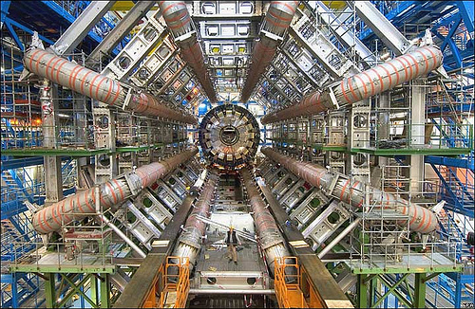
The Large Hadron Collider
Used to try to detect Higgs Boson particle
Notes:
The Large Hadron Collider (LHC) is the world's largest and highest-energy particle accelerator. It was built by the European Organization for Nuclear Research (CERN) over a ten year period from 1998 to 2008, with the aim of allowing physicists to test the predictions of different theories of particle physics and high-energy physics, and particularly for the existence of the hypothesized Higgs boson and of the large family of new particles predicted by supersymmetry

Slide 30
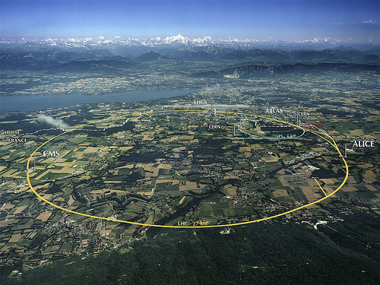
Largest scientific instrument in the world - CERN
27 km circumference
Notes:
The LHC lies in a tunnel 27 kilometres (17 mi) in circumference, as deep as 175 metres (574 ft) beneath the Franco-Swiss border near Geneva, Switzerland.

Slide 31
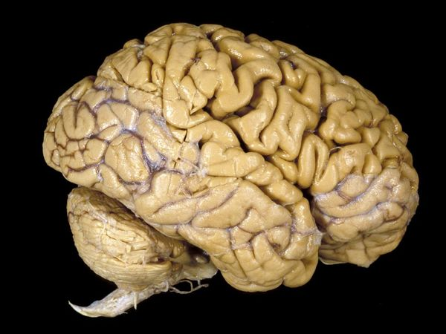
Is there a God-detector?
What is the most complex thing in the universe?
The human brain

Slide 32
Does it need tuning?
Like a radio
How does one tune it?
Spiritual life
Prayer, meditation
Practice
Personal experience
Mystical
Numinous
Conscience
‘Coincidence’

Slide 33
Any other evidence?
Can you see gravity? Can you see God? – see the effects of gravity and the effects of God
Study history
Is there a pattern suggesting there is a ‘force’ guiding history? – history parallels
How else does one explain religious experience?
We need to postulate the existence of God to be able to give the most complete explanation of the world in which we live.

Slide 34
Conclusion
One cannot prove or disprove the existence of God
Richard Dawkins says he is an agnostic who thinks the existence of God is very unlikely
Based on above facts about fine tuning one could say the existence of God is very likely

