Slide 1
Steps towards forming models explaining psychological well-being, personal growth and healing

Slide 2
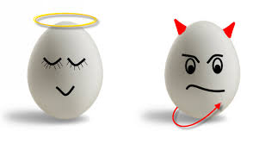
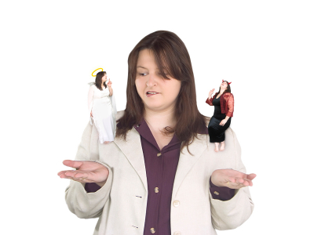
Model 1
Unhealthy – tends towards ‘Mental dis-ease’ – often leads to crimes or ‘evil’
Healthy – tends towards goodness
Historic Struggle
How am I going to handle this problem?

Slide 3
If we look a little closer
Can you offer some examples of where you feel you are:
Quite good at loving well
Not so strong – in need of gentle, step-by-step improvement
Strong love skills Weak love skills
I have the ability to grow
– to co-create myself –
Life long learning about the art of loving well
– treasuring my divine potential

Slide 4
The ‘fallen’ part of ourselves
Hidden traumatisation of the original mind
A past perceived traumatic event - when not processed in a growth oriented co-creation way - leads us:
To take on the attitude of a victim | To store the painful emotion associated with that event.
These cause me to exhibit ‘fallen’ natures – psychological ‘dis-ease’
They also trap me from seeing that I DO have the divine potential to solve my problems through using growth oriented, co-creation strategies that I successfully use in other areas of my life.

Slide 5
Looking more closely at the process
Trauma based Victim attitudes + hidden stored painful emotion | This stored painful emotion has the potential to be triggered by an event that stimulates the same emotional content and the attached victim attitude | Fallen natures Victim based acts or words – often leads to becoming a rescuer or a persecutor
 | Or they create a present day ‘survival’ behaviour or communication strategy that is deeply influenced by that painful memory, stored emotion or victim attitude

Slide 6
Where do these traumas come from
Victim attitudes + hidden stored painful emotion | Original sin
 | Family tree – From my parents, my ancestors and from my wider family system (hidden lineage traumas)
 | Collective traumatisation – that flow through my national culture, race, religion, etc.. Some caused by wars, economic hardships, etc
 | From early personal childhood experiences, or through life experiences that I find hard to process in co-creation way

Slide 7
A more complete model of myself
Fallen natures
Victim, rescuer, or persecutor – in acts or words
Co-creation – Adam and Eve before the fall
Hidden Trauma = Stored painful emotions that trigger victim, rescuer or persecutor attitudes
Strong love Weak love
Skills skills
Key Questions this model raises
What are the most important principles of co-creation that I need to follow in order to offer more mature, God centred love to those I care about? How to educate from birth, not only intellect but the art of loving well | 3) How can we categorize the fallen natures to allow for better recognition and understanding | 4) What methods work when it comes to healing traumas? Releasing trapped emotions? Becoming aware of victim attitudes? Are some methods better for certain types of people or certain types of trauma?

Slide 8
The different challenges need different solutions
Fallen natures
Victim, rescuer, or persecutor – in acts or words
Hidden Trauma = victim, rescuer or persecutor attitudes + stored painful emotions
Strong love Weak love
Skills skills
Uncovering the hidden painful emotions and recognizing the victim attitudes:
Family Constellations, Repentance,
Psychotherapy, self-awareness techniques, etc. Some find help in the emotional code, etc
Self Management
Prayer, EFT, NLP, anger management, Cognitive Behavioural Therapy, meditation, etc
I grow – co-create myself - through encouragement, education, coaching, through practice and trial and error, modelling, and through better regulation of the principles of co-creation

Slide 9
Who am I? And ‘how do I achieve my goals?’
Model 2
Model 1
My external goals – How do I set about achieving them?
I use similar principles every time = The principles of creation
Victim rescuer or persecutor
- in acts or words
Hidden Trauma
Strong Weak
Love Skills

Slide 10
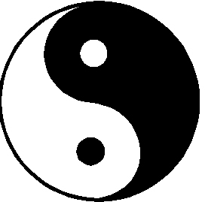
Model 2 – follows outline of Principle of Creation 7 Principles of Creation – How we achieve goals
1 | The Principle of Identity – Clear Goal
2 | The Principle of Diverse Inputs
3 | The Principle of Give and Take (in order to create an agreed plan of the ‘Baby Steps’ forward)
4 | The Principle of Including Love, Beauty, Truth, Goodness, Joy and Meaning in our goal
5 | The Principle of Respect for all key stakeholders
6 | The Principle of the Growth of the Individual (in order to support the growth of the whole)
7 | The Principle of gaining Vitality through Feedback

Slide 11
Example: Key dynamics in a marital setting
Me
1 | Identity: Marriage?
2 | Diverse Inputs: Valuing of Masculine and Feminine and diversity of skills
3 | Give and Take: Talk, make a common vision (finances, kids, roles, etc)
4 | Create goodness, Beauty, Joy, Truth, Meaning
5 | Respect for stakeholders
6 | Growth of the marriage through my personal growth – books, seminars
7 | Vitality through Feedback
Victim rescuer or persecutor
- in acts or words
Hidden Trauma
Strong Weak
Love Skills
My Partner
Victim rescuer or persecutor
- in acts or words
Hidden Trauma
Strong Weak
Love Skills
Where do most struggles in marriage come from? From the hidden traumas.
What keeps most marriages alive and well? Ability to live the healthy principles of co-creation

Slide 12
Model 3 – The basics of positive psychology
My relationship skills
Words and acts – to myself and others
The 5 main textures of God’s love
Principles of Co-creation
The attitudes that I use when I enter relationships. Determines my growth and happiness
Nurturing P Protective P
Sensible Adult
Heart
Appreciation
Personal learning in challenges
Forgiveness
Keep learning
Team Player child
Free Child
My Core personality
Core values - protect me and others
A sense of being loved/valued
My Self identity – child of God with divine potential?

Slide 13
Positive psychology – What do we find?
Those people (Teams, companies, etc) who live a set of core values are happier and generally do better in life (e.g.; dealing with money, sexual norms, use of violence, etc). Why?
Religious people are generally happier than none religious people - a sense that divine cares about them, loves them personally, creates a life of meaning for them..
Those who have an integrated a sense of self worth, of self-respect, a picture of them succeeding in life (optimism, confidence, etc) – Happier, or sadder?
My Core personality
Core values - protect me and others
A sense of being loved/valued
My Self identity – child of God with divine potential? One life to show the goodness that only I can show.

Slide 14
Positive psychology – What do we find?
My relationship skills
Words and acts – to myself and others
How we perceive healthy God’s love flowing through others and myself
Those people that have a wider range of relationship skills are generally happier and have better outcomes in life – in work and in family
People who bring their most developed relationship skills into their family life or work – tend to be happier, more fulfilled
Those who work on improving some of their weaker relationship skills – end up feeling happier and more in control of their life
Nurturing Protective
Sensible Adult
Team Player child
Free Child

Slide 15
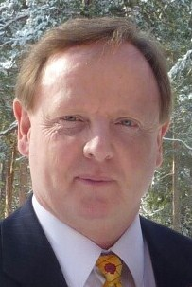
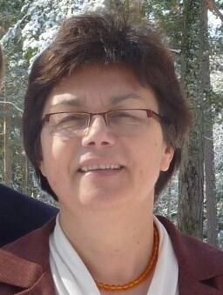
Positive psychology – What do we find?
Most positive outcomes come from the ‘heart cycle’
Heart – The Desire To Give of myself – into meaningful work or to others
Things I appreciate in you or in my work
When I find things to appreciate in you – I want to give to you even more (TRIGGERS love).
The more I appreciate the divine in you, the more respect I give you
When I have meaningful work – it triggers a desire to give
This is THE MOST IMPORTANT dynamic for happiness in marriage and satisfaction in the workplace
Successful couples create 5 positives for every negative

Slide 16
Positive psychology – What do we find?
Principles of Co-creation
The attitudes that I use when I enter relationships.
Through being triggered to give … I am pushed to grow.. All of me – my relationship and practical skills and knowledge
Being ‘In Flow’ – Joy that comes through full involvement in a meaningful activity Living a ‘meaningful life’ – Joy that comes through feeling my activities directly help others
Appreciation and joy are deeply linked. I can learn to be more appreciative. I can do acts that show I appreciate.. I can find joy
Heart
Appreciation

Slide 17
Positive psychology – What do we find?
Principles of Co-creation
The attitudes that I use when I enter relationships.
For best outcomes we need to learn to regulate All the Principles of co-creation (e.g. How can I find beauty in my wife today)
Healthy people learn the art of finding personal meaning in difficulties – they are opportunities. This brings the difficulty back into the heart cycle
The art of Forgiveness? Why is this important to personal well-being? And lastly, keep learning, keep being stimulated, keep finding the joy that comes with personal growth
Heart
Appreciation
Personal learning in challenges
Forgiveness
Keep learning

Slide 18
When our core-personality and the original mind – suffers trauma – the emotional pain and the victim attitudes get buried in our core personality
Traumatisation of my deepest self – my divine nature – gets buried in my core personality (subconscious) – hard to get at and heal
I get assaulted by a lack of healthy core values
I am not given a sense of being loved/valued
My Self identity – child of God with divine potential – is consistently questioned and denied

Slide 19
The presence of the traumatised self and the associated victim attitudes are then expressed through fallen natures (words and actions that don’t express God’s love) – that lack respect for myself or others.
Doormat Parent | Overly Critical Parent | Overly Controlling Parent
Under-developed Adult | Nurture P Protect P Sensible Adult Team PC Free C | Too Rational Adult
Compliant ‘Yes’ child | Hurt Child | Rebel Child

