Slide 1
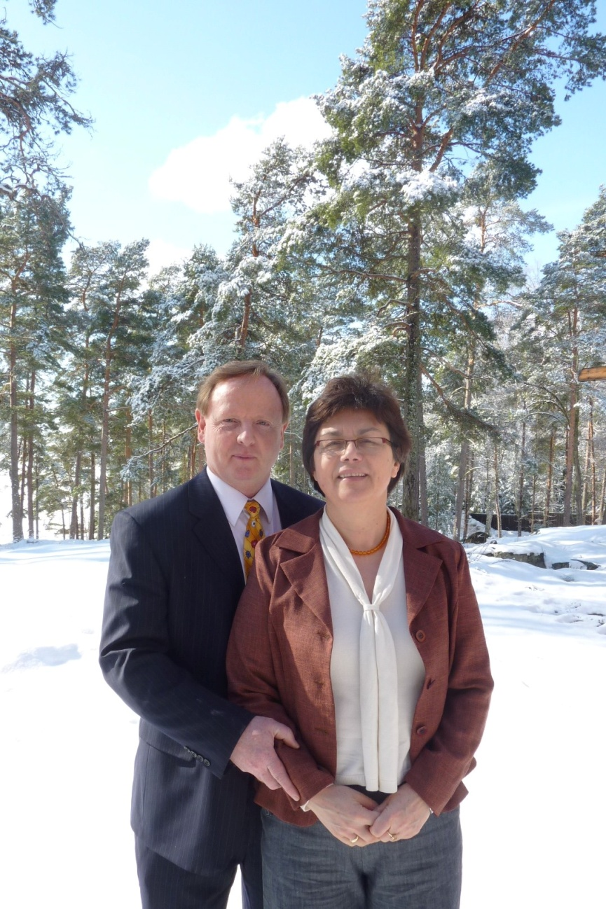
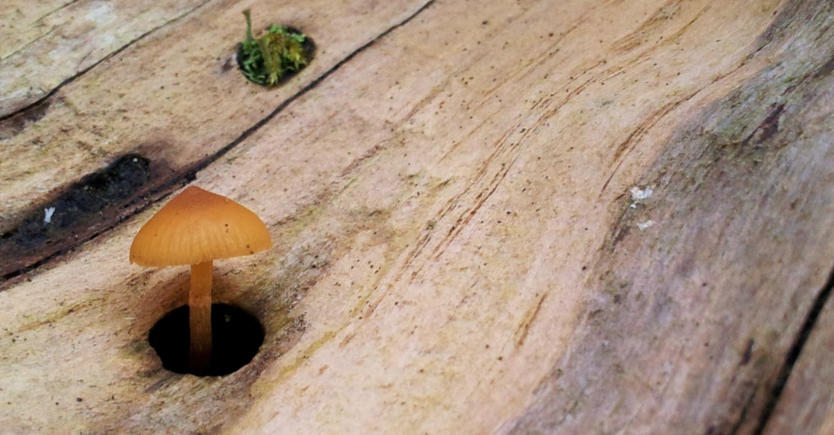
The 7 Principles of Creation
Stephen Stacey. 2007

Slide 2
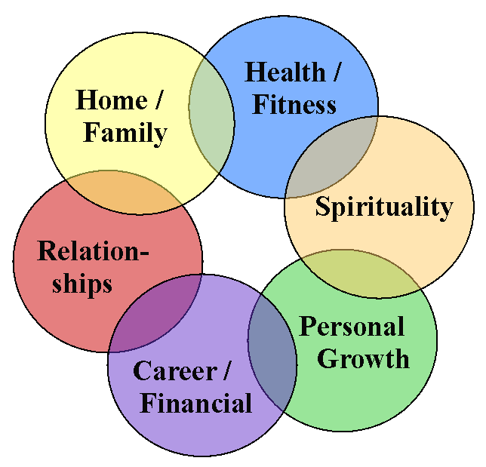
We all have a range of goals
The key question is:
Do we use completely different strategies in order to achieve each goal?
Or when we think about a goal in any area of life, do we use similar strategies (tailor-made for each goal) to ensure success?

Slide 3
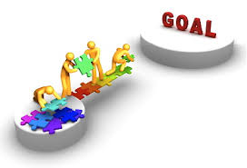
many life-coaches say similar things to completely different audiences when it comes to goal achievement
There are certain common principles in goal setting, goal achievement and continual improvement
We can call these principles the 7 principles of creation

Slide 4
Why is it valuable to understand the 7 Key Principles that lie in the middle of goal achievement?
Understanding these principles allows:
For better planning at the outset of any goal
For improved reflection on any desired goal as it nears achievement
For more insightful analysis of any ongoing project, company department, marriage, team – as it seeks to be improved

Slide 5
the 7 Principles of Creation
1 | The Principle of Identity – Clear Goal
2 | The Principle of Diverse Inputs
3 | The Principle of Give and Take (in order to create an agreed plan of the ‘Baby Steps’ forward)
4 | The Principle of Including Love, Beauty, Truth, Goodness, Joy and Meaning
5 | The Principle of Respect for all key stakeholders
6 | The Principle of the Growth of the Individual (in order to support the growth of the whole)
7 | The Principle of Feedback

Slide 6
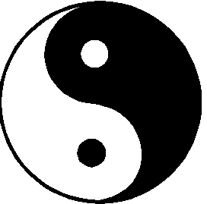
Principle 1 The Principle of Identity
To be successful, the first principle asks us to have a clear idea of what we want to achieve, what we want to become.
Body
Now we can use our resources to get there
Now we know where our department-marriage-team-project is heading
Now I can align my life style to achieve my goals
Mind
Clear idea of end identity
Clear goal or plan

Slide 7
Principle 2: The Principle of Diverse Inputs
We best achieve our identity or goals through Involving the skills, ideas and talents of a variety of people.
Questions such as:
Where can I/we get advice or support?
Who are the right people for this team?
Diversity improves outcomes when managed well

Slide 8
Principle 3 The Principle of Give and Take Action With a Clear goal in place - diverse inputs can then
Diverse input
Discuss and plan
Diverse Input
to create an agreed plan of the ‘Baby Steps’ forward

Slide 9
Principle 4 The need for truth, beauty, goodness, joy and meaning
Humans are more than seekers of practicality.
In everything we do we seek for truth, beauty, goodness, joy and/or meaning in almost everything we do or create. (TBGJM)
Questions such as?
How do we bring TBGJM into our home?
How does our product appeal to the TBGJM needs of our customers?
Why is the goal so meaningful for me?

Slide 10
Principle 5 The Principle of Respect for all Key Stakeholders
As humans we find we do best when we are treated with respect – and others do best when we treat them with respect.
All human systems that maintain health and flourish over a long period of time do so through the process of each stakeholder respecting the rights and needs of ALL the other key stakeholders in the eco-system.
E.g.; Disrespect your customers, staff, suppliers, etc at your peril

Slide 11
Principle 6 The Principle of the Growth of the Individual (in order to support the growth of the whole)
All systems mature or goals come to fruition through the growth and maturation of smaller parts of that system
In nature, a pride of lions grows in power as the health of each individual lion increases
As a baby grows in the womb, each individual aspect of the body grows to complete the whole
If just one member of a work team matures, the whole team benefits

Slide 12
Principle 7 The Principle of Maintaining Health and Continual Growth through Feedback
As human beings we constantly receive feedback from our actions or words.
This feedback can be as a result of self-reflection, through the response of others, or through outcomes
Feedback can be positive or negative – but either can be helpful as a pathway to growth
In nature – feedback systems are everywhere. E.g.: Choosing a mate; are small evolutionary steps useful or not; etc

Slide 13
7 Principles of Creation in a marital setting
1 | Identity: Marriage – fidelity, school of love, eternal,
2 | Diverse Inputs: Masculinity and Femininity – helps create a home and with parenting. Many books
3 | Give and Take: Communicate, common vision around finances, children, roles, leisure, etc. Many books
4 | Love, Beauty, Joy, Truth or Meaning: Dating, romancing, serving community, honesty, etc. Books
5 | Respect: No infidelity or abuse; no addictions; keep away from divorce. Many books
6 | Growth of the Whole through Growth of the Individual: Keep learning – books, seminars, etc
7 | Feedback: Praise, room for growth complaints, etc

Slide 14
7 Principles of Creation in a Business setting
1 | Identity: Brand name, product or service, etc
2 | Diverse Inputs: Who to hire. Diversity in age, experience, sex, race, profession.. All helps
3 | Give and Take: Communication processes, create common vision, project management, etc
4 | Love, Beauty, Joy, Truth or Meaning: Either in products or service; or to motivate staff
5 | Respect: for all key stakeholders. Also win-win contracts, no sexual or racial harassment, etc
6 | Growth of the Whole through Growth of the Individual: Keep training staff and managers
7 | Feedback: from customers, staff, product errors, etc

Slide 15
The 7 principles of Creation in Nature (A flower)
Identity – what kind of flower am I
The masculine and feminine create this flower
Various elements inside the flower work together in harmony to develop the flower as a whole
What TBGJM does the flower need to receive or offer in order to survive and prosper (e.g.: colour, smell, pollen)
The flower shows some respect (e.g. Doesn’t poison soil)
Various elements in the flower need to work on themselves in order to support the development of the flower as a whole
And feedback systems – are any small genetic changes helpful, am I strong enough to stand in the wind, etc.

Slide 16
Personal goal setting - Example
I want to promote my product through offering samples at supermarkets
Who are the key people who can help me achieve my goal
What key decisions need to be made and what communication processes will allow for this idea to succeed?
What are the TBGJM needs of my customers or the supermarket – what will inspire them
Who are the key stakeholders that I need to honour and respect on the way to achieve my goal?
Do I need to develop some skills in order to reach my goal?
And feedback – how can I learn from both my successes and failures

Slide 17
Even people who have evil intentions use the principles of Creation to achieve their goals – but they typically violate principle of respect
1 | Let’s invade and take over another country
2 | Who are the key people who can help us succeed
3 | Let’s discuss, plan, set up communication processes
4 | How can we motivate our army and population
5 | We respect the needs of OUR army and population
6 | What training will help our troops to succeed
7 | What feedback systems will help us understand what we need to improve.

Slide 18
Principle 1 – identity or goal– determines the rest of the other 6 principles
Once your identity or goal is determined then:
You chose the mix of people to support that identity or goal
Your communication structures and smaller goals are built to support that identity or goal
You have to ask what TBGJM is in that identity/goal
You ask who are the key stakeholders in that identity/goal – who do you have to respect?
You ask what kind of training of individuals is needed to support that identity/goal
And feedback systems – which best help the maintenance and development of that identity/goal
For this reason it is REALLY important that
your goal or identity is as clear as possible

Slide 19
In any healthy system – the principles of creation are typically at work on every level within that system – all aligning themselves in some way with the core identity or goal
Principles of Creation
Principles of Creation
Principles of Creation
Principles of Creation
Principles of Creation
Principles of Creation
Principles of Creation

Slide 20
Though it is really good to understand the Principles of Creation
Wholehearted, virtuous human
And
The Principles of Creation
Our key problem is that we are many times far from being wholehearted, virtuous human beings. Our core values, our inner sense of security, our attitudes, our inner traumas, etc – can all be far from ideal - making it difficult to be the spouse, parent, boss, employee, friend – we would like to be

Slide 21
About
Stephen Stacey has been lecturing at various universities in Finland for the last 12 years
In 2010 I developed an ‘inner world systemic’ model to complement the 7 Principles of Creation. This new model helps people understand how their inner world works – giving them greater ability to bring about better outcomes in all their significant relationships.
Email: sstacey700@gmail.com for a copy of this presentation
All rights reserved - 2007

