Slide 1
The Blessing Process for Married Couples seeking to receive the Blessing

Slide 3
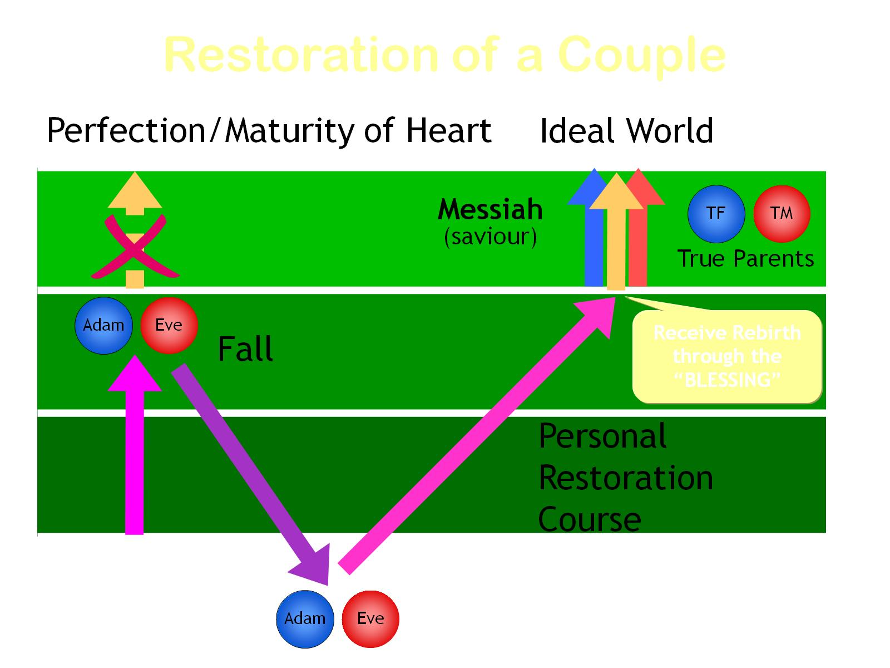

Slide 11
So ‘the Blessing’ includes a process:

Slide 12
The Blessing Vows:

Slide 14
They help us aspire to more than an ordinary marriage!

Slide 15
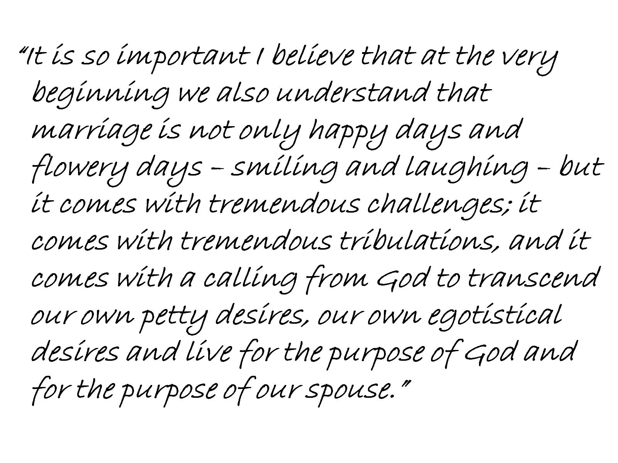

Slide 16
What does it mean to take responsibility for mistakes?

Slide 18
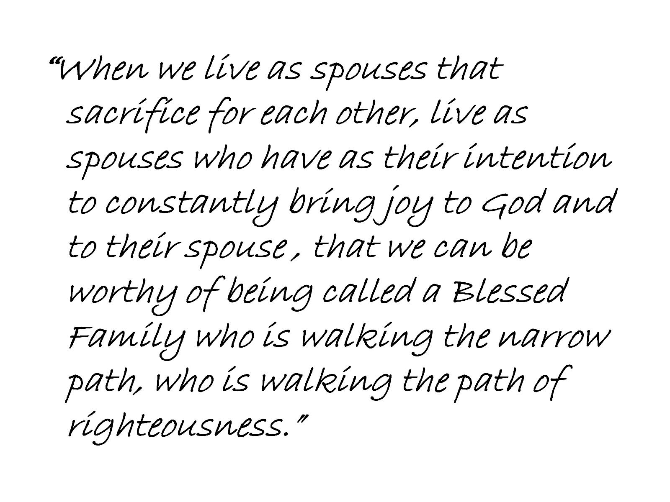

Slide 21
A life of Common Purpose

Slide 22
What gives us value or worth?

