Slide 1
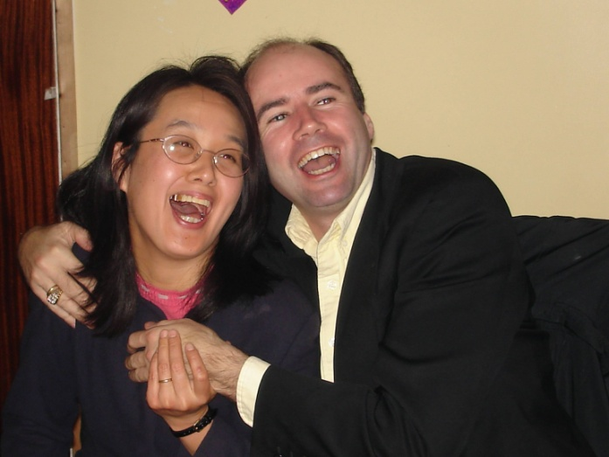
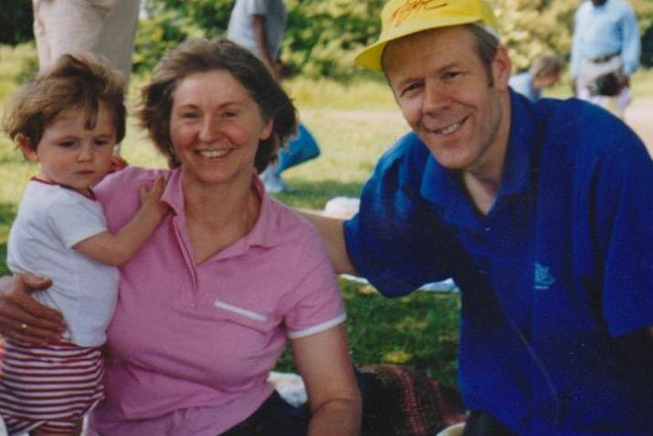
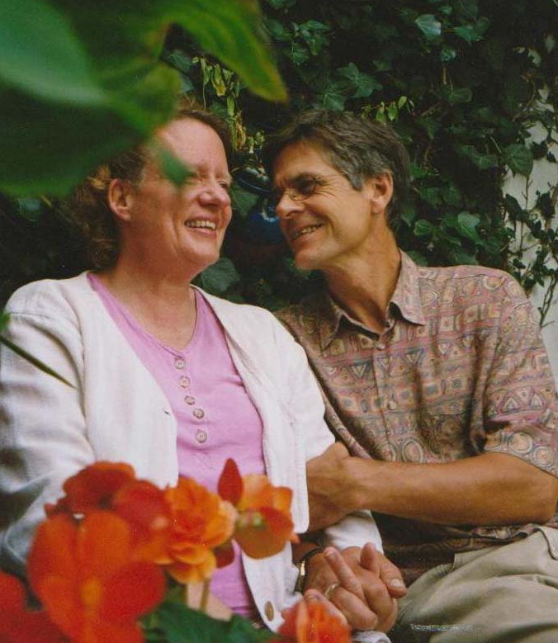
The Heart-Power Program – part 1
Notes:
Welcome to the Heart-Power Program! In this session we hope to highlight practical ways in which we can experience the joy of God’s Second Blessing (to marry and raise a family ), by understanding what the needs of man and woman are and how to approach filling those needs for each other.

Slide 2
A wise father said to his children:
“Don’t say, ‘Where is love?’ Don't say, ‘I expect love from my spouse.’ If you do, peace and love can never be realised within your family. There is no love until we put our love in.”
Father Moon
Notes:
Our focus is to understand what we need to give to our spouse ( ‘put my love in’ ), and a little bit about how that differs for men and for women.

Slide 3
As we consider renewing our marriage vows…
Let’s consider HOW do I
Become a source of
happiness for my spouse
– and ‘put my love in’ ?
Notes:
As we consider renewing our marriage vows… Let’s consider HOW do I become a source of happiness for my spouse – and ‘put my love in’?

Slide 4
The key is to give what my spouse needs:
to create happiness
to heal the heart
to support each other in all the work of making the purpose of marriage fulfilled:
Notes:
The key is to give what my spouse needs - to create happiness, to heal the heart, and to support each other in all the work of making the purpose of marriage fulfilled. That is actually what it means to fulfill the “Three Great Blessings”. This is what it means to make the Marriage Blessing truly sacred in practice.

Slide 5
God’s Three Great Blessings
The First Blessing - personal development
The Second Blessing - experiencing conjugal love, and raising children in security and joy
The Third Blessing - living responsibly in God’s creation

Slide 6
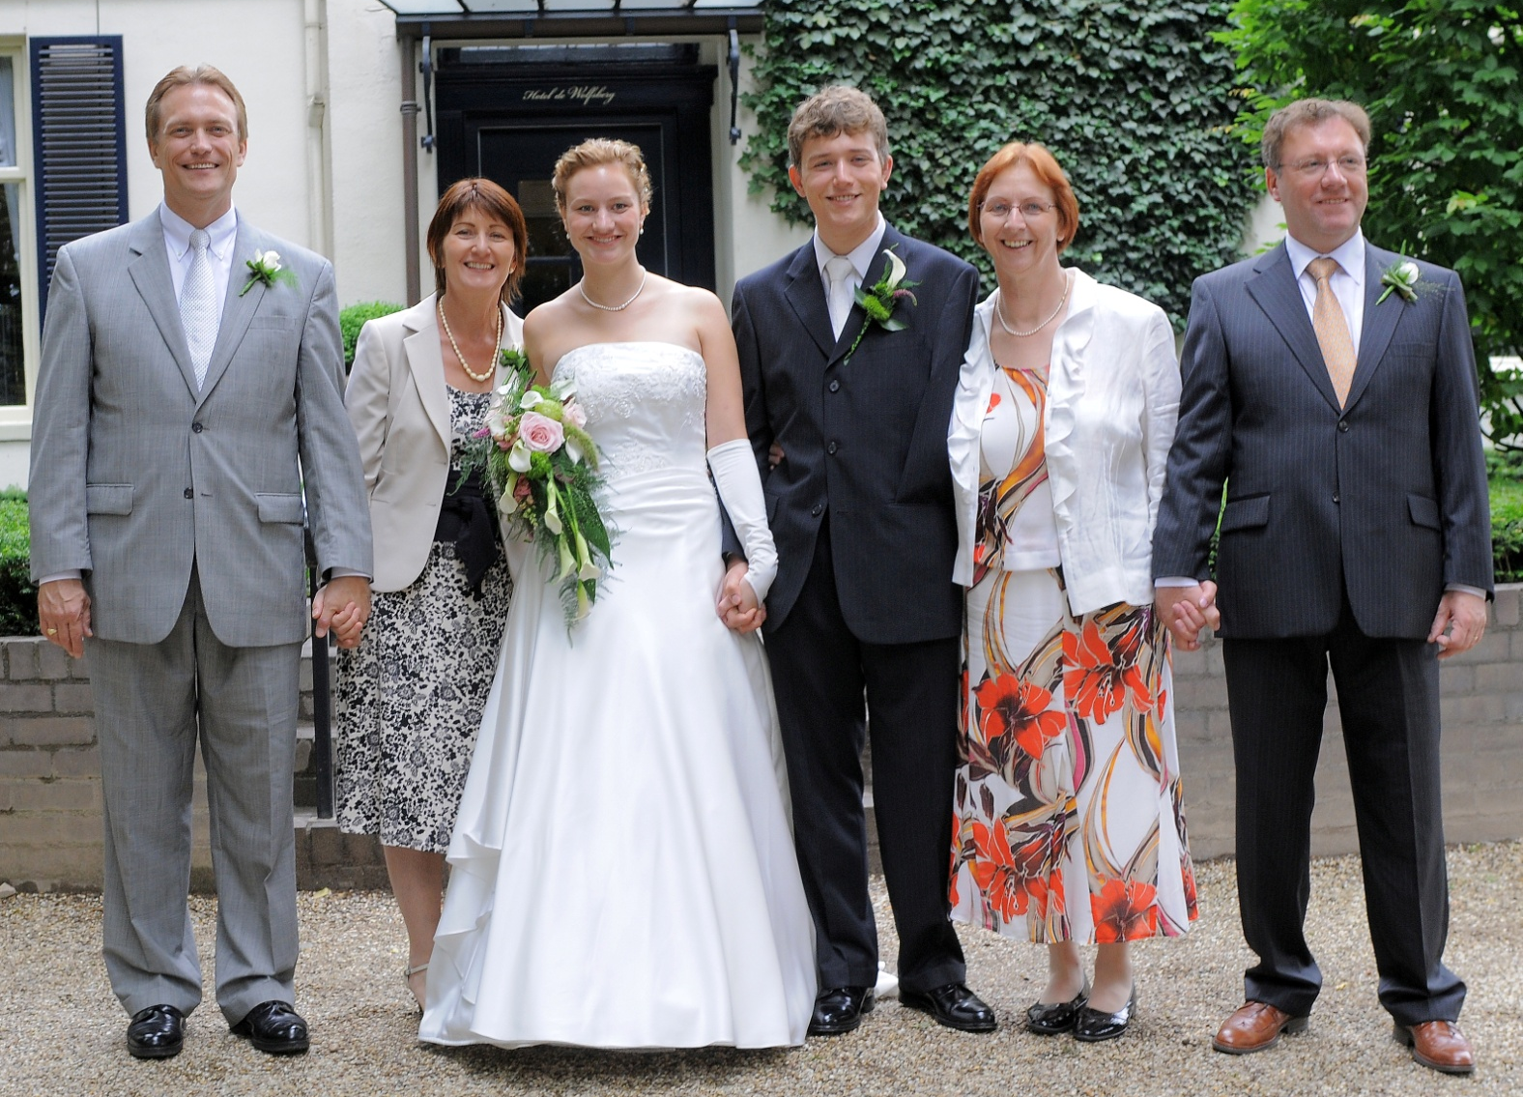
The Three Great Blessings
The Second Blessing is the Marriage Blessing
Notes:
The Second Blessing is Marriage and giving birth to children.

Slide 7
Give and Receive Action
“God created two kinds of human beings, giving men what women need and women what men need, in order to fulfil love.” - Father Moon
What is it
that men and women have
That the other needs?
Notes:
One of the Principles of Creation is about the power of ‘give and receive action’, which is essential for creating happiness in a relationship. Let’s take a look at what men have to give that women need to receive, and what women have to give that men need to receive.

Slide 8
Love
Men
Women
Respect
Notes:
When a man gives love to his wife she naturally receives that and responds with respect. When she gives respectful love to him, he is naturally encouraged and gives more love to her in turn. They are energised by this uplifting cycle. These qualities feed our deepest needs.

Slide 9
Love and Respect
MEN need to feel respected for who they are regardless of their performance.
It is their deepest emotional need
WOMEN need to feel loved for who they are apart from their performance.
It is their deepest emotional need
Notes:
We need love and respect as much as we need oxygen to breath. Not giving it is the same as stopping the oxygen supply. Would you purposely do that to your spouse?

Slide 10
Love and Respect
We need love and respect as
much as we need oxygen!
When we are deprived of the oxygen of the relationship, we panic. Then we tend to behave aggressively and defensively.
Notes:
We need love and respect as much as we need oxygen to breath. Not giving it is the same as stopping the oxygen supply. Would you purposely do that to your spouse?

Slide 11
Unloving
Men need respect
Women need love
Disrespectful
Notes:
When this cycle happens, there is conflict and misunderstanding. This is usually how arguments start.

Slide 12
When we have a conflict we usually feel deflated:
In those moments it helps to communicate in a new and different way, perhaps like this:
A wife might say, “I’m feeling unloved or hurt, was I disrespectful to you in some way?”
A husband might say, “I’m feeling insulted or rejected, have I been unloving to you?”
Notes:
What we need to remember is that women need to feel loved and men need to feel respected to be happy. “All you need is love” is not quite the whole picture.

Slide 13
When we have a conflict we usually feel deflated:
Try to remember and trust the heart of your spouse when it is difficult – we are crying out for our need to be filled( to be loved or respected ), but don’t know how to express it well.
Notes:
What we need to remember is that women need to feel loved and men need to feel respected to be happy. “All you need is love” is not quite the whole picture.

Slide 14
So, what is a husband’s love?
She needs face to face connecting, and some eye contact
She needs him to speak tenderly & let go of bitterness
She needs him to empathise and listen; let her have emotional intimacy before sexual intimacy
Notes:
A husband’s love looks like this.

Slide 15
So, what is a husband’s love?
She needs him to be a peacemaker who is able to say “I’m sorry” when it’s needed
She needs absolute commitment and fidelity for to her to be at peace
She needs him to treasure her above everything else
for more information about how to practice this, we highly recommend “Love and Respect” by Emerson Eggericks www.loveandrespect.com
Notes:
A husband’s love looks like this.

Slide 16
How can a wife fill her husband’s need for respect ?
Get in tune with his desire, and appreciate his desire for the following:
He has a need to work, and achieve something of value in his work
He has a need to protect and provide for his wife and family
He needs to feel her support as they lead the family together
Notes:
Perhaps respect is old fashioned, but husbands need it as much as ever.

Slide 17
How can a wife fill her husband’s need for respect ?
He needs to feel that his wife respects his opinion
He needs a shoulder to shoulder friendship rather than a lot of talking
He needs regular sexual intimacy
for more information about how to practice this, we highly recommend “Love and Respect” by Emerson Eggericks www.loveandrespect.com
Notes:
Perhaps respect is old fashioned, but husbands need it as much as ever.

Slide 18
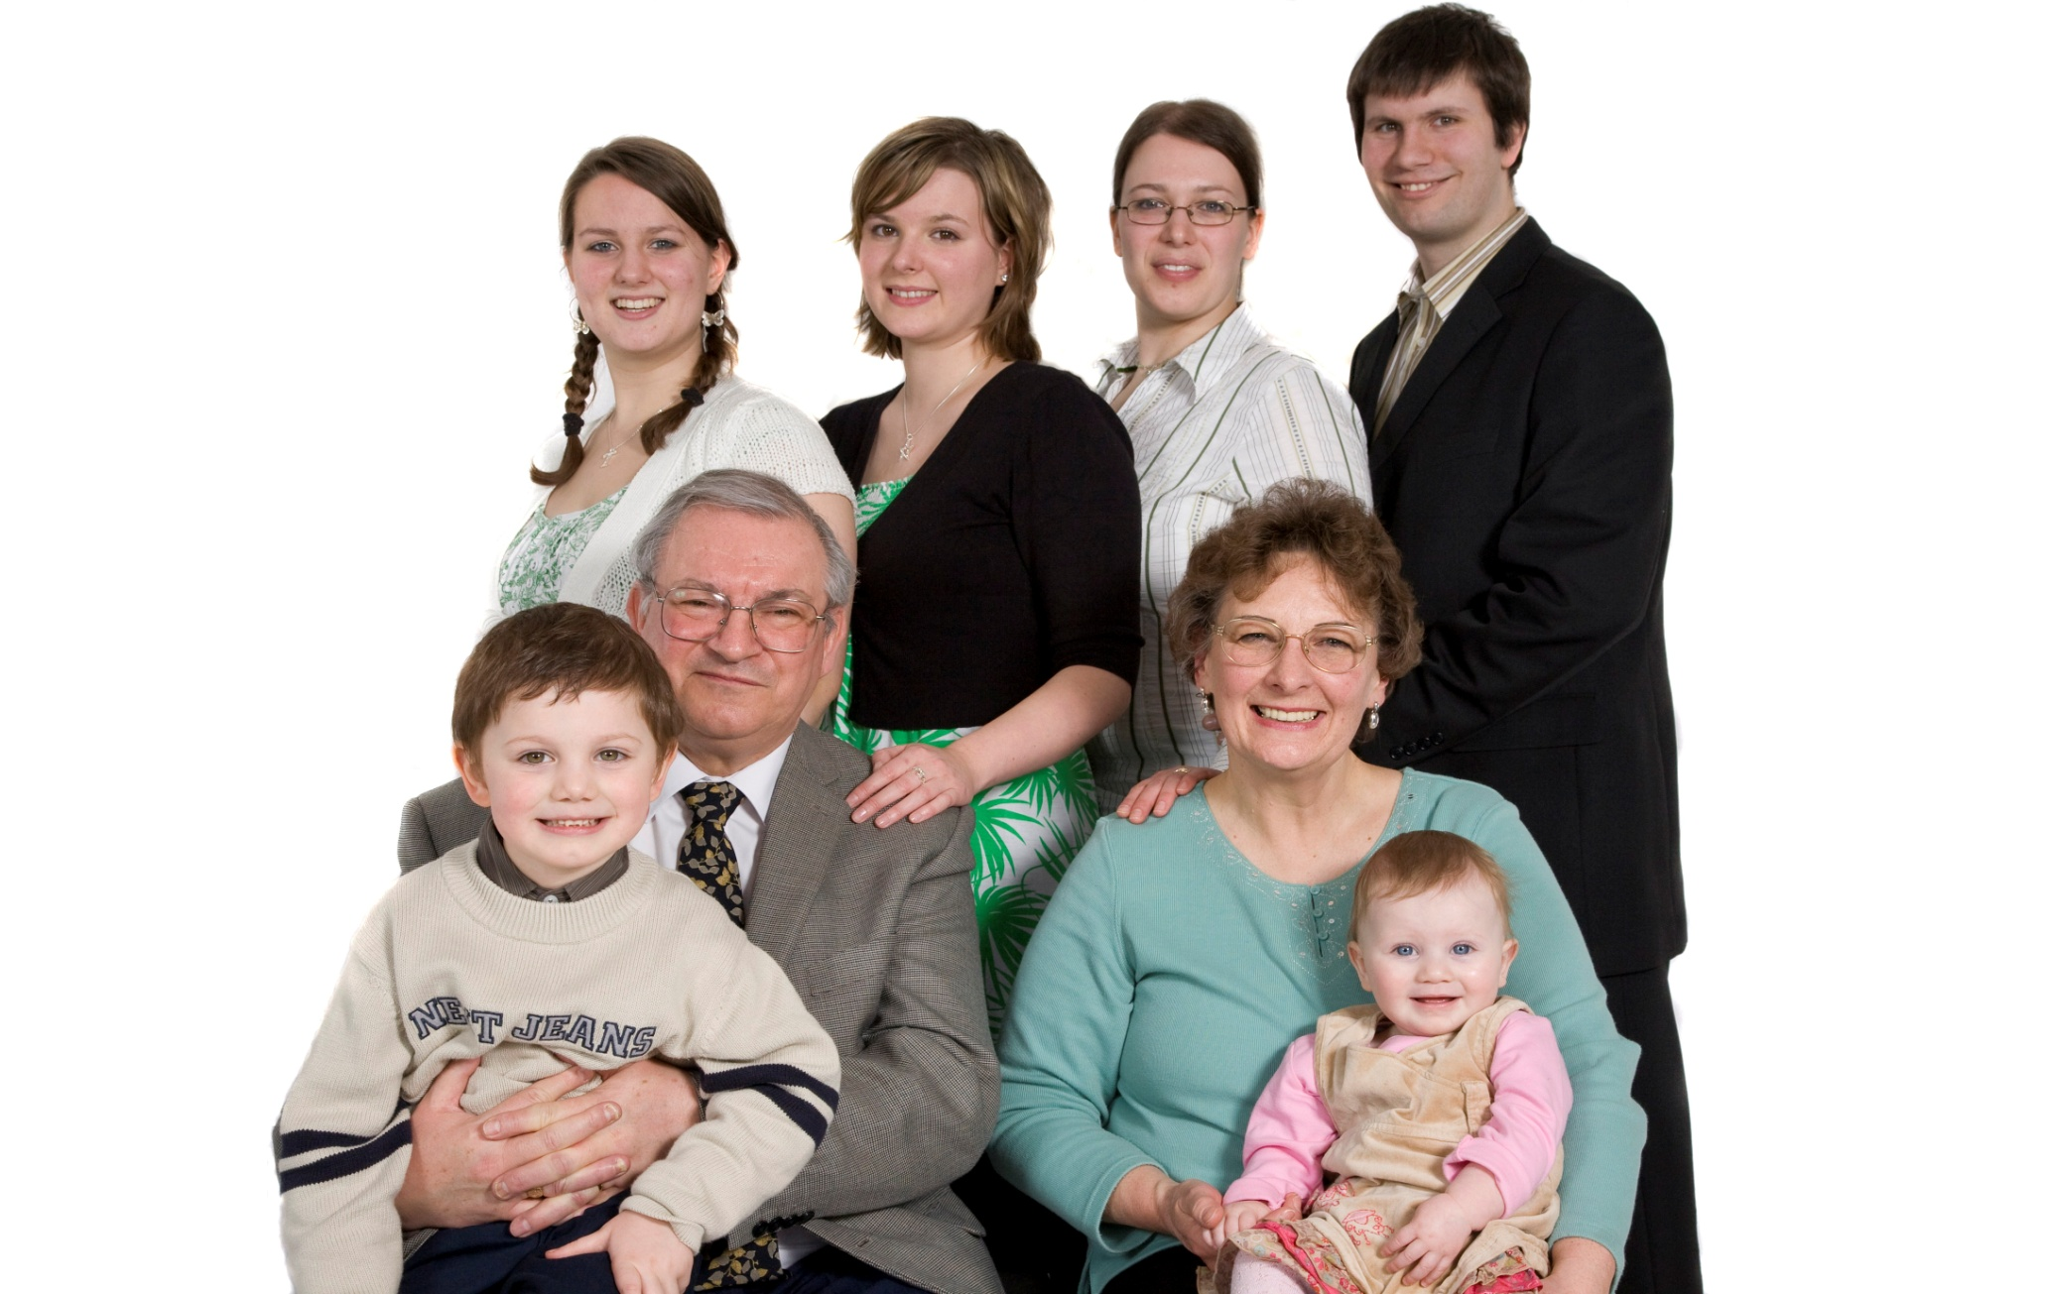
Four Great Realms of Heart
Notes:
Within a family we can learn and experience everything we need to know about love.

Slide 19
Here’s another way of looking at it
Human beings are created
to grow our hearts ( our ability to love and be loved ) in a family – which is ‘the school of love’.
Notes:
This is a natural process, and the values and elements of heart are all supplied through this mysterious experience of maturing through the ups and downs, challenges and accomplishments in all these relationships.

Slide 20
Here’s another way of looking at it
In that school there are 4 realms of heart
to learn about and experience:
Children’s - receiving love from parents
Sibling’s - giving and receiving from elder and younger siblings
Spouse’s - the conjugal relationship
Parent’s - unconditional giving
Notes:
This is a natural process, and the values and elements of heart are all supplied through this mysterious experience of maturing through the ups and downs, challenges and accomplishments in all these relationships.

Slide 21
Problems in these relationships…
…are sometimes caused by past
unhealed difficulties. Marriage can be
the source of healing, so…
Women………you can be:
spouse and lover
mother
sister and friend
or daughter
according to what your husband needs right now.
Notes:
Family relationships sometimes stir up pain from our childhood or past relationships. In our marriages we have an opportunity to heal those wounds.

Slide 22
Problems in these relationships…
…are sometimes caused by past
unhealed difficulties. Marriage can be
the source of healing, so…
Men………you can be:
spouse and lover
father
brother and friend
or son
according to what your husband needs right now.
Notes:
Family relationships sometimes stir up pain from our childhood or past relationships. In our marriages we have an opportunity to heal those wounds.

Slide 23
Some solutions - For Him
Spouse / Lover: Appreciate her; listen to her. Say “I love you”, be affectionate, have a candle-light dinner, wear nice clothes, be sensitive to her feelings, let yourself be heartistically close, learn how to become a good lover.
Father: Listen; be tender and compassionate. Do something to ease the burden, be firm and calm if she’s overwhelmed. Be understanding, embracing and compassionate. Be protective when she needs it.
Notes:
It’s good seek solutions rather than blame someone. When there’s difficulty in marriage we often blame our spouse rather than looking to oursleves to heal wounds in our heart coming from past relationship conflicts. If you find that you are conflicted, reach out for help; there are many wonderful programs available to support healing of people’s hearts. A list of good resources will be found at the end of part 2. and in an accompanying sheet of books, programs and web-sites.

Slide 24
Some solutions - For Him
Brother: Be fun-loving, spontaneous, even outrageous
Son: Recognise your inner child’s needs; ask for support and/or advice from your wife when you need it.
Notes:
It’s good seek solutions rather than blame someone. When there’s difficulty in marriage we often blame our spouse rather than looking to oursleves to heal wounds in our heart coming from past relationship conflicts. If you find that you are conflicted, reach out for help; there are many wonderful programs available to support healing of people’s hearts. A list of good resources will be found at the end of part 2. and in an accompanying sheet of books, programs and web-sites.

Slide 25
For Her
Spouse / Lover: Respond warmly when he’s romantic. Don’t reject his expression of affection. Help him to create time and space in your lives for romance.
Mother: Be sensitive and comforting when he’s ‘down’ or insecure. Be understanding if he’s depressed. Listen when he opens his heart to share; Don’t criticise, but be encouraging. Admire, appreciate and praise his efforts and success. Believe in him.
Notes:
It’s good seek solutions rather than blame someone. When there’s difficulty in marriage we often blame our spouse rather than looking to oursleves to heal wounds in our heart coming from past relationship conflicts. If you find that you are conflicted, reach out for help; there are many wonderful programs available to support healing of people’s hearts. A list of good resources will be found at the end of part 2. and in an accompanying sheet of books, programs and web-sites.

Slide 26
For Her
Sister: Have fun; keep your sense of humour alive. Laugh at his jokes. Tickle him. Share you dreams and plans.
Daughter: When you are hurt let him know. Ask for support and help directly; don’t expect him to know. Humbly learn from his wisdom and talents
Notes:
It’s good seek solutions rather than blame someone. When there’s difficulty in marriage we often blame our spouse rather than looking to oursleves to heal wounds in our heart coming from past relationship conflicts. If you find that you are conflicted, reach out for help; there are many wonderful programs available to support healing of people’s hearts. A list of good resources will be found at the end of part 2. and in an accompanying sheet of books, programs and web-sites.

Slide 27
This brings us to the end of part 1
In part 2
We’ll look at an exercise which is
also practical and effective.

Slide 28
Thank you for your listening!
Notes:
Welcome to the Heart-Power Program! In this session we hope to highlight practical ways in which we can experience the joy of God’s Second Blessing (to marry and raise a family ), by understanding what the needs of man and woman are and how to approach filling those needs for each other.

