Slide 1
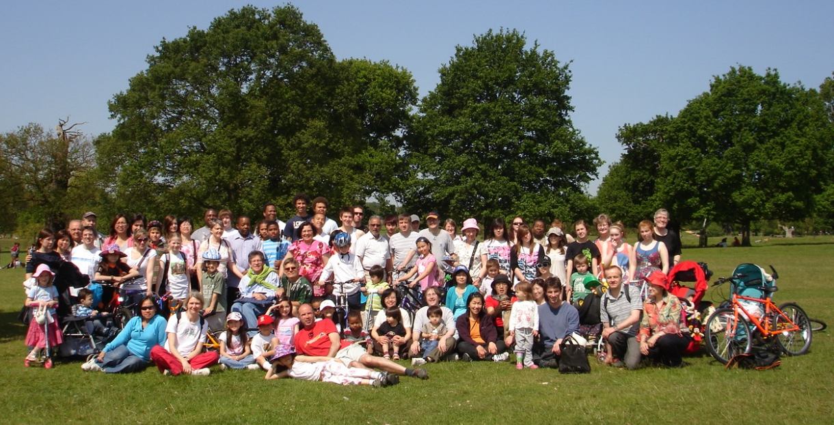
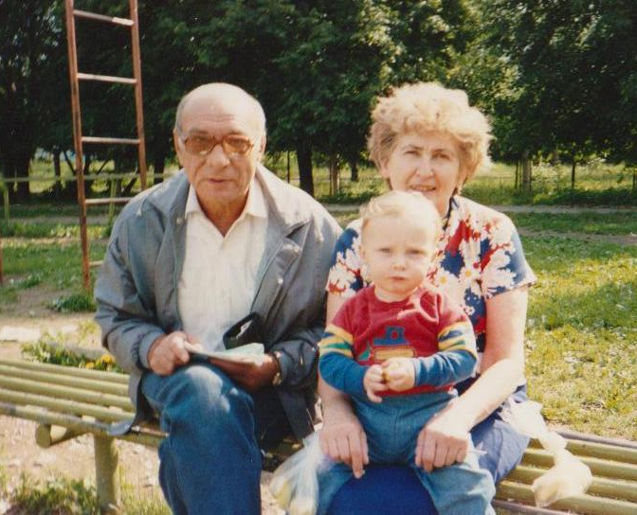
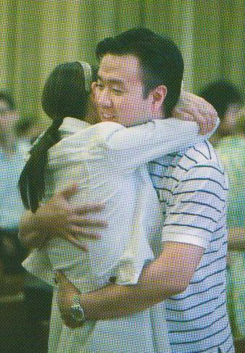
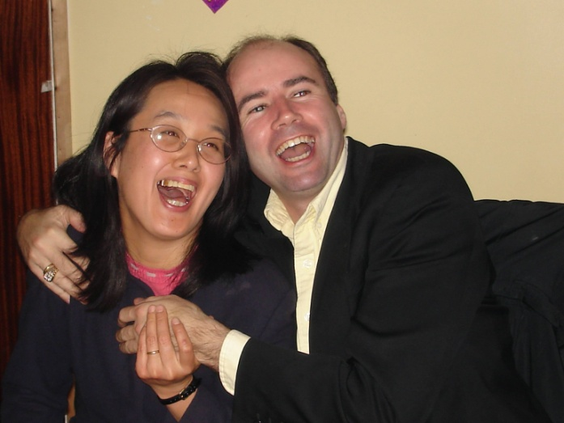
The Heart-Power Program – part 2
Notes:
Welcome back!

Slide 2
In part 1 we learned about love and respect.
In part 2 we’ll be looking at an exercise consisting of 4 steps that has helped many marriages.
First of all, we’re going to look at some back ground information
Notes:
Part 2 is going to be more practical.

Slide 3
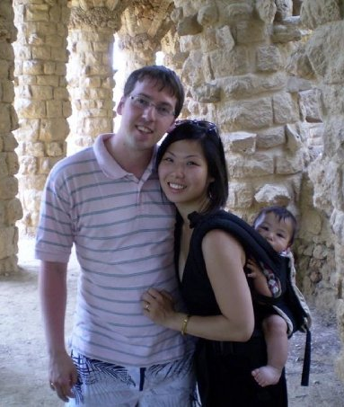
Love is a Verb
Growing our love and developing it requires action. On average couples end the ‘in love’ stage of their relationship after two years.
When that happens we need to make more conscious effort to keep love alive.
Notes:
According to Dr. Gary Chapman, author of “The 5 Love Languages”, on average it takes 2 years before a couple leave the time of the euphoria of ‘falling in love’, or the joy of the early romantic experience, and start to be aware of their own needs.

Slide 4
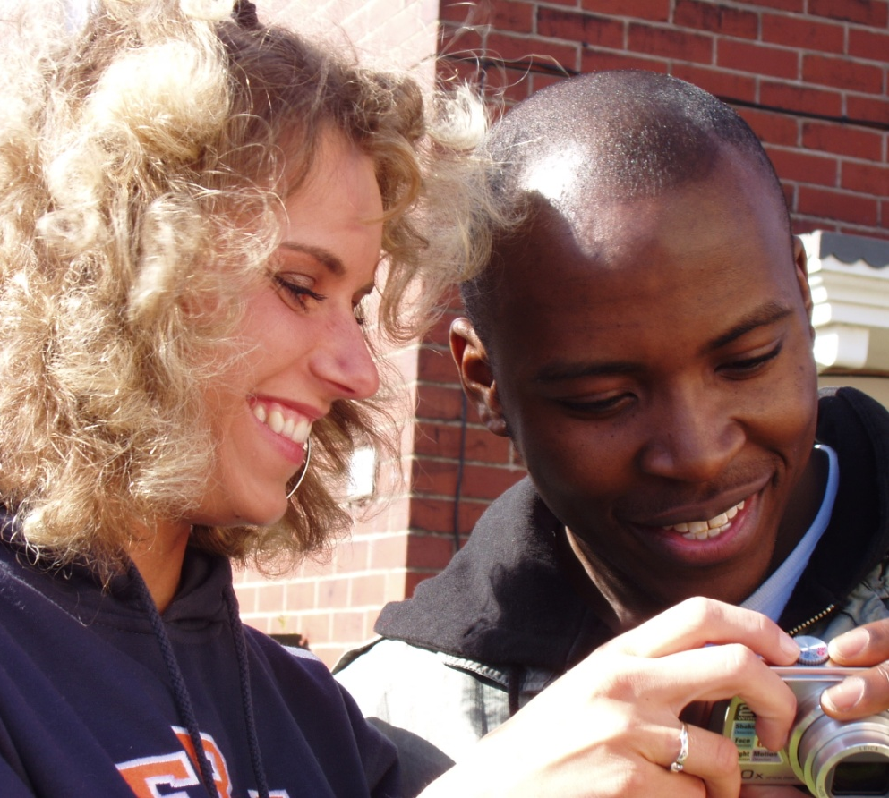
You can keep your relationship well- conditioned, and renew it too:
By practicing healthy thinking patterns
By consciously behaving in loving ways.
By repairing hurts through giving what your spouse needs
Notes:
Refresh your mind and heart towards each other

Slide 5
Build and repair your
connection of heart by:
IMPROVING - Make things a little better – you can’t do it all at once.
APPRECIATING - Allowing yourself to feel enriched by the good and genuine qualities of another person or something in nature or something human-made, like music or art which is beautiful.
Notes:
Appreciating – sometimes you need a break from the relationship to nurture yourself, and come back to the relationship renewed. Connecting – your marriage is enriched by your connection with the wider community.

Slide 6
Build and repair your
connection of heart by:
CONNECTING - Emotionally fitting together with another person or with something larger than oneself like God, nature, social causes or a community.
PROTECTING - Safe-guarding the emotional and physical well-being of another person.
help him relieve his dread of failure as a provider,
lover, protector and father help her relieve her fear of isolation (being alone), deprivation and harm (to herself or others).
Notes:
Appreciating – sometimes you need a break from the relationship to nurture yourself, and come back to the relationship renewed. Connecting – your marriage is enriched by your connection with the wider community.

Slide 7
Build and repair your
connection of heart by:
If you feel like :
blaming
withdrawing
attacking
Make a small
change to:
appreciate!
connect!
protect!
Notes:
Appreciating – sometimes you need a break from the relationship to nurture yourself, and come back to the relationship renewed. Connecting – your marriage is enriched by your connection with the wider community.

Slide 8
Four steps towards a better connection with your spouse
Hold your partner in your heart during four crucial times of the day
Hold positive thoughts about your relationship
Hug your partner a lot – at least three times a day
Make a contract to hand out love with compassion and generosity
Notes:
Some people believe we need a minimum of 8 hugs a day to be healthy!

Slide 9
Why should we do this?
Because when you connect with positive thoughts, hugs and a compassionate heart, the needs of both the man and the woman will be met.
When you don’t connect well, or hurt each other there is a hormonal reaction – cortisol is secreted – and you feel really bad.
The bad feeling is meant to urge you to make a positive change – which will allow the hormone serotonin to be secreted making you both feel good!
Notes:
Scientific Research is showing the correlation between our behaviour and hormones – when you behave wisely, that will make you feel better. (Note to the lecturer – please read “How to Improve your Marriage without Talking about it.” by Patricia Love and Steven Stosny for more information about this scientific research.)

Slide 10
As we saw in part 1, men & women are different in the way we respond
Talking makes women move closer, but it makes men move away.
Men have a heightened sensitivity to feel shame and inadequacy, for example when they are criticised or nagged at. Shame may lead a man to hide and not speak about it, but show it with annoyance, impatience, anger or shutting down.
Notes:
This slide is describing the different sensitivities of men and women.

Slide 11
As we saw in part 1, men & women are different in the way we respond
Women feel fear of being isolated and shut out very strongly, for example when their husband doesn’t answer them, or if they are left too often alone with children in a ‘nuclear family’.
Of course, women feel enormous fear and anger if they are verbally, emotionally, sexually or physically abused.
Notes:
This slide is describing the different sensitivities of men and women.

Slide 12
Connection and Compassion
Love is about connection without hurting each other … but not necessarily about talking-communication.
Many people feel more love from a hug and physical intimacy than talking about feelings.
Notes:
There are many ways to express your love other than talking about your feelings

Slide 13
Connection and Compassion
Positive, encouraging words and generous acts of service as well as positive thoughts sent to each other all create a positive hormone response … serotonin is secreted, which creates calmness and relaxation and a sense of well being.
Being generous towards your beloved with your time and resources also makes them feel cared for.
Notes:
There are many ways to express your love other than talking about your feelings

Slide 14
So, when we make mistakes
and hurt each other…
Men will tend to feel ashamed, and withdraw, or attack
Whereas women tend to feel afraid, and become anxious and demanding, nagging or complaining
So the four steps are designed to transform the shame and fear into connection and compassion
Notes:
There are many ways to express your love other than talking about your feelings

Slide 15
Step One
Hold your partner in your heart
During four crucial times of the day
Focus your attention on keeping him/her close to your heart. Write with a brief phrase that acknowledges your partner's value to you.
e.g. “ He gives my life purpose”, or “She is teaching me how to love” or “ He/She is the reason we have joy and love in our family”
It can include simply reaching out your hand for a brief touch or making eye contact, or both.
Notes:
Note to the staff: This is the time to give out the worksheet. Step One

Slide 16
Repeat this phrase (silently) or the simple gesture at 4 crucial times of the day
When you wake up
When you set out for work, or begin the daily tasks
When you return home from work or begin the evening time
As you lie down to bed at night
This gets a line of positive thought between you and your spouse going from the very beginning to the end of the day.
Notes:
Here are the four times of day to repeat your mental phrase about the value of your spouse to you

Slide 17
Step Two
Hold positive thoughts about
your relationship
Several times in the morning and afternoon - as often as you can - stop for ten seconds to think positive thoughts about your partner and your relationship. Write three on your worksheet... e.g.
1. He/she is sincere
2. He/she is generous
3. We take time for deep communication every week
Notes:
Note to the staff: This is the time to give out the worksheet. Step One

Slide 18
Step Three
Hug your partner at least three times a day and hold it for a long warm embrace
This kind of embrace increases
seritonin levels to give a
general calming effect. When
you hug, give compassion and
Gratitude for your blessings,
And consciously sooth away
His shame and her fear with
Your attitude of respect and
love, caring and tenderness.
Notes:
Note to the staff: This is the time to give out the worksheet. Step One

Slide 19
Step Four
Make a decision (perhaps even a contract with yourself) to hand out
love with compassion and generosity
Decide on at least one thing you will do every day to express ‘loving kindness’.
e.g. 1. Thank him/her specifically for something they do each day
2. Write a love/gratitude note and put it some where for him/her to find.
Notes:
Note to the staff: This is the time to give out the worksheet. Step One

Slide 20
Step Four
Make a decision (perhaps even a contract with yourself) to hand out
love with compassion and generosity
3. Do something new to show your love…make him his favourite food, or
buy her a little gift or write her a card
with sincere sentiments expressed, or do
an extra chore with a cheerful heart.
4. Write a card or note expressing what you respect and admire about him.
Notes:
Note to the staff: This is the time to give out the worksheet. Step One

Slide 21
The contract might read like this:
In return for the privilege of loving you ……….., I commit myself to the following generous gesture/s:
1. ___________________________
2. ___________________________
3. ___________________________
One of the amazing and wonderful things about this approach is that - once you decide what to do and fill up your work sheet - it takes less than 5 minutes a day to do. But that 5 minutes will be effecting your whole day positively.
Notes:
This approach doesn’t take a lot of time, but makes a big impact. ( Note to the lecturer - So those are the four steps. Now let’s look at the importance of community before everyone fills in the worksheet )

Slide 22
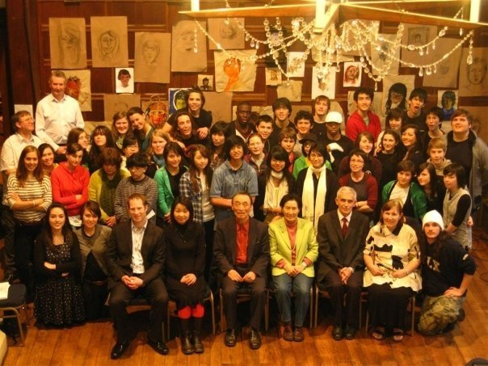
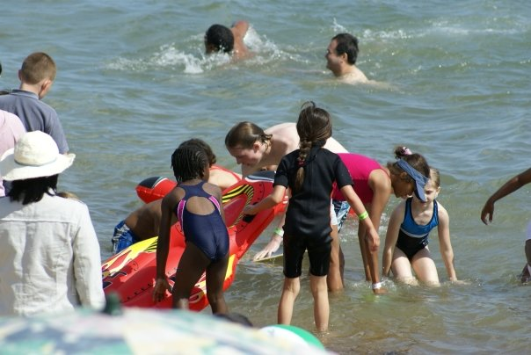
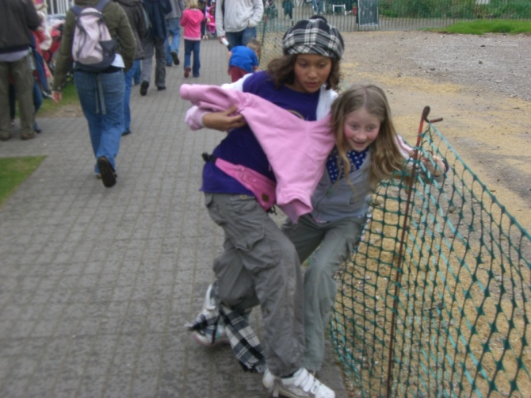
Some experiences of heart come through relationships in a loving community
Notes:
Families thrive in a loving community.

Slide 23
Experience being part of the World Peace Blessing Community
Study more about the Principles of Peace
Mentor the younger couples
Have family fun times together as a community
Reach out for support when you need it
Create a culture of heart together – sing dance and celebrate together
Solve social problems through service
Start up a local support/social/ service group or join one that is already active
Notes:
Building the World Peace Blessing Community is the work of each one of us

Slide 24
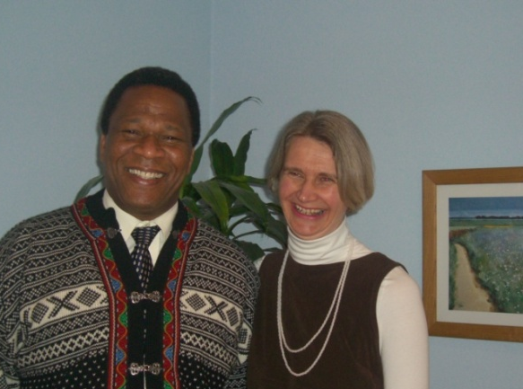
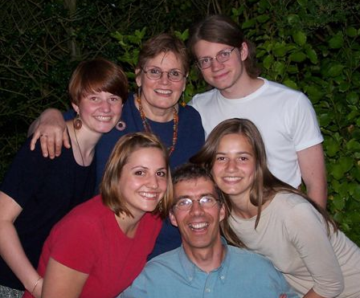
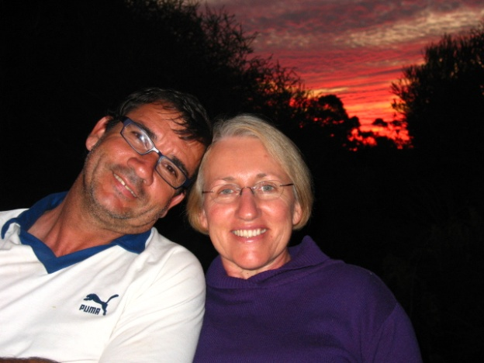
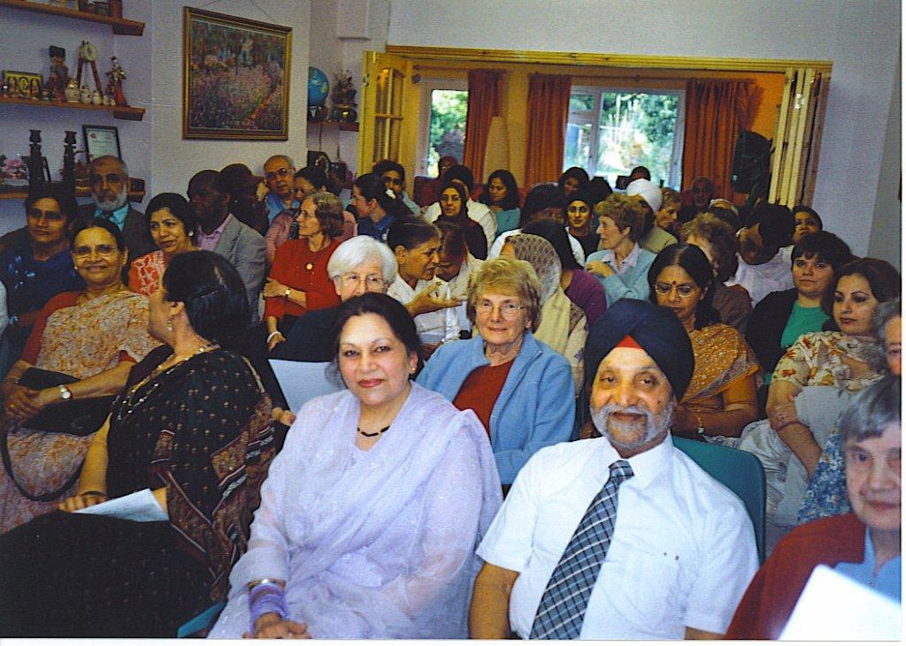
Notes:
Blessed Couples from all over the world, and community meetings organised by them.

Slide 25
Please take 10 minutes to write
On your work sheet. Fill in steps one, two and four.
This program would be a good choice for you to focus on while
you are offering 40 days of purification and renewal after
the World Peace Blessing
Notes:
Time for an exercise

Slide 26
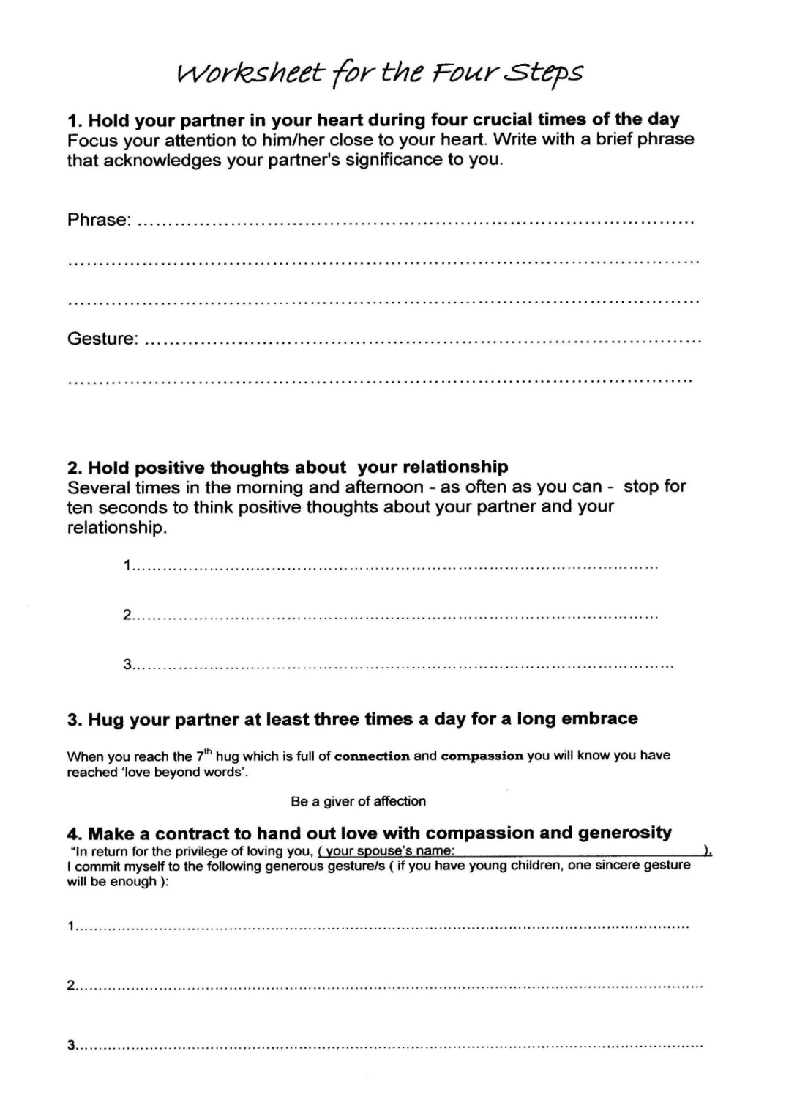
Writing down your goals is a powerful way to help you get started.
Notes:
Writing your goals gives you more power to reach for them

Slide 27
Special thanks to those who have inspired us with their ideas:
Emerson and Sarah Eggerichs - “Love and Respect”
Steven Stosny and Patricia Love - “How to Improve your Marriage without Talking About it - Finding Love Beyond Words”
Harville Hendrix and Helen La Kelly Hunt – for being united in their marriage enrichment work and showing the example of how to listen and create a sacred space.
Gary Chapman – “The 5 Love Languages”
Father and Mother Moon – “The Four Great Realms of Heart”, “The 3 Great Blessings” and much more.
Smart Marriages Coalition – Diane Sollee, Director
Notes:
Here we acknowledging some of the sources of the ideas and inspiration behind the Heart-Power Program

Slide 28
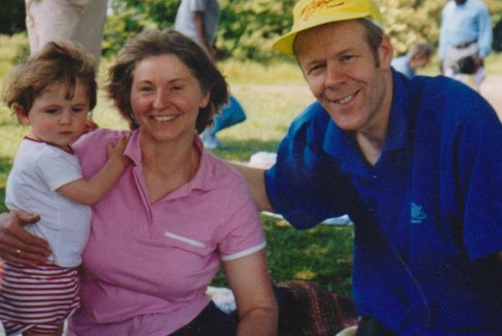
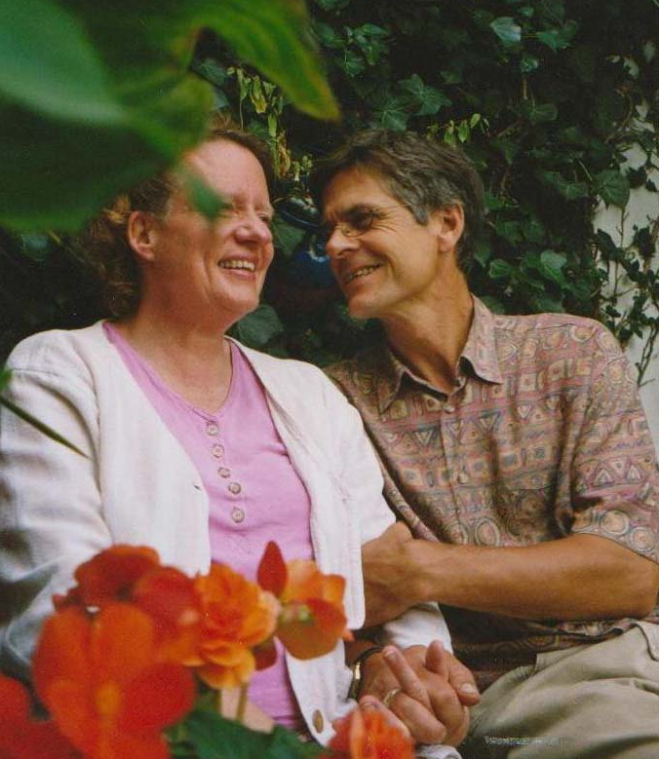
Thank you for your listening!
Notes:
Welcome to the Heart-Power Program! In this session we hope to highlight practical ways in which we can experience the joy of God’s Second Blessing (to marry and raise a family ), by understanding what the needs of man and woman are and how to approach filling those needs for each other.

