Slide 1
The Value of Marriage To Society
By Stephen Stacey

Slide 2
Section 1: What is Marriage We are all part of the circle of life
We are tiny part of the history of mankind.
In some ways we are just caretakers – making sure we keep the best of what past generations developed, and
In some ways we are creators – making sure we add our own positive contribution so future generations benefit
The key to human development: “Can my children be slightly more caring, slightly more intelligent, slightly better at building intimate relationships, and slightly less traumatized - because of my input into my family?”
If my overall contribution is positive, then the future of my descendants is more secure. If my overall contribution is negative – my family tree takes a step backwards and future generations may suffer.

Slide 3
Every species of animal has discovered their way of raising their offspring so their species survive for millions of years – and they do it just that ONE way
Harem style – alpha male has several ‘wives’ who raise offspring in groups
Lay hundreds and hope 1 or 2 survive
Pair bonding eagles
Each of these ways of raising children allows each species to receive nature’s blessings of survival and well-being. If they changed their family structures to a different one – they probably would become extinct within one generation

Slide 4
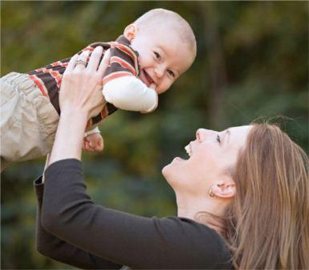
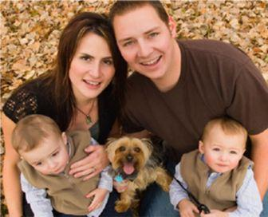
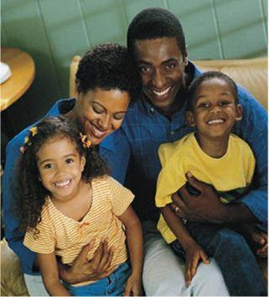
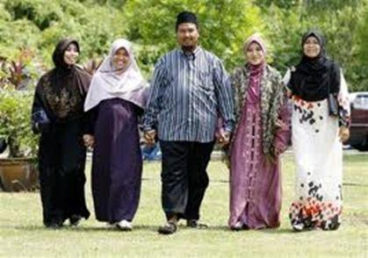
What about us – Do we just have ONE type of family structure that allows us to receive nature’s blessings of survival and well-being OR are we so flexible that we can have multiple family forms and do just as well?
OR
Cohabiting with children
Single Mother – never married or divorced
Only This?
Heterosexual marriage with children
Polygamy

Slide 5
What is Marriage? – Current definition
Union of a man and a woman
A desire to make a permanent commitment and to offer sexual exclusivity towards each other
IN ORDER THAT
The children created by their love benefit – behaviorally, materially and psychologically
I pass on the good qualities of my ancestors + plus add my own positive creative input so that my children have more positive qualities than I have. Marriage and family building, when done reasonably well, brings about ‘lineage improvement’

Slide 6
The marital commitment allows parents to INVEST so their children benefit in 8 Key ways
Children’s health and material well-being
Children’s emotional well-being
Their educational attainment
Disciplining and moral development
The family is a school of love – learning important social skills – forgiveness, tolerance, altruism, etc
Protecting the children from abuse in any form
Modelling of a couple relationship so children have some successful strategies when they build their families
Extended family love and support from both sides of the family
If parents do their job well – lineage improvement occurs.

Slide 7
Worldwide research over 60 years is clear: Best outcomes in ALL 8 areas occur when children are raised by their two, married, biological Parents – by the people who brought them into the world. on average, they have far better outcomes in every area – when compared to children raised in -
Single parent homes, never married
Single parent homes, divorced
Cohabiting couples with children
Step-parenting homes
Children raised by same-sex couples
All other family constellations
Marriage is the most successful family constellation for creating ‘lineage improvement’ – the next generation is a bit better than the last

Slide 8
What is Marriage: – the circle of life moves forward
Society should try to help more children grow up with their two biological, married parents in a reasonably healthy, stable relationship – not to pay respect to a Victorian idea of proper behaviour, but because the overwhelming consensus of research shows that's the very best way to raise children.
Theodora Ooms, Center for Law and Social Policy, USA

Slide 9
It’s important to note that EVEN IF a couple are going through a rough patch, or even if they moderately struggle for several years – they still offer their children most of these benefits
Health/material well-being | Educational attainment
Emotional well-being | Protection from abuse
Modelling of the couple relationship | Disciplining and moral development
Family is a school of love | Extended family support
Once parents separate it just becomes more complicated to maintain these benefits. Some divorced husbands and wives work very hard to fulfil their parental roles and the children are still very protected. Others struggle and the children lose more of these benefits as a result.

Slide 10
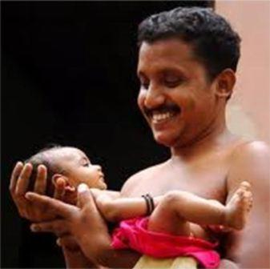
With the marital commitment and fidelity in place – Husbands also, On Average, Do Better on every Social Scale
It allows men to channel their natural sex drive into something that has positive outcomes for society
It allows men to enter into community building - helping them move from independent thinking to thinking about how they can use their life to benefit others – and to find meaning through focusing on homebuilding and child rearing

Slide 11
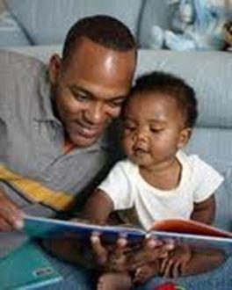
“Because of divorce, young men in England and Germany have become much more prone to criminality, drug abuse, and sub-criminal disorder.”
Norman Dennis, University of Newcastle, UK
“When men and boys embrace the norm of stable married life, violence and disorder decline, and peace ensues as men become stakeholders in community life”
Sociologist David Courtwright

Slide 12
Even in today’s imperfect marriages, a woman who has a husband, on average,
Is better protected from physical harm or sexual abuse
Is more protected from depression,
Thus drinks less or takes fewer drugs
Is less likely to indulge in risky behaviours to get love
When compared to women in other forms of relationship

Slide 13
married partners, On Average, Do Better on almost every Social Scale
Wealthier
Healthier (eat better, more money for health, etc)
They have better sex because of trust
And are generally happier – life has meaning.
– when compared to cohabiting couples, single mothers and divorcees

Slide 14
Conclusion What is Marriage – Not Just a Piece of Paper
Marriage – EVEN WITH all its ups and downs – is, by far and away, the healthiest form of family constellation we know of. Opposite-sex marriage stands as best practice for some 98% of humanity
True, it is not perfect for everyone, and things go wrong sometimes, and in many cultures the structure of marital relationships can be improved – but still - things go wrong far more often in other forms of family constellation
See: Why Marriage Matters: 30 Conclusions from the Social Sciences
www.americanvalues.org/pdfs/dl.php?name=wmm3-30-conclusions
When Couples Part: Understanding the Consequences for adults and children
www.oneplusone.org.uk/publications/whencouplespartexecutivesummary.pdf

Slide 15
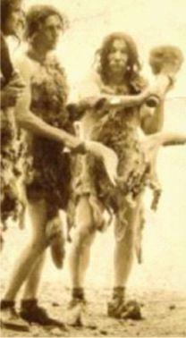
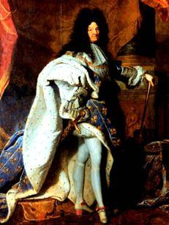
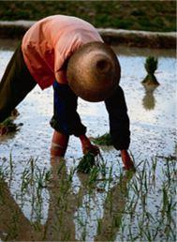
Conclusion What is Marriage – Not Just a Piece of Paper
Lineage improving opposite-sex marriage has been at the core of many societies of thousands of years. It slowly but surely created the social stability which has allowed society to move from:
The rise of democratic traditions
Economic development
See Books:
The Case for Marriage – Linda Waite and Maggie Gallagher
The Marriage-Go-Round – Andrew Cherlin
The Unexpected Legacy of Divorce – Julia Lewis and Sandra Blakeslee

Slide 16
Conclusion What is Marriage – Not Just a Piece of Paper
In 1915, every major culture and almost every minor culture in the world was a ‘marriage affirming’ culture. In the ‘survival of the fittest’ cultural battles across world history - ‘marriage-affirming, lineage-improving’ cultures had proved the most successful strategy in creating national strength and well-being.

Slide 17
Section 2: Why marriage is important to society At the start of the 20th century, why didn’t we see ANY cultures in the world that were mainly:
Single Mother – either never married or divorced
Cohabiting with children
And only a few cultures that accepted TIGHTLY REGULATED polygamy

Slide 18
We didn’t see such cultures because if they ever existed -
They eventually collapsed
WHY?
Instead of being ‘lineage improving’ cultures - they become ‘the next generation is slightly more damaged – lineage weakening’ cultures
Over time, the society becomes so weak that it is easily destroyed by invaders or other forces.
In today’s world, lineage weakening leads to state bankruptcy and the collapse of social health

Slide 19
How do marriage denying cultures become weak – leading to collapse? We’ve seen that married parents, on average, offer their children support in 7 key areas
This leads to a situation where about 85-90% of children reach adulthood without having major trauma as part of their lives. Though 10-15% of children have some form of trauma – there is enough social strength and money in the system to support them – thus social stability and development is ensured

Slide 20
When children are raised in ANY other form of family the rate of trauma is higher – Children are just more likely to be negatively affected in any of the 8 areas
Research from around the world shows that children raised in other forms of family have about a 65-75% chance of reaching adulthood without having trauma as part of their lives. The remaining 25-35% of children have some form of trauma – many very deep. Such a high rate of trauma leads to a collapse of social norms and is financially unsustainable on a social level

Slide 21
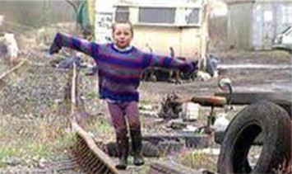
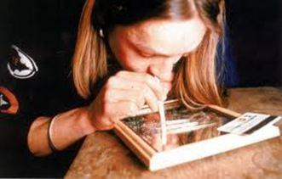
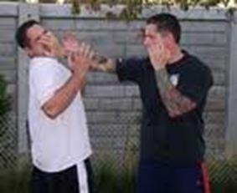
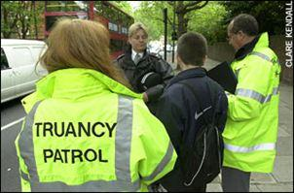
Children are more likely to suffer from traumas if they are not raised by their own married, biological parents
Material well-being and health trauma | Living on the poverty line, eat unhealthily, no hobbies, live in deprived parts of town, etc
Emotional traumas | I don’t feel loved – leading to drugs or alcoholism, self-harm, depression, suicide, living on medication, psychiatric needs, etc
Moral development traumas | Increases in crime, violence, bullying, prison, vandalism, gang culture, binge drinking, etc
Education attainment traumas | Drop out of school or college, poor academic record, classroom disruption, truancy, etc

Slide 22
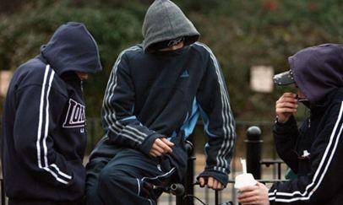
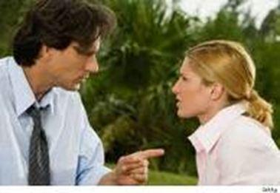
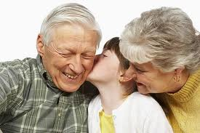
Children not raised by their own married, biological parents are more likely to suffer these traumas
School of love traumas | Harder for the children to learn important social skills – more anger and resentment, selfishness, lack of empathy, etc
Child abuse traumas | Higher rates of sexual or physical abuse – which might lead to host of traumas when reaching adulthood
Modelling of the couple relationship traumas | Fear of marriage, fear of having children, walk away when marriage gets a bit difficult, a spiral downward effect, etc
Separation from extended family love traumas | Sometimes children are cut of from the love and support of grandparents or significant others

Slide 23
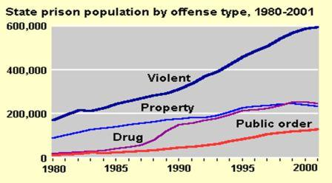
Thus we can see similar graphs in every developed nation – as divorce and single parenting increased – so did trauma rates in the children e.g.: USA
www.ojp.usdoj.gov/bjs/glance/corrtyp.htm

Slide 24
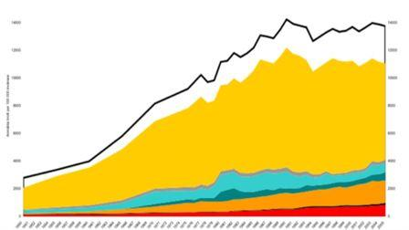
As more children are raised outside of marriage – social trauma increases –
e.g.; Total crime- Sweden 1950-2005

Slide 25
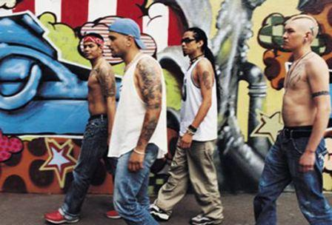
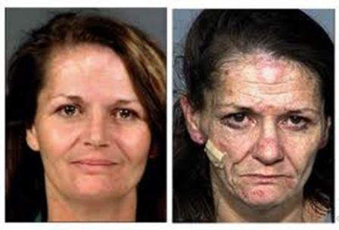
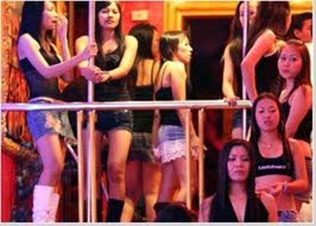
As marriage breaks down – More and more people lose their healthy social skills – skills that often took GENERATIONS to develop – and social norms collapse
Men who struggle to be fathers
Increased depression in single parents leading to increased drug abuse leading to poorer parenting
Increasing numbers of young women now develop behaviours that make it harder for them to raise their children successfully
Soul destroying prostitution increases in almost every country

Slide 26
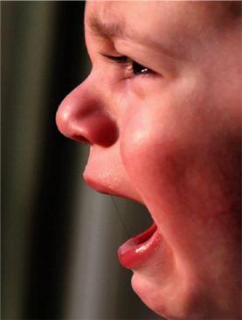
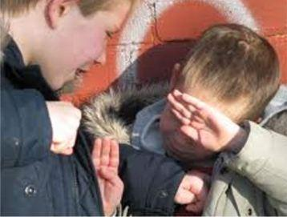
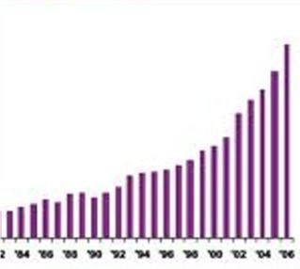
Thus, despite all the positive changes many people have seen over the last 50 years, there are more and more people who find it harder to enjoy these benefits
More children with no father to hug them every day
Private wealth and economic develop. We’re OK.
Millions more locked away
More online and physical Bullying
Drug overdose deaths
And government deficit grows and grows

Slide 27
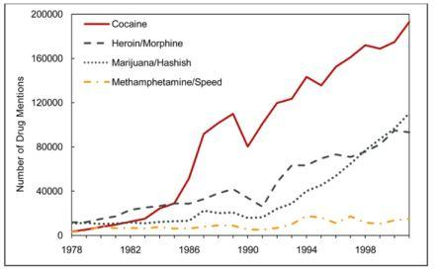
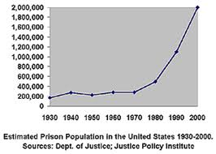
Traumas are very expensive for society because when parents don’t raise their own children, government often becomes a foster parent
Drug abusers needing hospital treatment – USA 1980-2000
At least 1/3 of ALL health system costs are directly linked to family breakdown
Source: Drug abuse warning network, USA
Prison population. USA.
1930-2000
– At least 70% of all justice system costs are due to marriage weakening

Slide 28
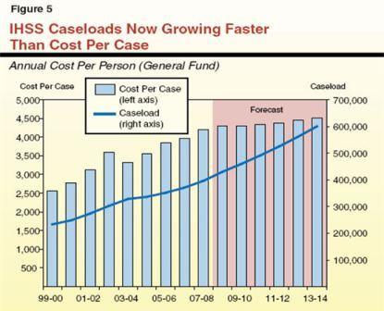
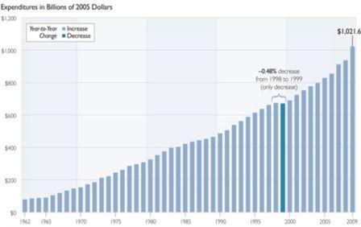
Traumas are very expensive for society
Social service caseloads to support distressed families are increasing rapidly
Source: Legislative Analyst’s Office, CA, USA
Social security spending USA:
Probably some 40% of social costs are due to the decline of marriage
Source: US government
Finland conducted a study recently – ‘How much does it cost to deal with ONE traumatised child across the life-span?’
Answer: About Eur 1,000,000. ($1,300,000)

Slide 29
Society can deal with some trauma – but too much trauma makes the society financially unsustainable
How unsustainable – well – if the USA or the UK still had a marriage affirming culture – one where almost all parents took full responsibility for the children they brought into the world -
They would have no public debt today.
USA debt - $14,000,000,000,000
($85,000 for every working citizen)
UK debt - $1,500,000,000,000
($50,000 for every working citizen)

Slide 30
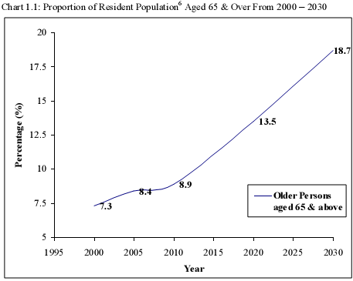
Most developed countries are already heavily in debt. Unless something is done soon to strengthen marriage – States will go bankrupt with global consequences
Drug abuse needing hospital treatment
Prison populations
Social benefit payments
More retirees needing health care and financial support

Slide 31
How did USA and EU become Weak Marriage cultures? Partly by governments creating policies that destroy the value of the marital contract + Refusing to support the marital dreams of the overwhelming majority of their taxpayers
1967 – no fault divorce started.
This redefined marriage from ‘lineage improvement ‘ to ‘personal happiness’
Children’s well-being is not important – only one adult’s personal happiness.
Law can take the husband’s children away from him ‘just because he isn’t the perfect husband’
Partners don’t have to take responsibility for their marital promise - ‘for better, for worse’
Took no account of the ups and downs that are a normal part of the family life-cycle
State might become new foster parent and assumes financial responsibility
= Marriage becomes ‘just piece of paper’
Because of state support – many people who are quite capable of finding solutions to their marital difficulties divorce instead. Divorce rates start upwards – so do prison rates and drug abuse = Social costs
- Drug gangs emerge
- Inter-generational single mothering living off benefits occurs = more social costs
1970’s – social support starts for single mothers = so more single women get pregnant

Slide 32
governments destroy the value of the martial contract - and have to become foster parents
Governments fail to follow the advice of research ‘marriage is best practice’ and do very little to support the marital dreams of the majority of taxpayers – but instead invest heavily in supporting divorcees and single parents – at least 100:1 ratio
With states not supporting people’s marital dreams - fragile cohabiting with children becomes common – with high break-up rates = more trauma and social costs
Due to government policies – birth rates drop – need immigration to pay for pensions and to have workers –social tension grows
As cohabiting becomes a norm – the ‘everyone is doing it’ factor appears – so people who are quite capable of marrying don’t = more social costs
Years 2015 onwards - Most children raised by a single parent some time in their childhood – large amounts of social trauma
Governments have to borrow heavily to pay for social trauma = possibility of financial collapse

Slide 33
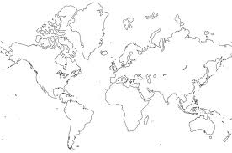
The weak marriage cultures of Europe and USA are Not just affecting their own cultures – they are destroying other countries too
Drug abuse in EU and USA = civil wars and drug gangs in
Sexual demands of single men in EU and USA = prostitution and women trafficking
Single mums and female divorcees – create problems for the local population when they go abroad in search of a romantic fling with an exotic foreigner
USA and Europe produce marriage harming films and soap operas – leads to more divorce and single parenting elsewhere

Slide 34
Imagine how many countries would suffer immense social trauma if India and China became weak marriage cultures too
Drug wars and drug gangs
prostitution and women trafficking
Single mums and female divorcees seek romantic flings
Many cultures will experience devastating trauma because marriage has collapsed elsewhere. We will have a very dysfunctional world. This can all happen in 30 years

Slide 35
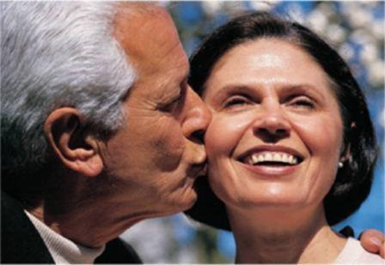
What about Heterosexual couples who marry and can’t or don’t want to have children?
They contribute to the social good by their supportive commitment to each other – bringing about, on average, better health and well-being
Through their sexual exclusivity, they also uphold the norms of marriage – clarifying its definition for the benefit of the social good.

Slide 36
I thought marriage was about finding a soul mate and lasting personal happiness
It’s true – personal happiness is important, and so is sharing one’s life with someone with whom you can feel deep connection with. Nature, however, also provided us with sexual attraction and this primarily exists for one main purpose – to bring couples together to create babies. It is this form of bonding – connection leading to procreation - that is at the heart of the purpose of marriage.

Slide 37
I thought marriage was about personal happiness
And just like many species have to go through all kinds of challenging situations to raise their offspring, our married and child-raising path is full of challenges – and the feeling of love can disappear for periods of time.
The marital commitment, however, is there to maintain the connection between you and your soul mate during those difficult times – allowing you to come out the other side together, hopefully more in love – allowing you to continue to enrich your children’s lives across the life-span.

Slide 38
As human beings we cannot get away from this ONE FACT
One of the KEY things that helps us to grow up to become stable, loving human beings is knowing that BOTH our biological parents show us that we are worthy of love and respect – just for being who we are.
When we don’t have both our biological parents there to show us this love, it is sometimes more challenging for us to gain this feeling. So instead, I might look for acceptance and love in all kinds of unhealthy places. This might lead to a host of negative outcomes.
See: Brene Brown:
www.ted.com/talks/brene_brown_on_vulnerability.html

Slide 39
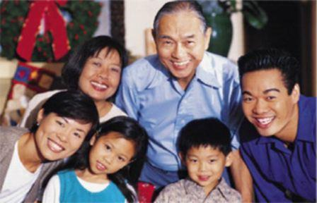
Summary
From the research – it appears that we human beings, have only ONE main form of family constellation which is lineage improving – opposite-sex, married partners raising their own biological children.
Despite its present limitations ONLY THIS family formation gets nature’s sustainability and well-being blessing

Slide 40
Summary: Even though many parents in other forms of family CAN raise wonderful children - research clearly shows that ALL other family constellations ultimately lead to lineage weakening – and thus to social decline
single parenting and divorced parenting
cohabiting with children – because they separate 65-70% of the time whilst children are under 16
See: http://unitedfamilies.org/default.asp?contentID=18 for comprehensive database of research on family issues
Polygamy on a world level would lead to poor outcomes (e.g.; many, many men unable to find a wife – leading increases in prostitution, etc)

Slide 41
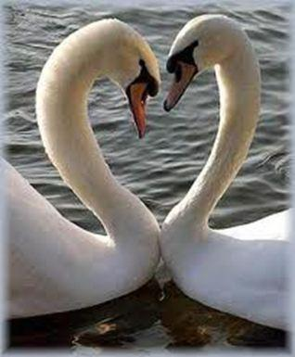
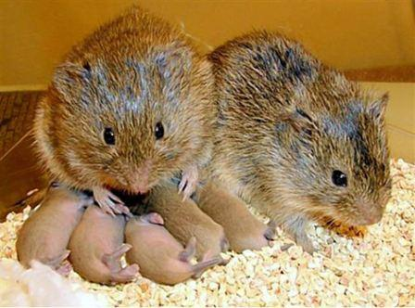
Conclusion: Opposite-sex life-long commitment is the ONLY way humans receive nature’s sustainability and well-being blessings. We are in good company
Emperor Penguins
Swans
Bald Eagle
Gibbons
Prairie Vole

Slide 42
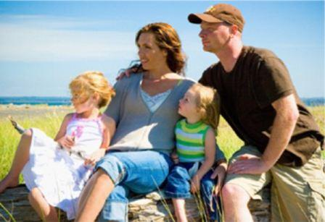
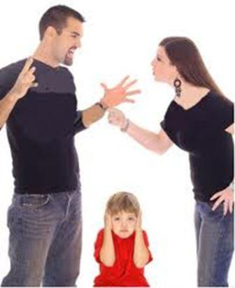
Section 3 – What can be done? Are we saying that the best mankind can do is have marriages – some of which are successful – but many of them struggling, with partners just staying together ‘for the sake of their children’? Is this the way we humans receive nature’s sustainability and well-being blessings ?

Slide 43
No – there has to be a better way
The ‘family as a school of love’ doesn’t only apply to the children – it applies to the adults too.
When adults marry, they are learners in the art of marital love – and life’s journey involves us learning more each day about how love works.
The question is:
‘Can society can get better at supporting married partners when they come across the typical bumps that lie along the road of marital life – helping them over the bumps so they can continue on life’s journey together?’ and also
‘Can a range of social institutions get better at helping married partners become more loving over the years

Slide 44
“Huston – We have a problem” The biggest problem the marital family faces today is that ALL the main social institutions don’t understand that the opposite-sex marital family is the ONLY way for society to maintain mother nature’s ongoing blessings
Governments keep passing laws that create barriers to people marrying or they pass laws making it more likely they divorce. Governments also do very little to support the marital dreams of the majority of taxpaying citizens – whilst at the same time pouring vast financial resources into supporting other, socially weakening forms of family constellation
The university and education system seems to have no interest in supporting the marital dreams of those who pay their salaries

Slide 45
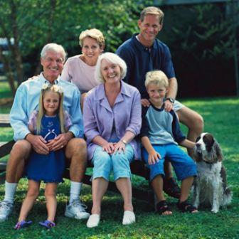
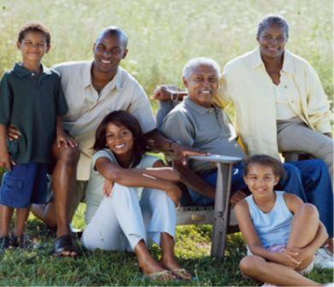
If societies can get better at both of these – helping married couples over the bumps, and improving the standard of love that partners offer each other – then ever more couples will find themselves being rewarded with nature’s sustainability and well-being blessings
It’s what the overwhelming majority of people want – both young adults and the parents of those young adults – so it’s time states started supporting what their citizens want

Slide 46
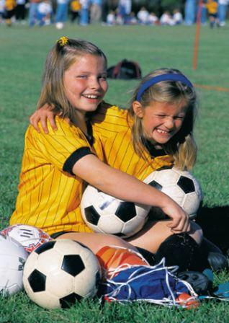
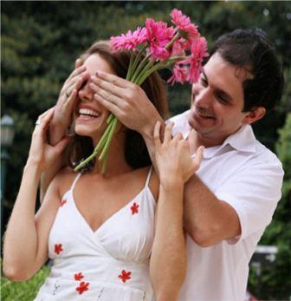
Governments can support the marital dreams of the majority through the education system
Our schools mainly prepare young people for jobs, but they can also teach them how they might build better relationships? (Some USA states are finally starting to do this) See: www.dibbleinstitute.org and www.freeteensusa.org for example school programs
Also, can we offer marriage and dating education courses in higher education – helping young adults prepare for their family life

Slide 47
the state can help citizens better prepare for the married life by Offering support for engaged couples
State supported pre-marital counselling (PMC) – helping engaged partners identify issues where they might struggle once married (finances, roles around home, child rearing beliefs) , etc.
About 10% of couples that do PMC realize they are quite incompatible
Sponsored pre-marital education – helping young adults (many of whom were never raised both their parents) understand the key elements that help marriages succeed.

Slide 48
How can the state help? Relationship Education Centres in every community
Since marital relationships go up and down across the family life-cycle, every community should have a relationship centre like a health centre, where people can go to get professional advice, education or help when their couple relationship is struggling.
(Australia is pioneering these – See www.relationships.com.au)
Couples counselling and mediation
Marital enrichment and parenting courses
Abuse and addiction support
Citizens can go to a place where they get real help
– not just anti-depressants

Slide 49
How can the state help? Support ongoing marital enrichment
Support and subsidize a range of marital enrichment programs
Research which programs seem to be more effective
Develop best practice models that others can follow.
See: www.nermen.org for a range of research and resources. See best practice report: www.nermen.org/Guide_to_Programming.php
See: www.smartmarriages.com/app/Directory.BrowsePrograms for a wide range of programs that are available

Slide 50
How can the state help? tax and social benefits
Does the tax and benefit system encourage people to marry and stay married – or does it penalise couples for trying to do the right thing? (still today some countries penalise people for marrying - and this encourages couples to enter in to more fragile cohabitation)

Slide 51
How can the state help? University Departments – training and research
To achieve the above goals we need departments of marriage and family in various universities – producing experts, lecturers, good research, developing best practice interventions, writing books, holding conferences – creating a spill-over that supports marriage enrichment in other fields -religion, politics and social services. (many developed nations – like GB and Finland - don’t have even one department of marriage and family in their university system - while many married taxpayers struggle for years with fairly simple to fix relationship issues. Meanwhile universities offer several degree programs on gender issues or families in general. This is negligence in its highest form).
See - http://mft.byu.edu/ for best practice

Slide 52
How can the state help? Counselling Support for Struggling Couples
Most couples who want to divorce are moderately struggling – not suffering from major abuse or violence – and supportive counselling can do a lot to help them through their difficulty
Only 12.5 percent of parents attending a marriage education program within three weeks of starting divorce proceedings went through with the divorce
- Margie J. Geasler and Karen R. Blaisure, 1998

Slide 53
There are many other things states can do to support their citizens marital dreams – e.g.;
Marital enrichment classes as part of pre-natal courses.
E.g.; Bring baby home program - www.bbhonline.org
Celebrate and strengthen marriage in local communities
E.g. www.Firstthings.org
Marital support for couples going through short or long-term trauma (e.g.; unemployment, a disabled or sick child, a long-term illness, etc – all increase the chances of divorce)
Develop a marriage index – one that clearly identifies how well the marriages in your country are doing and set goals to increase positive outcomes
See: www.americanvalues.org/pdfs/IAV_Marriage_Index_09_25_09.pdf for index ideas + a hundred other ideas for strengthening marriage
Also: www.heritage.org/Research/Reports/2011/06/A-Marshall-Plan-for-Marriage-Rebuilding-Our-Shattered-Homes

Slide 54
Supporting marriage is not enough
Because people have a strong tendency to follow the money
From today governments have to stop offering financial support to adults who wish to choose a family lifestyle that leads to:
The possibility of an increase in social decay (e.g.: Single parenting)
The imposition of a heavy financial burden on the rest of society.
It’s important for governments to recognize that children have rights too – that they want a fruitful and happy life – and that is most likely to occur if they are raised by their two, married, biological parents, who receive support along their journey through life.
That’s what the next generation wants and needs and that’s what states should support with their finances

Slide 55
The time to act in support of marriage is now
Some states are already close to a financial tipping point of no return – they will go bankrupt if they carry on not supporting their citizens marital dreams.
If states today feel they don’t have the finances available to strengthen marriages, in 10 years time, with even more social problems to deal with, it will be close to impossible to find the money.

Slide 56
Conclusion: If developed nations, over the last 50 years, had leant how to support the marital dream of the majority of their citizens:
Today’s marriages would be much more stable and loving places than they were in the 1950’s
We would have a society that was far richer
Our jails would be far emptier
Our drug problems far smaller
Our children would grow up in a far friendlier society
Most people want marital success.
What are we waiting for?

Slide 57
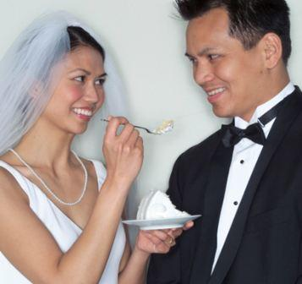
religions can do much to support marriages
Train members of your congregation:
To give a variety of marriage education seminars,
To offer pre-marital counselling
To be mentor couples for newly-weds
To support couples that are going through a struggling time.
Create a community marriage policy – where every church, synagogue, mosque or temple in a city agrees to support marriage in the above ways – thus protecting the whole community
See www.communitymarriagepolicy.org

Slide 58
Married couples – Keeping your marriage healthy takes effort and time but it’s well worth it
The best way to love your children is to love your partner
Read a marriage education book together every year and improve your abilities to love
Go on a marriage enrichment seminar every 5 years
Make time for each other – find interesting dates
The number one predictor of a successful marriage –offer each other positive affection at least 5 times a day in a way that your partner appreciates

Slide 59
The media – creates a lot of social harm by promoting anti-marriage norms
The media can play a major role in supporting marriage – leading to a healthier society for all
The media needs to show more honesty – what really happens when people follow an anti-marriage path.
When the married boss leaves his faithful wife for the younger secretary – and marries her – he has a 90% chance of divorce
The STD’s and infertility that comes from jumping into bed on first or second dates or the negative effects of cohabitation
And to stop running marriage down and making every other form of romantic relationship look more exciting – not true
Media can also play a big role in showing healthy dating patterns, good communication strategies, enriching affection between marital partners, etc

Slide 60
Businesses can support the marital dreams of their employees too
A divorcing employee will lose at least a months or even 3 months output
One who is overly stressed at home will take many more days off work.
Holding relationship enrichment seminars in the work place – or just helping your employees develop new communication and teamwork skills – will help them become better employees too.
Couples in happier relationships are also more loyal employees.

Slide 61
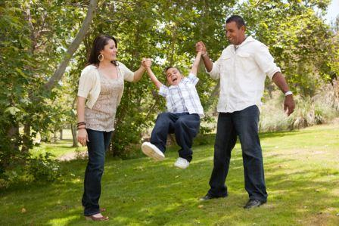
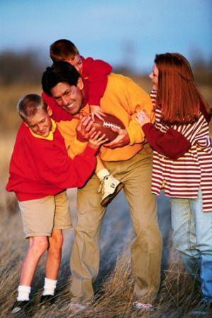
It’s not surprising that children do best when raised by their two married, biological parents
We are born with a strong emotional desire to know we are loved by the two people who created us.
After we know we’re loved, we more likely to be motivated to study and to behave appropriately.
And by working together our parents are more able to offer us material stability, protection and healthy modelling.

Slide 62
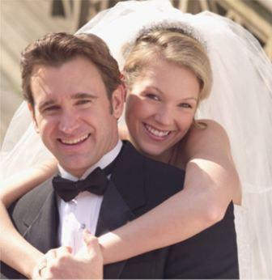
Conclusion: It’s Marriage or Bust Marriage, when done right, will offer humanity the very best blessings that nature has to offer.
– MARRIAGE –
“one man, one woman, who invest together in their children to offer lineage improvement”
is probably the most important word in the human language.
When something is important to you,
you cherish it, value it, nurture it

Slide 63
Special thanks goes out
ALL the marriage experts who inspired this slideshow
Stephen Stacey lectures on the couple relationship in Finland and runs marriage enrichment seminars
www.creationofacouple.com

