Slide 1
Good Leadership
Notes:
Reflect theory and practice

Slide 2
What is leadership?
The ability to inspire willing obedience in others
Xenophon
Leadership is about getting extraordinary performance out of ordinary people
John Harvey-Jones
Your position never gives you the right to command. It only imposes on you the duty of so living your life that others may receive your orders without being humiliated. Dag Hammarskjold

Slide 3
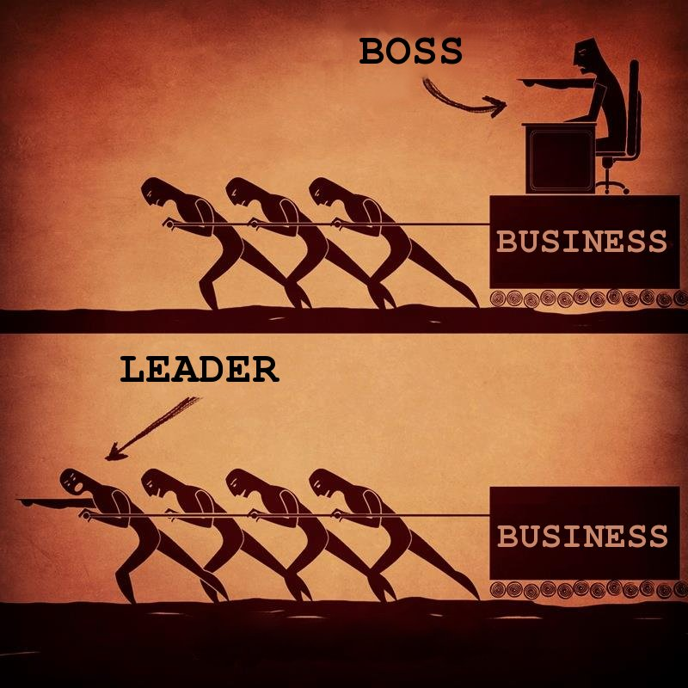

Slide 4
The front-line leader, should always work harder and better than other people, then they will follow him. If you live that way yourself then you will not have to tell your members to follow you; they will want to follow you on their own.
Sun Myung Moon
You can be appointed a commander or a manager, but you are not a leader until your appointment is ratified in the hearts and minds of those who work under you.
John Adair

Slide 5
What are the different ways at looking at leadership?
Qualities approach
Situational approach
Functional approach
They are interlinking

Slide 6
What are qualities of a good leader?
“It was said that he had all the qualities of leadership which a man of his sort could have.” Xenophon
One good quality in a leader is not enough; you have to be good at everything.
Sun Myung Moon
Assumption that “Leaders are born and not made”
Notes:
Qualities approach was earliest. Long list of qualities a leader needed to have. Lists varied. How to get quality? Born with them?

Slide 7
Necessary qualities
Enthusiasm
Spirit filled
Integrity, authenticity, character
The quality that makes people trust you
Toughness and demandingness
Resilient and challenging
Fairness
No favourities, be consistent
Warmth and humanity
Heart
Humility
Own up to mistakes
Notes:
Integrity – wholeness, committed to values, truth,
Tough – not always popular. Demanding. Have to push and challenge people. Demand the best from people. Withstand stress, strain. Resilient. Committed. Steel in soul. When going gets tough the tough get going
“Are you going to be a loser? No one will sympathize with the loser. But you will never be losers. Never be discouraged by everything that people say to you; just go forward and win.”SMM
Demanding high standards. Stretch people. Get out of comfort zone.
Fairness – no favourites. Consistency, decide based on rules. Ability to make decisions one of the most important qualities. Courage to make the right decision.
Empathy. Care, understanding, listening, supporting
Own up to mistakes, honesty, take responsibility, not blame others

Slide 8
Situational approach
Authority flows to the one who knows
Shipwrecked survivors
Importance of knowledge and being qualified
“There is small risk that leaders will be regarded with contempt by those they lead if whatever they ask of others they show themselves best able to perform.” Xenophon
Limitations
Not satisfactory to keep changing
Some people have general leadership competence
Notes:
Importance of being qualified. Be a leader in area interested in. study so know more than people you lead. Become an expert in that area. Read, learn. Being a nice person is not enough. Can’t lead by personality alone. Have to make decisions, draw up plans, manage things. Need to do that based on knowledge. Obviously cannot know everything – e.g. how a computer works but have to understand its potential etc. to drive a car don’t need to know what is under the bonnet but do have to know how to use all the instruments.

Slide 9
Three types of authority
Authority of POSITION
Job title, appointment
Authority of PERSONALITY
Natural qualities of influence
Authority of KNOWLEDGE
Technical or professional
“Perhaps you have lots of enthusiasm and your members are inspired to work very hard, but if they get very little result they will stop working. You have to be smart as well as enthusiastic. One good quality in a leader is not enough; you have to be good at everything.” SMM
Notes:
Can’t just rely on position or title. “I am the leader therefore . . .
Need tech especially at start. But not enough to be a leader
Perhaps you have lots of enthusiasm and your members are inspired to work very hard, but if they get very little result they will stop working. You have to be smart as well as enthusiastic. One good quality in a leader is not enough; you have to be good at everything.

Slide 10
Group approach
Three variables with leadership
The leader
The situation
The group or team
More than sum of its parts
Group or team personality
Notes:
Collective memory
As a team captain you should always figure out how much better you can do this month than last month. Then you can make a plan, taking into consideration all the personalities on your team. SMM

Slide 11
Team approach
All teams have 3 universal needs:
The need to achieve the common task
The need to be held together or maintained as a working group
The needs which individuals bring into them by virtue of being embodied persons

Slide 12
Common task
Do something cannot do as an individual
Climb a mountain
If successful -> elation
If unsuccessful -> despair
Disband or reform?
Notes:
Have to set an achievable goal. Not too easy. Boring. Not too hard. Set up for failure. Too many disappointments become depresses. Lose heart. If stretched and accomplish feel victory, sense of accomplishment.

Slide 13
Team maintainence
Morale
Team spirit
Trust
Cooperation
Friendship
Threatened internally
Threatened externally
Team building exercises
Notes:
Team – different roles to be played

Slide 14
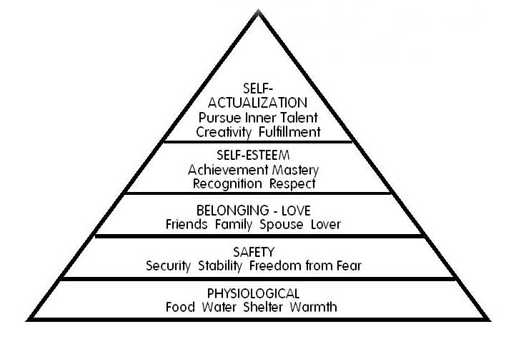
Individual needs
Abraham Maslow
Notes:
Satisfied need ceases to motivate
If lower need threatened focus on that

Slide 15
The three areas of need
Task
Individual
Team

Slide 16
Ignoring or forgetting the task
Task
Individual
Team
Notes:
If forget task and just have fun then purpose of team is lost and morale goes down.

Slide 17
Over-focusing on the task
Task
Individual
Team
Notes:
If just task orientated then team becomes tired. Not fun anymore. Work work work work. Also sacrifice individual needs such as health, dentist, education, career prospects for the sake of the goal. Damages the individual. Damages the team. Result task not accomplished.

Slide 18
Ignoring the team’s needs
Task
Individual
Team
Notes:
Don’t make sure there is unity and good morale. People not having fun and shared experience. Result goes down.

Slide 19
Over-focusing on the team
Task
Individual
Team
Notes:
Unity becomes most important value. Leads to sacrifice of individuality and personal needs. Suffocating. Lack of freedom and spontaneity.

Slide 20
Ignoring the individuals’ needs
Task
Individual
Team
Notes:
Don’t take care of basic health, safety issues. People feel used and abused and taken advantage of. Leave. Can’t give to team or task.

Slide 21
Over-focusing on individual needs
Task
Individual
Team
Notes:
Individual does own thing regardless of how inconveniences or disrupts the team. Focuses on personal needs during public time when should be working. Team becomes fragmented and can’t work together reliably. Task suffers.

Slide 22
In God’s ideal, there cannot be any individual purpose which does not support the whole purpose, nor can there be any whole purpose that does not guarantee the interests of the individual. DP
Notes:
Within a business individual purose supports whole.
Concern career,

Slide 23
What a leader has to do
Achieving the task
Developing the individual
Building and maintaining the team
Until you can do this essential work, your appointment as a leader
will not be ratified in the hearts and minds of the team
Notes:
Leader has to make sure all 3 needs are fulfilled.

Slide 24
Accountability and ressponsibility
Leaders can’t do everything but are accountable for everything
“It is good if you have a sense of responsibility yourself, but it will not accomplish anything until all your members also have that same sense of responsibility. Your problem is how to transfer your standard to them. You have to study this process all the time.” Sun Myung Moon
Notes:
Leader can’t do everything but is accountable for everything. Has to generate sense of responsibility and ownership amongst the team. Leadership team. Different members of the team taking responsibility and leadership for different areas.

Slide 25
Leadership for good
Task
Is this task worthwhile
What is its value to society?
How would one measure that value?
Group
What are the values that this group shares and holds it together?
Individual
Do I share the same values as this group?
Is this task worthwhile in my eyes?

Slide 26
Functional leadership
Making sure each three areas of need are fulfilled
Planning
Briefing
Initiating
Controlling
Supporting
Informing
Evaluating
Notes:
Leader doesn’t have to do all but is accountable for all. Generate a sense of responsibility so everyone involved

Slide 27
Planning
Bridging the gap mentally between where you are and where you want to be
How are we going to achieve the task?
Who is going to do what?
When does it have to be done?
“The first criterion of leadership is organization; you have to organize efficiently.” SMM
How to make a plan?
Leader? Together?
Notes:
No perfect plan. Depends on constraints. Has to be realistic and doable. Build in flexibility and plan B

Slide 28
I am telling you this because we should have the best organization in the world. Our planning and organization must be workable, not just idealistic.
As a team captain you should always figure out how much better you can do this month than last month. Then you can make a plan, taking into consideration all the personalities on your team. Make a workable plan and really stretch yourself to fulfill it.
Sun Myung Moon

Slide 29
Briefing
Communication important
Explain the task, its value and meaning
Preparing
Clarifying
Simplifying
Vivifying
Being yourself

Slide 30
Father on leadership
The fastest, easiest way to find the best method is to adopt the best man's technique for yourself. You have to standardize your method of doing things. You must have a clear idea of what you are going to do, and all your members must know what they are going to do. If any of them has a better way of doing things, of course let him suggest it. Organization, a strong sense of responsibility, enthusiasm and long hours of work are all very essential, but there is still one more crucial element: clear direction. Sun Myung Moon

Slide 31
Controlling
Be aware of what should be happening and what is happening and intervene if necessary
Goal is to intervene as little as possible

Slide 32
The ideal leader?
The best leaders are those the people hardly know exist. The next best is a leader who is loved and praised. Next comes the one who is feared. The worst one is the leader that is despised.
The best leaders value their words, and use them sparingly. When he or she has accomplished their task, the people say, "Amazing: we did it, all by ourselves!”
Taoism

Slide 33
Evaluating
Judging the effects of potential actions
Evaluating a team’s performance
Task achieved?

Slide 34
If I see a high team average, I think that is good, but if I see that each member has a similar high average then I value that team even more because I know that it is a stable team. Once you are stable as a leader your team will grow. For your first few months or even the first year it is too early to tell about you. But after a long time, if your teams are still up and down, with some members having very high results and others very low results, even though your team average is very good, the situation reflects your poor organization.
Sun Myung Moon

Slide 35
Delegating
Leader’s character
Subordinates
How knowledgeable, experienced, socially skilled
Situation
Task
Environment
Time constraints

Slide 36
At the same time, let your members give suggestions about the best method to use and give comments about themselves. If you are confident of having the best way, do not just insist that your members follow your way. If one of them comes up to suggest his own idea, even if you think he is wrong, do not say, "No, just hush up and listen to me." Rather, try to find the good points in his suggestion and agree with him on those. If you come to realize that someone is actually better than you in some ways, then you can always accept suggestions from him. You need to have vast information.
Sun Myung Moon

Slide 37
Decision making continuum
Use of authority by manager
Area of freedom for subordinates
Manager makes decisions and announces
it
Manager ‘sells’ decision
Manager presents ideas and invites questions
Manager presents tentative decision subject to change
Manager presents problem, gets suggestions, makes decision
Manager defines limits, asks group to make decision
Manager permits subordinates to function within limits defined by superior

Slide 38
If you deeply want to learn more about God then that desire becomes like an invisible antenna and God and the spirit world will communicate thoughts and feelings to you. The most profound experiences will come when you really shed tears and want to see me in the midst of difficulties. Then spiritually I will appear in person and explain exactly what the difficulty is and how to solve it.
Sun Myung Moon

Slide 39
Always remember one thing--God has never forgotten you. You may have forgotten Him, but He will never forget you. So as long as you are called to go this way, do it; that is the best way for you. No one is more qualified to complain than I am, but if I started complaining, it would make a mountain. Instead I dig deeper, like going down in a mine, and I find even more precious jewels. This has always been true. Actually the one who complains cannot go forward because he is putting limits on himself. Nobody is making him stop except himself.
Sun Myung Moon

Slide 40
Lists of qualities
Ability to make decisions
Energy
Humour
Sense of justice
Determination
Example
Loyalty
Sense of duty
Calmness in crisis
Confidence
Ability to accept responsibility
Integrity
Courage
Enthusiasm
Honesty
Human element

