Slide 1
The World Peace Blessing
Notes:
Dates can be changed for future use

Slide 2
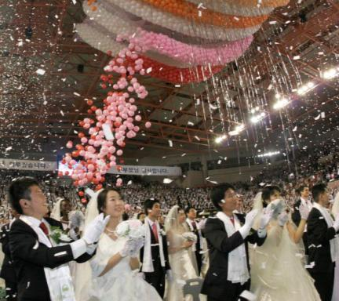
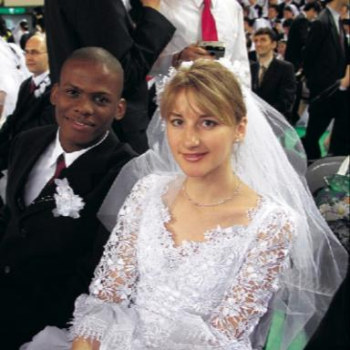
The World Peace Blessing
The Blessing affirms marriage and family, and links families together
As “One Family Under God” beyond difference of race and religion

Slide 3
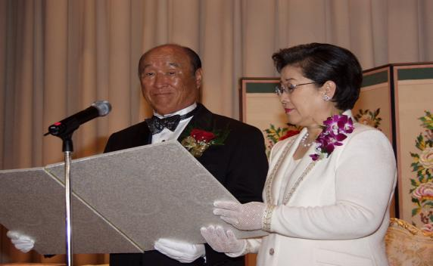
The significance
of the
World Peace Blessing
The Blessing is a ceremony for all
It is a re-dedication of marriage for couples loyal to each other
For some, it is their wedding day
It deliberately transcends boundaries of race and religion
In Europe World Peace Blessing events are taking place in all nations and many larger cities during January and February leading up to the 17th February in Korea.
Notes:
Dates can be changed for future use

Slide 4
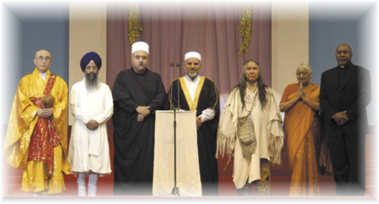
The World Peace Blessing
Co-officiators:
Buddhist, Sikh, Muslim, Native American, Hindu, Christian and ….
Notes:
Igumen Antoniy (Ukrainian Orthodox Department of External Church Relations)
Archbishop Emmanuel Milingo (Vatican City)
Sheikh Al Amin Osman (Grand Mufti of Eritrea)
Swamiji Sri Devendrakeerty Bhattarakji (Spiritual Head of Jains)
Rev. Earl Barrett (General Superintendent of the Church of God in Christ)
Venerable In Gok Hong (President Korean Buddhist Taegogh Order).

Slide 5
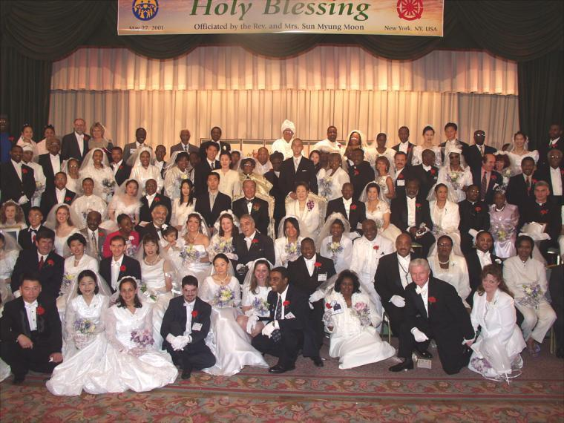
Ambassadors for Peace as
True Parents, Teachers and Leaders
Notes:
A WP Blessing for Religious Leaders in New York in 2001 – setting the example !

Slide 6
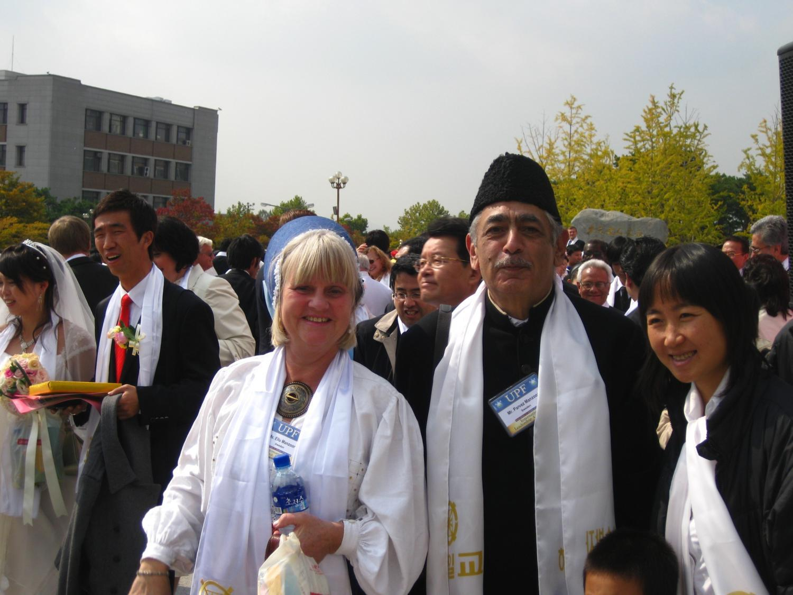
The World Peace Blessing
Mr. Parvez and Mrs. Ellu Manzoor of Stockholm, Sweden, rededicating their vows after thirty-five years of marriage

Slide 7
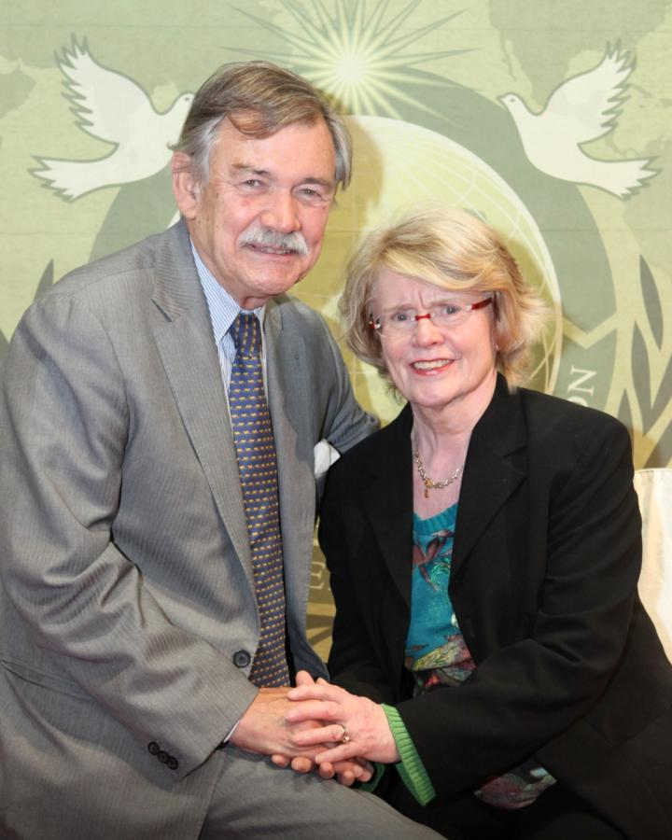
The World Peace Blessing
Dr. Wihelmus Bertens and Mrs. Lidwina Bertens

Slide 8
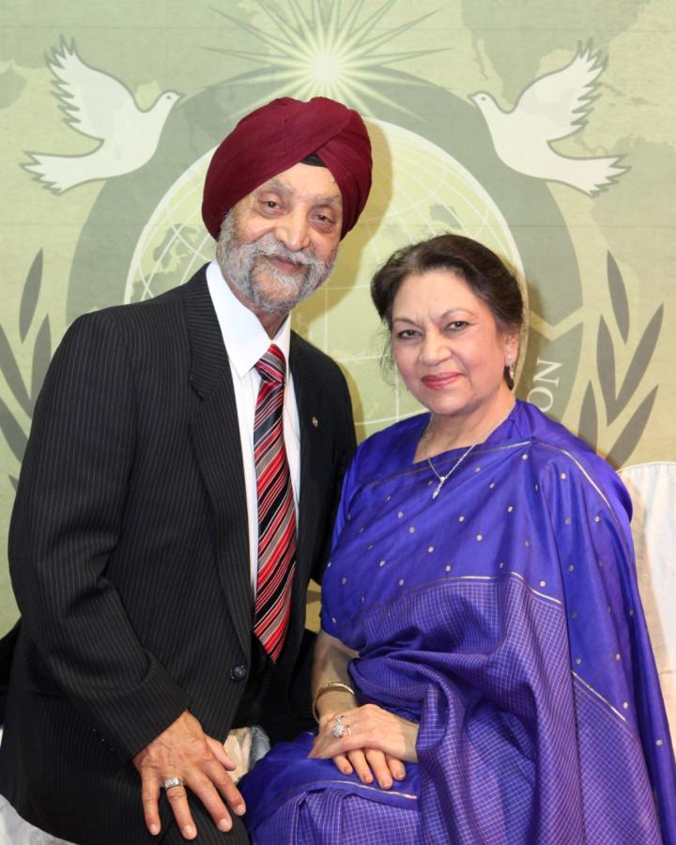
The World Peace Blessing
Dr Jagjit Singh Taunque MBE and Mrs. Taunque

Slide 9
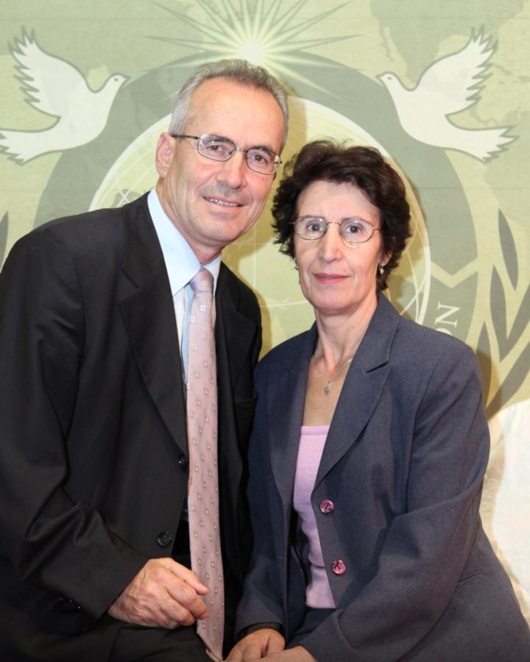
The World Peace Blessing
Mr. Hydajet Hyseni and Mrs Mina Hyseni – Kosovo

Slide 10
The Goals of the World Peace Blessing
To save the family and save the nation
To realize unification and reconciliation between races, religions, nationalities and cultures
To build “One Family Under God”

Slide 11
Freedom without responsibility is living for self, not for others
Love promises joy but often delivers heartache and misery
Notes:
We need to create a strong influence in support of a better understanding about love
True love LASTS

Slide 12
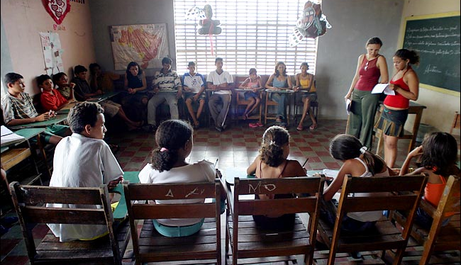
Educate young men and women that the most precious thing is to keep their love pure for their spouse.
Commitment and preparation for unchanging love and stable families.

Slide 13
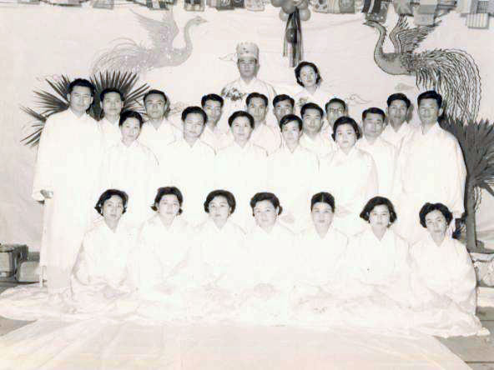
Origins of The World Peace Blessing
The World Peace Blessing movement started amongst
Rev. and Mrs. Moon’s own religious followers
Notes:
36 Couples Blessing 1961

Slide 14
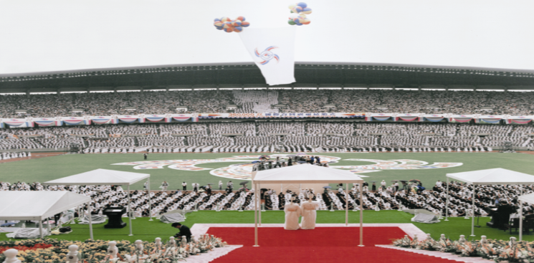
Family Federation for World Peace and Unification
Expanded to become Inter-Religious through FFWPU
Notes:
30,000 Couples 1992 – Olympic Stadium Seoul Korea

Slide 15
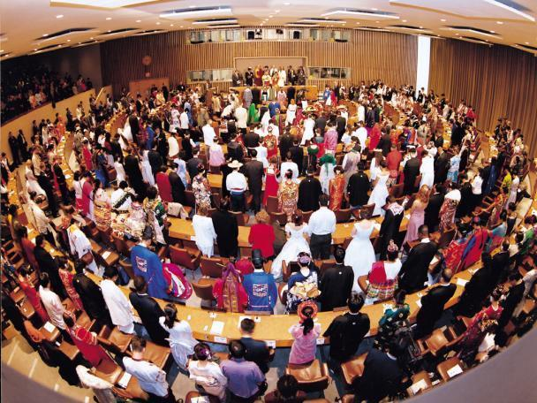
Universal Peace Federation
Reached Opinion Leaders and Ambassadors for Peace Through the Universal Peace Federation
Notes:
UN New York – 210 international married couples in 2001

Slide 16
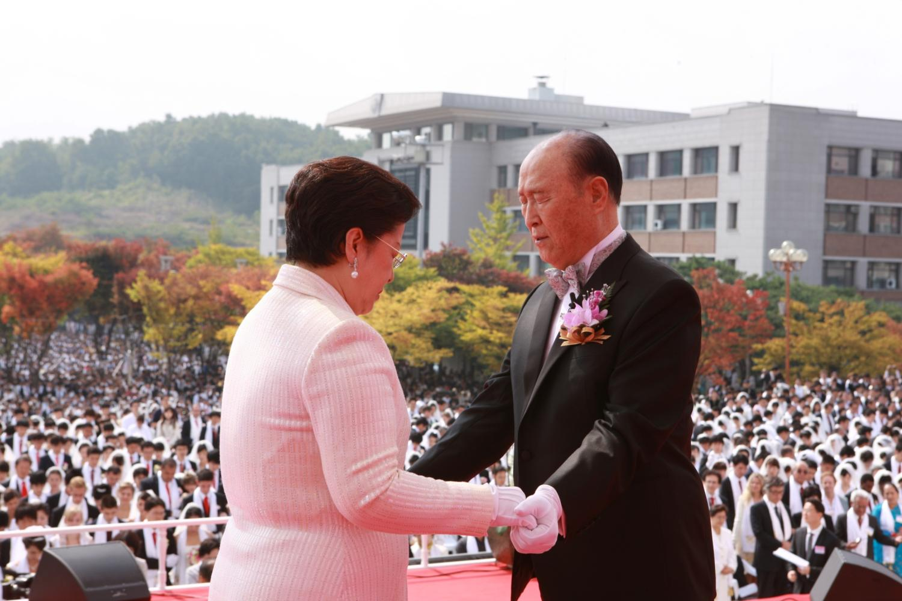
The World Peace Blessing
Rev. and Mrs. Moon offer the blessing prayer, asking God for His unchanging and eternal love and protection for all the couples.

Slide 17
“True love is love which desires to give and give again, and then forgets that it has done so. The source of this true love in none other than God, who cares for His creation with that love. We were all created to resemble His nature in this regard. This true love is more precious than anything else. For it is true love, and not anything else, that brings the realization of true selves, true families, and a true world of peace.”
From “True Self, True Family and True World through True Love”.

Slide 18
The Four Great Loves
GOD
M F
Parent’s Love
Spouse’s Love
Sibling’s Love
Child’s Love
GOD
Husband
Wife
Parents
Brother
Sister
CHILD
M F
Son
Daughter

Slide 19
Our attitude to receiving the Blessing
Determination to respect one’s spouse and keep one’s love pure
Determination of husband and wife to be faithful to each other
A heart and aspiration to become a true parent
A heart and aspiration to live for the sake of others

Slide 20
The sanctity of sexual love
God’s
Love
Man
Woman
Husband’s love
Wife’s love
A mans’ sexual love belongs exclusively to his wife and a woman’s sexual love belongs exclusively to her husband

Slide 21
Father Moon has said:
“If your heart never gets old, your love will
never grow old either.
Your life will never be boring and your lineage
will endure forever.
True love never grows old.
It becomes more beautiful as time goes on.
With such a heart you will always see your
husband as the best-looking man in the world,
and he will look at you as the most beautiful woman
in the world.”

Slide 22
The Blessing Ceremony

Slide 23
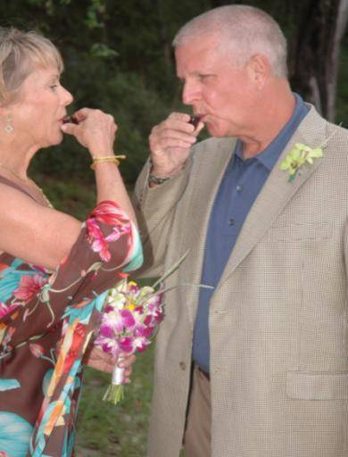
The Components of the Blessing
Holy Wine (Nectar) Ceremony (Symbolizing connecting to God’s True Love, Life, Lineage)
Notes:
23

Slide 24
The Components of the Blessing
Indemnity Ceremony (Symbolically healing past resentments between men and women)
Notes:
24

Slide 25
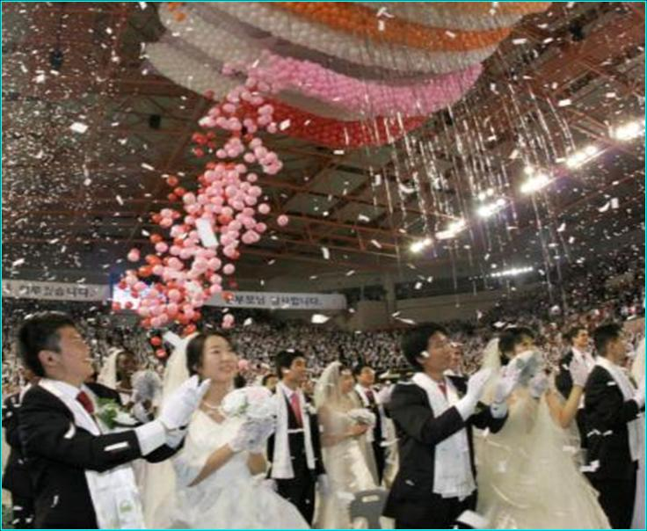
The Components of the Blessing
Blessing Ceremony (A solemn yet joyous wedding)
Notes:
25

Slide 26
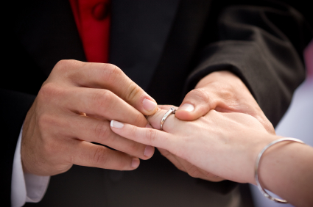
The Blessing Ceremony
Sprinkling with Holy Water
Recitation of Wedding Vows
Exchange of Rings
Blessing Prayer

Slide 27
The World Peace Blessing Vows
To uphold the standard of true love as a person of integrity, a true man or woman
To establish a family with which God can be happy
As a parent to raise your children in goodness to be an example to the world
To give love to the society, nation and world beyond racial, national, and religious boundaries

Slide 28
The Components of the Blessing
Time of Spiritual Renewal and Purification
A time of purification for a new beginning As in the great religious traditions of fasting, Lent, Ramadan or Passover (Pesach)
40 Days through which the couple can prepare to enjoy intimacy as husband and wife on a more profound and higher level
The Holy Honeymoon
Notes:
28

Slide 29
The Blessed Family Tradition
Blessed Family Associations On-going support and education for couples
Faith in the home and community
Workshops for children
Supporting each other in living for the sake of others
Notes:
Explain the need for further education during the 40 day period after the World Peace Blessing.
This will be the time to teach more deeply and prepare for the 3 day ceremony

