Slide 1

Innovative Approaches to World Peace
The Significance of Marriage and Family
U P F

Slide 2
Presentation 1
The Need for Family Renewal
Notes:
The statistics in this presentation are drawn from data in the USA
At this moment we do not have the information regarding the sources for this information – we will send this information to you as soon as possible
It would be better to substitute information from your national statistics

Slide 3
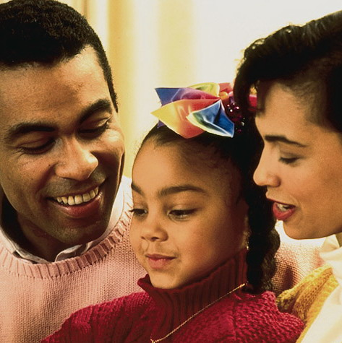
The Primary Human Institution
The family is the most important human institution. Without it we would not exist.
Through it we transmit language, culture, ethics and fundamental values.
Notes:
2011/1/22
3

Slide 4
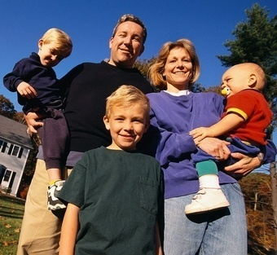
The Primary Human Institution
The quality of character, and the quality of the love of the man and the woman, as husband and wife and as father and mother, makes them the pillars of the family.
Notes:
2011/1/22
4

Slide 5
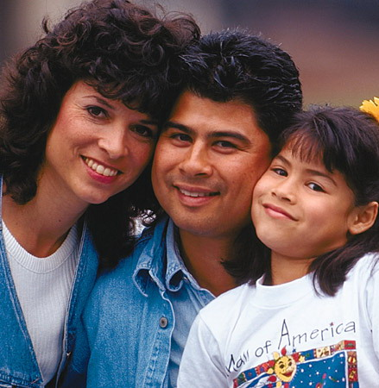
The Family is Sacred
The family---marriage and parenthood---
is regarded as sacred by the world’s religions.
Notes:
2011/1/22
5

Slide 6


Religions Honour the Family
When a man honors his father and mother, God says, “I regard it as though I had dwelt among them and they had honored me.
Talmud
If a man does not know how to manage his own household, how can he care for God’s church?
I Timothy 3.5
Notes:
2011/1/22
6

Slide 7
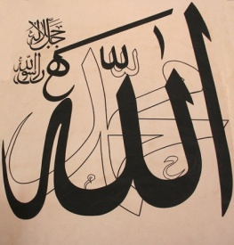
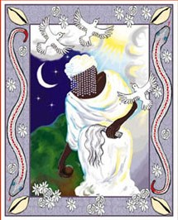
Religions Honour the Family
Lord, give us joy in our wives and children, and make us models for the God-fearing.
Qur’an 25.74
My father, thank you for petting me; my mother, thank you for making me comfortable; thank you for clothing me with wisdom, which is more important than providing me with clothes.
Yoruba Nuptial Chant (Africa)
Notes:
2011/1/22
7

Slide 8


Religions Honour the Family
Not those are true husband and wife that with each other (merely) consort:
Truly wedded are those that in two frames, as one light.
The Adi Granth, Var-Suhi-Ki, M.3 p.788
When the family declines, ancient traditions are destroyed. With them are lost the spiritual foundation for life, and the family loses its sense of unity.
Bhagavad-Gita 1.40
Notes:
2011/1/22
8

Slide 9
Family Breakdown has Social Consequences
Notes:
The statistics in this presentation are drawn from data in the USA
At this moment we do not have the information regarding the sources for this information – we will send this information to you as soon as possible
It would be better to substitute information from your national statistics

Slide 10
World Divorce Rates
%of marriages ending in divorce 2002
1 India 1.1
2 Sri Lanka 1.5
3 Japan 1.9
4 Rep. Macedonia 5.0
5 Bosnia 5.0
6 Turkey 6.0
7 Armenia 6.0
8 Georgia 6.6
9 Italy 10.0
10 Azerbaijan 10.3
11 Albania 10.9
12 Israel 14.8
13 Spain 15.2
14 Croatia 15.5
15 Greece 15.7
16 Singapore 17.2
17 Poland 17.2
18 Romania 19.1
19 Slovenia 20.7
20 Bulgaria 21.1
21 Switzerland 25.5
22 Portugal 26.2
Notes:
We will look at some of the more depressing data on the state of marriage and families. But let me start more personally by asking how many of you are confident in the stability of the marriage of your children or your grandchildren?

Slide 11
23 Slovakia 26.9
24 Moldova 28.1
25 Latvia 34.4
26 Canada 37.0
27 Hungary 37.5
28 Netherlands 38.3
29 France 38.3
30 Lithuania 38.9
31 Germany 39.4
32 Iceland 39.5
33 Ukraine 40.0
34 Norway 40.4
35 U. K. 42.6
36 Russia 43.3
37 Czech Rep. 43.3
38 Austria 43.4
39 Belgium 44.0
40 Denmark 44.5
41 Estonia 46.7
42 Luxembourg 47.4
43 Finland 51.2
44 Belarus 52.9
45 U. S. 54.8
46 Sweden 55.4

Slide 12
Decline of Birthrates
Many countries throughout the world are facing serious impact to the economy and support of the elderly because of birth rates below population replication.
World Average 20.30 per 1000 Total Fertility rate
European Union 9.90 1.5 per woman
Czech Rep 187th 8.83 1.23
Germany 190th 8.18 1.41
Italy 191st 8.18 1.30
CIA World Factbook estimates 2008

Slide 13
Children’s Well-being
Divorce doubles risk of children’s serious psychological problems later in life.
Swedish study found children of single parent families were 56% more likely to show signs of mental illness than from intact homes.
Institute for American Values, 2007

Slide 14
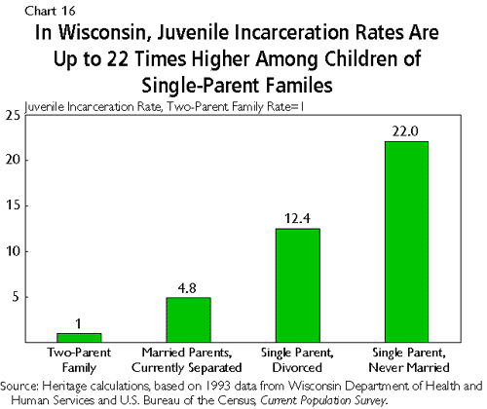
Juvenile Crime and Family Breakdown
Source: Heritage Foundation USA

Slide 15
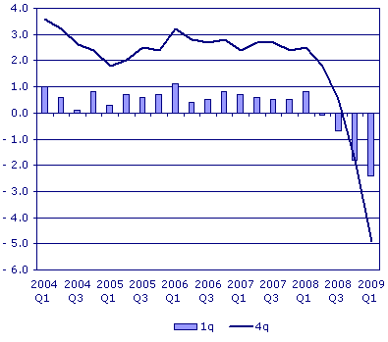
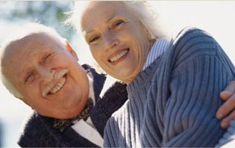
Securing a wealthy and peaceful future
Gross National Product
OR
A Store of Lasting Love

Slide 16
Presentation 2
A New Vision for Lasting Peace

Slide 17
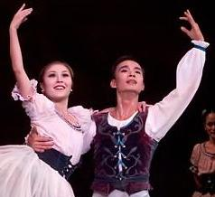
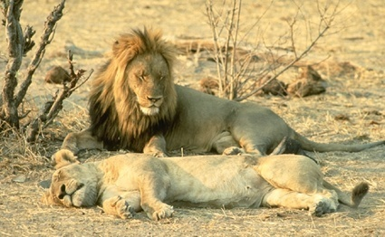


A world of complementary pairs
17
Notes:
Nothing exists independently.
Everything is created to exist through reciprocal relationships as part of a pair system.
Without such relationships nothing would be able to exist or develop or multiply
17

Slide 18

The Pair System - Male and Female
Human
Male
Female
Animal
Male
Female
Plant
Stamen
Pistil
Mineral
Positive
Negative
Notes:
Very brief explanation – just to establish this fundamental principle.
This is true of all existing beings in terms of male and female or positive an negative

Slide 19
The Pair system – Mind and Body
Human
Mind
Body
Animal
Instinct
Body
Plant
Plant Mind
Body
Mineral
Inherent Nature
Matter & Energy
Notes:
Very brief explanation – just to establish this fundamental principle.
This is true of all existing beings in terms of an outer form (body) and inner quality (mind)
For example in human beings the body is a visible expression of the invisible mind
Character can be ‘read’ from physical form – emotion can be ‘read’ from facial expression and body language

Slide 20


The Pair system - principle of interaction
Giving
Subject
partner
Object
partner
Responding
The body resembles the mind
Teacher and pupil
Notes:
These dual aspects of all existing beings relate to each other as subject and object partners.
For example in (effective/healthy) human beings the body resembles the mind and moves according to its directions so that it can sustain life and pursue the mind’s purpose.
The teacher gives – the pupil responds.

Slide 21
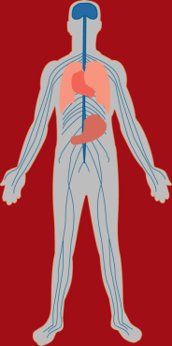
The pair system - centres on a higher purpose
Purpose to maintain life
Education
Notes:
The body’s systems – respiratory, vascular etc
The education of youth

Slide 22
The Pair System - higher purpose
GOD
Higher Purpose
Higher Purpose
Subject
partner
Object
partner
Give & Take Action
(living for each other)
Union
Good Result –
joy / Peace / happiness
Development
Realise the purpose
Notes:
The quality of those pair relationships determines whether or not we live in peace and happiness.
Explain:
That the relationship should be centered on a higher purpose (the purpose of the creator - God’s purpose)
That subject and object are created to live for the sake of each other under that higher purpose

Slide 23
The Pair System – Living for the Sake of Others
GOD
Higher Purpose
Mind Body
Husband Wife
Subject
partner
Object
partner
Parent Child
Union
Government People
Human Being Environment
Notes:
The pair system and living for the other applies to the natural world, our own mind and body and also to all social relationships

Slide 24
Foundation for Lasting Peace and Happiness
1. Individual Peace
Centring on higher values and the higher purpose
God
Mind
  Body
True Person
Notes:
24
There are 3 key pair system relationships which determine peace and happiness
(you are going to explain each in detail later in the presentation)
(You can also refer to the 3 Blessings if appropriate for your audience):
individual peace – mind and body - inner quality and outer form
peace in human society – family – husband and wife – male and female
universal peace - harmony between human beings and nature – stewardship
You can explain that those who do not believe in a personal God can relate God’s position to higher values and purpose

Slide 25
Foundation for Lasting Peace and Happiness
2. Peace in Human Society
God
Centring on higher values and the higher purpose
Husband
  Wife
The FAMILY
is the
‘building block’
Children
Family Society
Nation
World
Notes:
25

Slide 26
Foundation for Lasting Peace and Happiness
3. Universal Peace
Centring on higher values and the higher purpose
God
People
  Natural World
Harmony
People/nature
True Ownership,
Responsible Stewardship
Notes:
26

Slide 27
Three Foundations
3. Universal Peace
2. Peace in Family & Society
God
God
People
Nature
1. Individual Peace
Husband
Wife
Harmony
People/nature
God
True
Family
Mind
Body
true ownership-
responsible
stewardship
Family Society
Nation
World
True
Person
Notes:
27
This is just to show the 3 foundations together and how each is the foundation for the next
True (mature) individuals make true families – true people become true owners/stewards
This will launch into the detailed explanation in the following presentation

Slide 28
Individual Peace
Unity of mind and body – word and deed
Becoming a true individual

Slide 29
The Search for God and Goodness
As the deer longs for flowing streams, my soul longs for God
Psalm 42 (Judaism and Christianity)
The greatest bliss is the good pleasure of God: that is supreme felicity
Qur’an 9.72 (Islam)
Every being has the Buddha Nature. This is the self. …. The Tathagata shows all beings the storehouse of enlightenment .. their Buddha Nature. Mahaparinirvana Sutra 214-15 (Buddhism)
The virtues are acquired by first having actually practiced them … we become just by doing just acts, temperate by doing temperate acts, brave by doing brave acts.
Aristotle Nicomachean Ethics 2.1.4
Notes:
All people of sincere religious and moral conviction long to live in a way that is pleasing to God or true to their convictions .
How should we live to develop our God given nature ?
We grow spiritually through the give and take between our virtuous thoughts and good deeds.

Slide 30
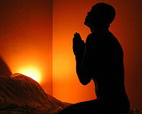
Individual Peace and happiness
God
Mind
  Body
True Person
Mind/body unity - integrity
Growth in character - maturity
Closeness to God – higher values
30
Notes:
30

Slide 31
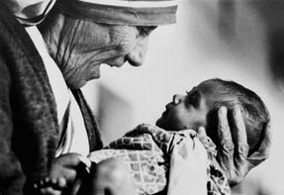
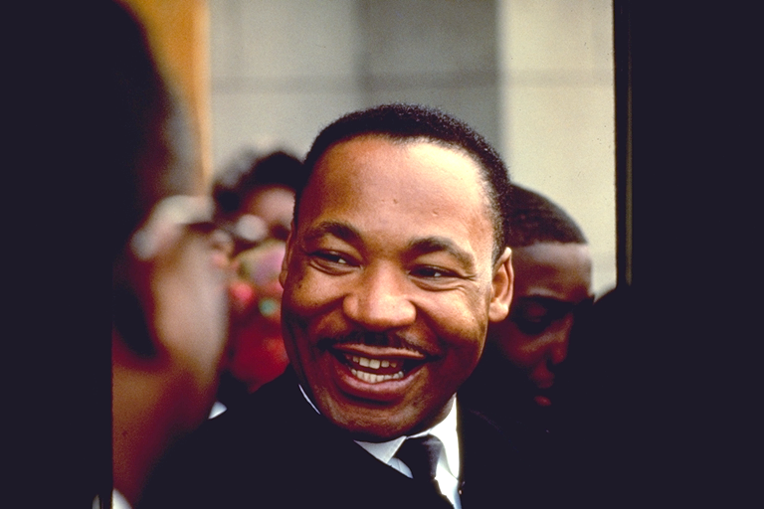
Individual Peace and happiness
Becoming a responsible individual with integrity

Slide 32


How do we grow physically?
Physical
World
Air and Sunlight
Food and Water
Growing
Period
Notes:
32
People understand what they need to grow and sustain their physical life
But they are not aware of what is need to grow and sustain their spiritual life and maturity ?

Slide 33
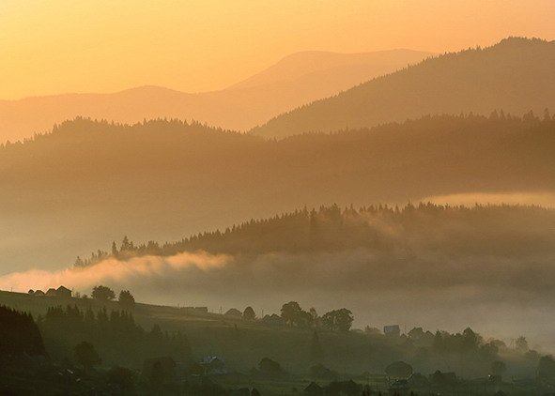
How do we grow Spiritually ?
Spiritual World
Life elements from God
Good (or bad ) vitality elements from our physical actions
Growing
Period
Notes:
33
We need to receive life elements – from God, religious founders,
holy scriptures, priests, parents, teachers, elders, etc
But we must also add our own part – unite our mind and body in a life of love and truth – living for God and others and generating good vitality elements through our physical actions

Slide 34
Human responsibility
To become a spiritually mature, ‘true’ person:
GOD
(subject)
Person
(object)
We participate in our own creation
+
God’s Responsibility
God – holy book, religious founder, priest, parents, teachers, elders, etc
Human Responsibility
(my 100% effort)
Notes:
So a person must participate in their own ‘creation’ through their own effort
We must be so grateful to God (and His representatives in our lives – religious founders, parents, teachers, elders etc) – they have given us so much!!
But still we must add our part – however small it may be in comparison
Without the addition of our effort all of God’s (parent’s, teacher’s etc) investment can be lost

Slide 35
Peace in the Family
and Society
The central role of the family
in learning to love

Slide 36
World Religions and Marriage
“Lord, give us joy in our wives and children, and make us models for the God-fearing.” (Islam) Qur'an 25.74
The moral man finds the moral law beginning in the relation between man and woman, but ending in the vast reaches of the universe. (Confucianism) Doctrine of the Mean 12
Supporting one's father and mother, cherishing wife and children and a peaceful occupation; this is the greatest blessing.
(Buddhism) Sutra Nipata 262
“Have you not read, that He who made them from the beginning made them male and female, and said for this reason… the two shall become one flesh, so they are no longer two but one flesh. What therefore God has joined together, let not man put asunder… Matthew 19:4-10

Slide 37
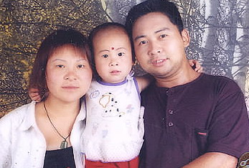
Peace and happiness in Family and Society
God
husband
wife
Children
Family Society
Nation
World
The FAMILY
is the
‘building block’

Slide 38
Foundation for Lasting Peace and Happiness
2. Peace in Human Society
God’s Love
God
husband
wife
True Love
true
children
True Life
Family Society
Nation
World
True Lineage
Notes:
38

Slide 39
Love, Life and Lineage
Marriage joins the life of one woman and the life of one man. In time, through children, it joins the lineage of the man and the lineage of the woman. It thus begins a history, a nation, the world and the Kingdom of Heaven on Earth.
        Sun Myung Moon

Slide 40
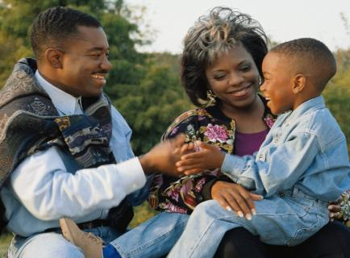
Where do we learn True Love?
From our parents, as our first teachers
The Family is:
The School of Love - nurturing heart and character, the primary training ground for relationships
Notes:
40

Slide 41
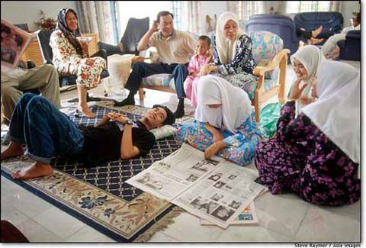
Where do we learn True Love?
In relating to brothers and sisters, parents and grandparents
The Family is:
The School of Morality – the basis of societal norms and proper conduct in the wider world
Notes:
41

Slide 42
Where do we learn True Love?
As husband and wife; and from seeing God in our partner
The Couple is:
The Image of the Creator – living for the sake of each other, the family and the wider world; being a model of True Love to their children
Notes:
42

Slide 43
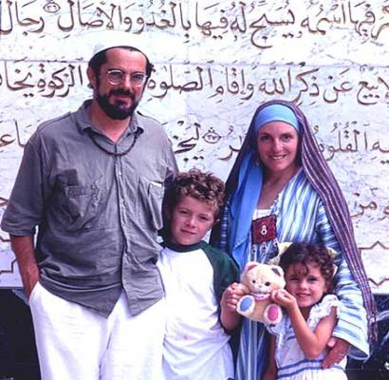
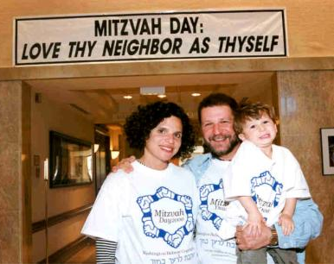
The Family living for the society, nation and world
Strong families have a focus higher than self
Altruistic Purpose
Service to Community
Notes:
43

Slide 44
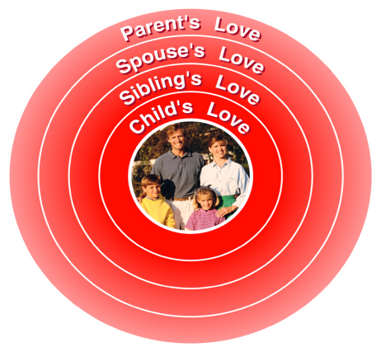
The Four Great Loves
Experienced and learnt within the family
Child’s Love
Sibling’s Love
Spouse’s Love
Parent’s Love

Slide 45
The Four Great Loves
GOD
M F
Parent’s Love
Spouse’s Love
Sibling’s Love
Child’s Love
GOD
Husband
Wife
Parents
Brother
Sister
CHILD
M F
Son
Daughter

Slide 46
The sanctity of sexual love
God’s
Love
Man
Woman
Husband’s love
Wife’s love
A mans’ sexual love belongs exclusively to his wife and a woman’s sexual love belongs exclusively to her husband

Slide 47
Universal Peace
Harmony between people and nature
Responsible Stewardship
True Parents, Teachers and Owners

Slide 48
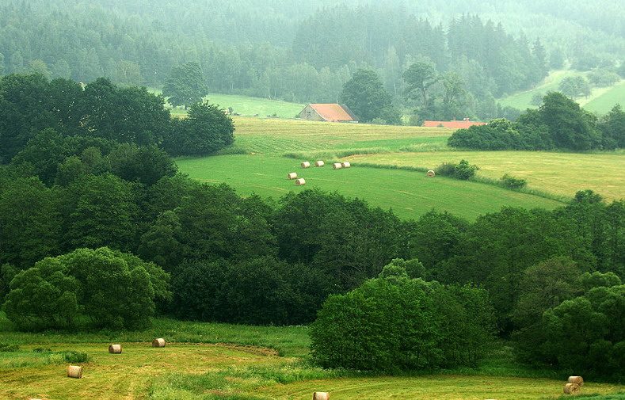
Universal Peace – harmony with nature
God
People
  Natural World
Dominion through love
Care for the environment
Material prosperity for all
Science and technology benefit human beings and the natural world
Harmony
People/nature
True Ownership,
Responsible Stewardship
Notes:
48

Slide 49
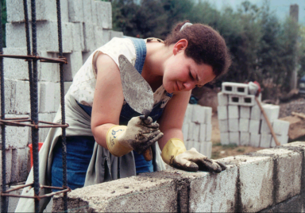

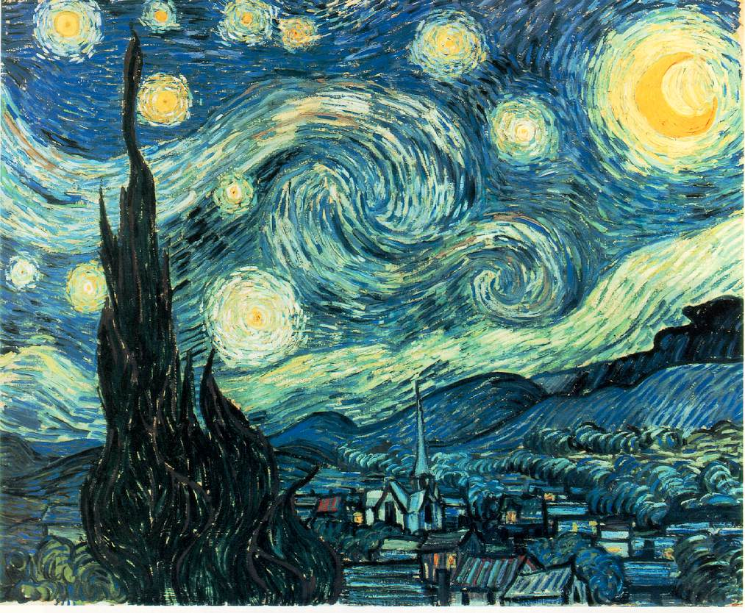
True Ownership – responsible stewardship
Notes:
We derive great joy from our interaction with the natural world.
Nature provides us with beauty to stimulate our senses and materials with which we can
express our creativity.
We should value these precious gifts and be responsible owners who develop them through
our good management to pass them to future generations.

Slide 50
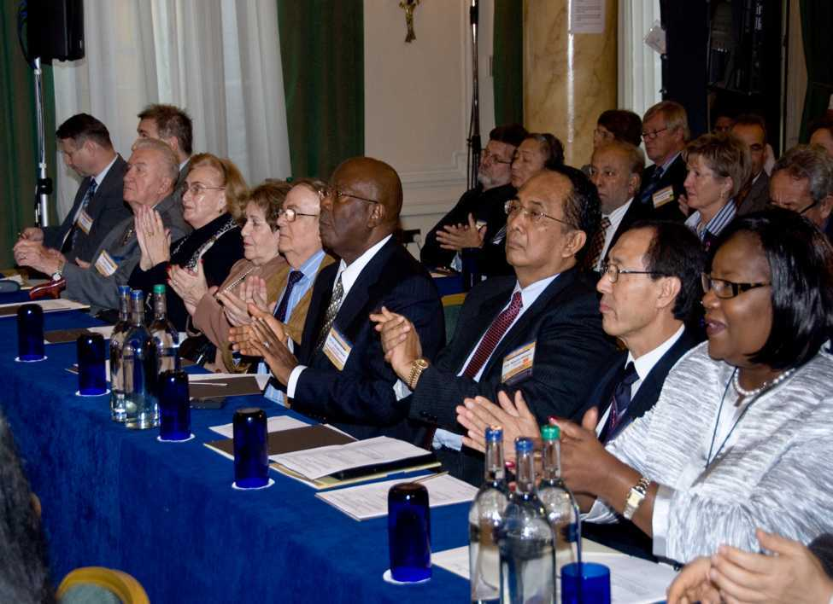
What is our role as Ambassadors for Peace?
Individual - True Teacher
Be of benefit to others by words and example
Family and Society - True Parent
Establish a marriage and family of true love - Have a parental heart towards all
Environment – True Owner
Exercise good stewardship and dominion over nature
50
Notes:
50

Slide 51
The Significance of Marriage and Family for Peace in the 21st Century
U P F

Slide 52
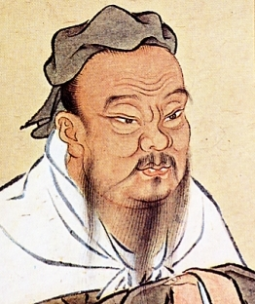
Religions Honour the Family
When the personal life is cultivated, the family will be regulated; when the family is regulated the state will be in order; when the state is in order, there will be peace throughout the world.
The Great Learning
When the family declines, ancient traditions are destroyed. With them are lost the spiritual foundation for life, and the family loses its sense of unity.
Bhagavad-Gita 1.40
Notes:
2011/1/22
52

